Slide 1
Planning a new Flare-CME-SEP mission:
Energetic ions and relativistic electrons in the solar atmosphere
N. Vilmer
LESIA- CNRS/Paris Observatory
Planning a new Flare-CME-SEP mission
Annapolis- August 5 2010

Slide 2
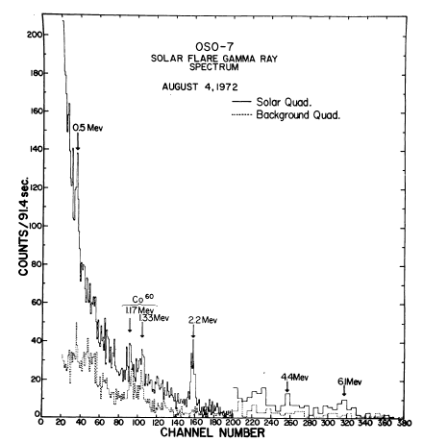
A long way from OSO7 to RHESSI…
First detection of gamma-rays with OSO7
(Suri,Chupp, Forrest, Reppin, 1975
But still a limited number of GRL flares: ~30 and still unresolved questions!
Weak number of higher energy photons:!
Statistics!! Need to improve the sensitivity!!
(Lin et al., 2003, Smith et al., 2003; Hurford et al, 2006

Slide 3
Energetic ions and relativistic electron acceleration at the Sun: a few science-driven key questions
What are the constraints on particle acceleration?
Where? When? How fast ? How long? How to link reconnection to acceleration processes?
How many? Energy spectra? Composition??
Electron and ion acceleration sites?
How to disentangle acceleration and transport from acceleration sites to emitting sites?
Do all flares accelerate ions?
What are the extremes of ion acceleration?
Particle acceleration and CMEs?
Particles at the Sun and in the Interplanetary medium??

Slide 4
Do all solar flares accelerate ions?
-Also energy contents in >MeV ions and
>20 keV electrons (Ramaty and Mandzhavidze
(2000); Emslie et al, 2004)
Strong relationship between the production
of energetic ions > 30 MeV and electrons
>300 keV
Weaker relationship with the > 50 kev
fluence and the GOES class
-Ion acceleration (>30 MeV) and electrons
(>300 kev)
Electron acceleration below 300 keV and
above? ?
Episodes of electron-dominated events??
Fast time scales for ion acceleration ?
Shih et al., 2009
Need of a low background spectrometer to search for such a correlation in weaker flares

Slide 5
Do all solar flares accelerate ions?
Electron-dominated events?:
No detectable gamma-ray lines:
Sensitivity issue?
Energy resolution issue?
Flat spectrum above 400 keV
(-1.6 in photons)
Strong variation of the slope of the
continuum spectrum below 400 keV
and no variation of the slope of the
Spectrum above 400 keV?
No systematic study of the location
of the interaction sites at energies
above the break (400-500-600 keV)
Same electron population? Same acceleration mechanism
PHEBUS/GRANAT
Trottet et al. 1998
Need of a low background gamma-ray spectrometer in
a large energy range (100 keV->100 MeV) (Labr3?)
with some imaging capabilities

Slide 6
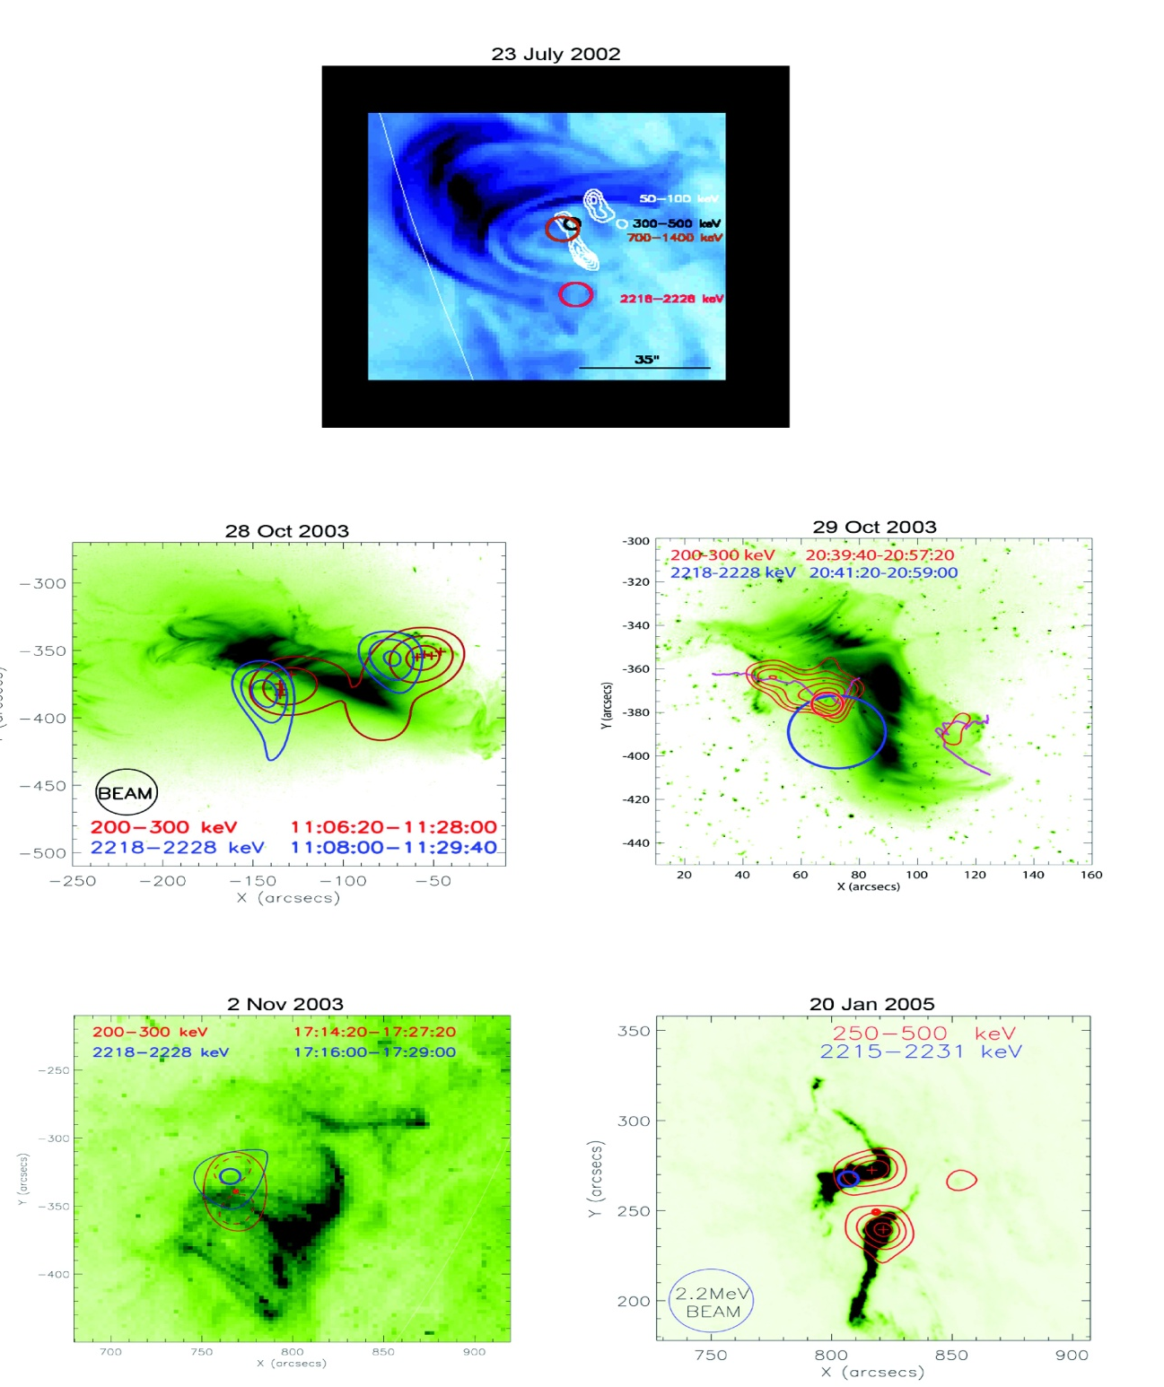
Electron and ion acceleration sites?
Displacement of the electron/ion
interaction sites:
3 events
14 to 25’’
Double / single footpoints for ion
interaction sites: limitations due to
count statistics and spatial
resolution
Interpretation: acceleration mechanisms? Transport??
Need of a gamma-ray imager
with a higher spatial resolution and a higher dynamic range
(with context observations)
Hurford et al., 2003;2006

Slide 7
Ion energy and angular distribution?
Ion energy spectra in the MeV-10s of MeV range
determined from:
Fit of the total spectrum
Ratio of the fluences in different lines
But many additional parameters:
Target abundances
Alpha/p ratio
Accelerated heavy ions?
(see work by Share & Murphy)
Additional constraints can be derived from the shape of the narrow gamma-ray lines (e.g. work on Integral by Kiener et al.)
Line shapes provide constraints on the angular distribution of ions but are not independant on transport effects thus on magnetic field topology
Lin et al., 2003
Need of a low background spectrometer with a high resolution (with context observations)
Smith et al;, 2003

Slide 8
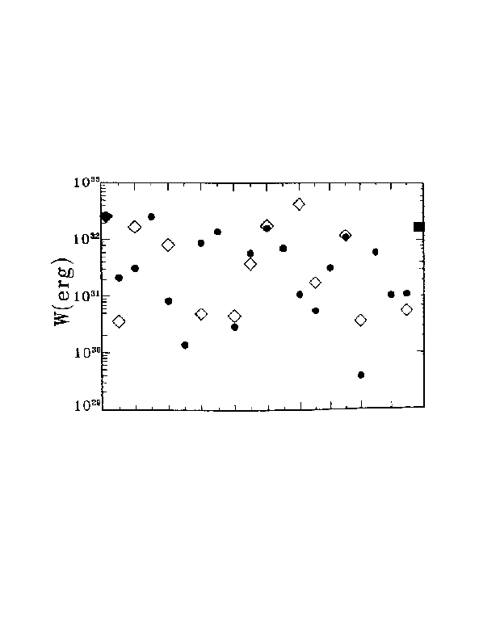
Ion/electron energy content: low energy ion distributions?
Low energy ion distribution largely unknown…
Low constraints on energy distribution of ions at low energies and on the ion energy content.
Need of observations of Doppler shifted spectral lines resulting from charge exchange reactions of fast ions to constrain fast ion energy distributions at lower energies.
Need of a UV spectrometer with very fine spectral resolution close to a few key spectral lines (Lyα and others)
Adapted from Ramaty & Mandzhavidze (1999)
W_{i>1MeV/nuc} for 19 SMM flares
W_{e>20 keV} for 19 SMM flares
W_{i>1MeV/nuc} for OSSE 4 June 1991
W_{i>1MeV/nuc} for PHEBUS 1 June 1991
Not plotted one similar estimation from RHESSI (Emslie et al. 2004)

Slide 9
Extremes of ion acceleration?
Large flares accelerate ions into the GeV energy range, producing continuum gamma radiation at 0.1 GeV and above.
Need of a better understanding of the acceleration of flare GEV ions and of their relationship with SEPs.
Need of a dedicated spectrometer in the GeV photon energy range optimised for solar purposes combined with SEP observations
Also see future FERMI results?e
Large numbers of fast neutrons are produced in nuclear reactions of low energy heavy ions.
Need of measurements of fast neutrons to better understand heavy ion production.
From Masson et al., 2009
Prompt arrival of relativistic ions at the Earth for
The January flare

Slide 10
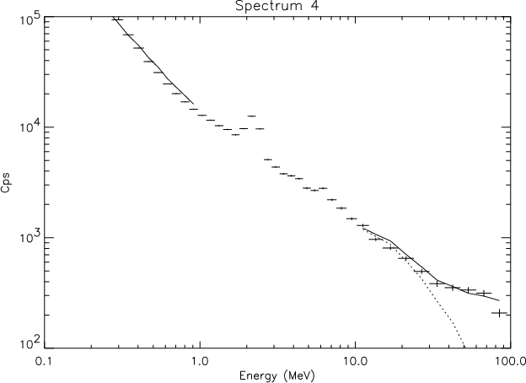
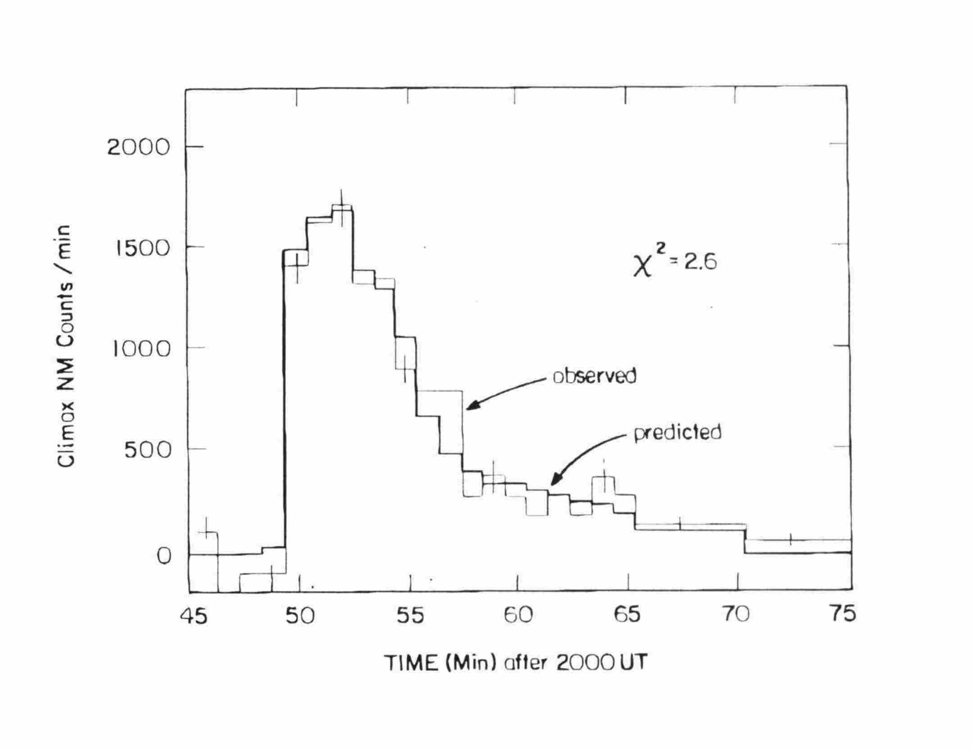
Extremes of ion acceleration: Pions and neutrons!!
Around 20 events observed with significant pion production:
Shape of the ion spectrum in a wide energy band?
pions
Proton spectra and numbers from pion decay radiation and γ-ray line radiation and neutron observations?
Do we have a single energetic ion population from a few MeV/nuc to a few GeV/nuc
Combined constraints from γ-ray lines, pion decay radiation (and also neutrons) imply that the ion energy distribution is not a single power law from the MeV to the GeV range (also observed for other events e.g. Kocharov, Murphy et al., 2007)
Need of a dedicated spectrometer in the GeV photon energy range (also see future results with FERMI)
neutrons
Neutrons and Heavy ions
Heavy ions are produced in flares but difficult to characterise (broad lines in the gamma-ray spectrum
Large numbers of fast neutrons are produced in nuclear reactions of low energy heavy ions.
Need of measurements of fast neutrons to better understand heavy ion production (orbit? )
PHEBUS/GRANAT and
Neutron monitors
(Vilmer et al., 2003; Debrunner et al; ,1996)

Slide 11
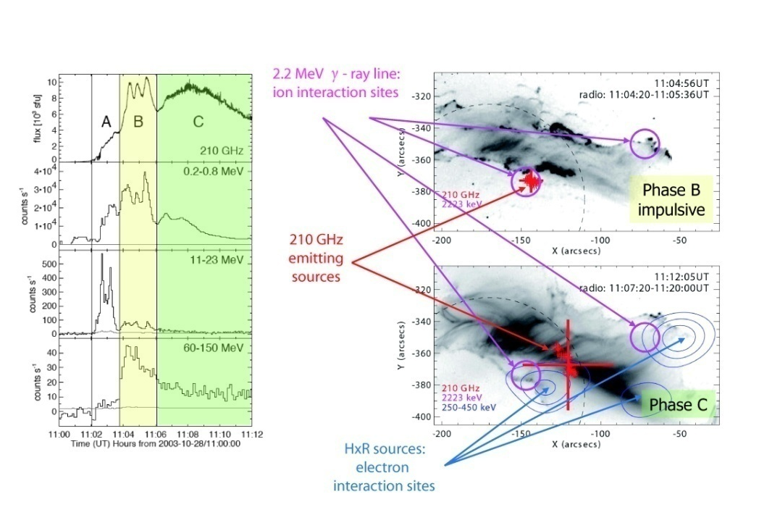
A new window to open with implications on electron and ion accelerations:!
Between near IR and sub-mm waves: a flare window of two decades in wavelength yet unexplored
Key diagnostics of high-energy particles and energy transport in flares:
  The high-energy tail of the microwave spectrum (synchrotron emission of relativistic e)
  Synchrotron emission from relativistic positrons produced in HE nuclear reactions.
  Thermal continuum emission from the flare - heated chromosphere (energy budget, agent of the energy transport)
Recent observations at 200 GHZ and 400 Ghz and combination with high energy radiation
(Trottet et al, 2008;
Kaufmann et al., 2004)
Need of measurements in the THZ range

Slide 12
A Wish List!!
- A low background X-ray/gamma-ray spectrometer (30 keV-300 MeV) (higher energy?) with a high resolution (Labr3?) and some imaging capabilities (technique?)
A gamma-ray imager with a higher spatial resolution and a higher dynamic range(with context observations)
A spectrometer in the GEV range and SEP observations
- Neutron measurements (orbit?)
Measurements in the THz domain
- a UV spectrometer with very fine spectral resolution close to a few key spectral lines (Lyα and others)
Context observations: magnetic fields, EUV images, CMEs,…
-

