Slide 1
RHESSI gamma-ray analysis

Slide 2
New DRM
Photon bins now go up to 150 MeV
No front/rear anticoincidence
Partial response elements cannot be removed

Slide 3
Example
segs=[bytarr(9),1,0,bytarr(7)+1] hsi_rd_ct_edges,20,es ps=[es,11000.+1000.*findgen(90)]
hessi_build_srm,es,segs,srm,geo,/direct,ph_edges=ps,$ time_wanted='2005-Jan-20‘
Update: currently the default, but does not currently work for the front segments

Slide 4
Artifacts
Full-scale artifact
Excess plateau around ~3 MeV
Depleted regions (especially detector 8)
Half-scale artifact
Primarily in detectors 5 and 8
Excess plateau around ~1.6 MeV
Dropouts in the rear segments
…

Slide 5
Artifact correction
Artifact regions are excised where appropriate from each detector
Given gain differences, there will still be data at all energies if enough detectors are used
Response matrix is modified in the same manner
Artifact-corrected spectra can be fit in OSPEX

Slide 6
Example
Need an spectrum object so either:
sp=hsi_spectrum()
hessi_data,sp=sp
sp->filewrite,/build,/use_artifact_mask
Update: selectable in the GUI

Slide 7
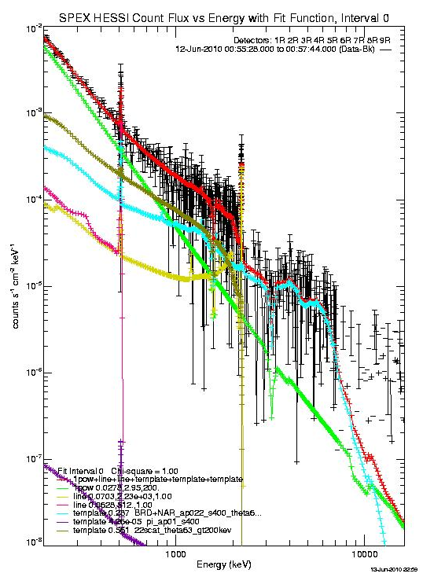
Example

Slide 8
Cosmetic correction
Artifact correction produces “dips” in count spectra that are aesthetically displeasing
Can scale the regions of the “dips” to correct for the now energy-dependent effective area
Due to off-diagonal response, the scaling is model-dependent
Cosmetic correction possible, but only after a valid best fit is first obtained

Slide 9
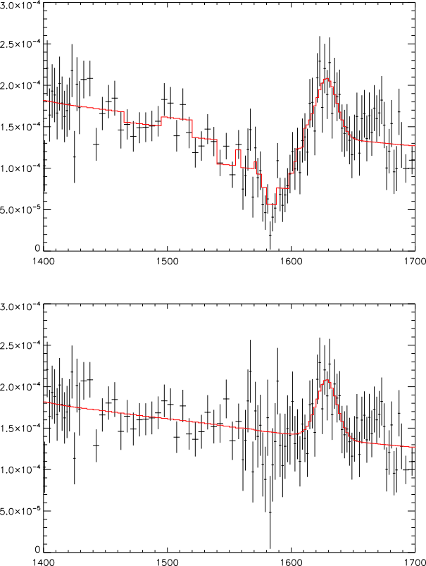
Example

Slide 10
Accessing Fermi/GBM data
http://hesperia.gsfc.nasa.gov/fermi_solar/
Click on “Analyzing GBM Data in OSPEX” for more information

