Slide 1
Comparing Solar-Flare Acceleration of >~20 MeV Protons and Electrons Above Various Energies
National Aeronautics and Space Administration
Albert Y. Shih
NASA Goddard Space Flight Center

Slide 2
Comparing ions and electrons
Do all flares accelerate ions and electrons?
Flare-acceleration models do not typically predict a constrained ratio of ion and electron acceleration
Use ion-associated and electron-associated emissions as measures of particle acceleration
2.223 MeV neutron-capture line for ~20 MeV/nucleon ions
Bremsstrahlung emission for energetic electrons
Flare-integrated fluences
Observations from RHESSI and SMM/GRS

Slide 3
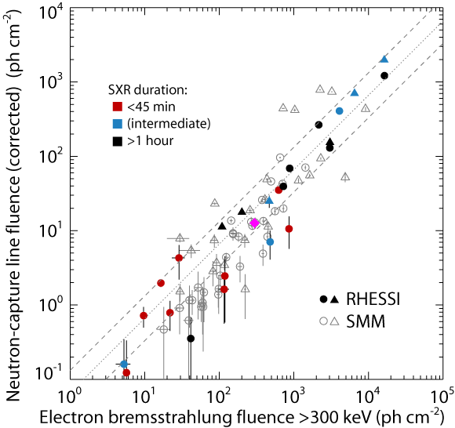
Versus >300 keV electrons
Direct proportionality
Dotted lines are factors of 2 from the best-fit line
Some spread is due to incomplete coverage (triangles)
Almost all flares fall within 1 σ of spread
Magenta diamond is the 2010 Jun 12 flare
(Shih et al. 2009, ApJL)

Slide 4
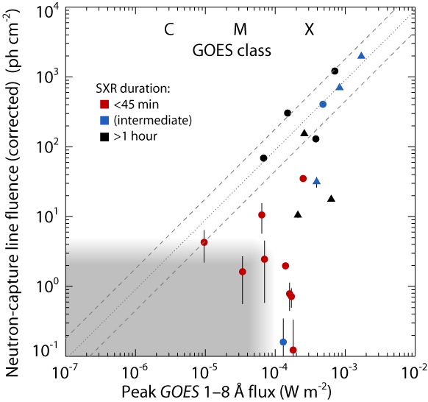
Versus thermal emission
GOES class (emission from hot plasma) as a measure of flare size
Gray region has not been systematically searched
Direct proportionality above a threshold?
Below threshold: excess heating
(Shih et al. 2009, ApJL)

Slide 5
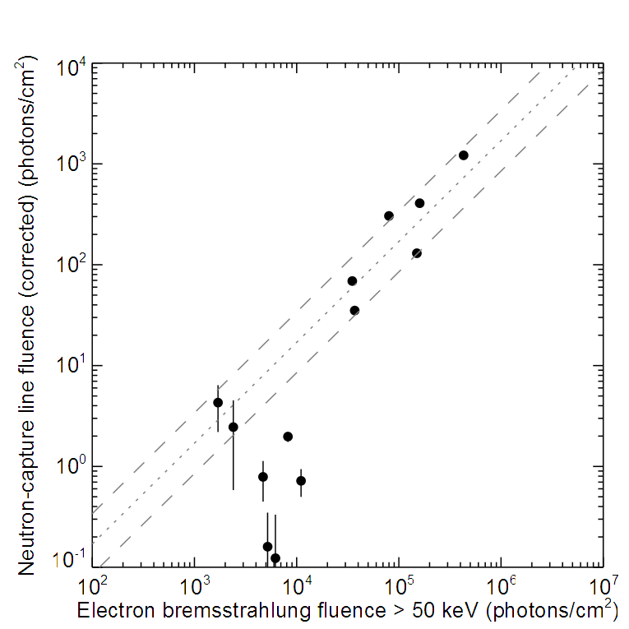
Versus >50 keV electrons
Subset of the RHESSI flares that are easier to analyze
Many flares show comparable correlation as with >300 keV fluence
Five flares appear to deviate significantly: excess >50 keV?

Slide 6
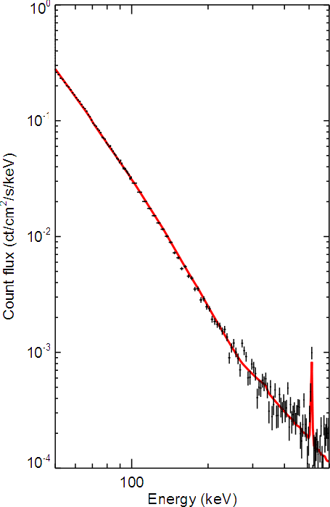
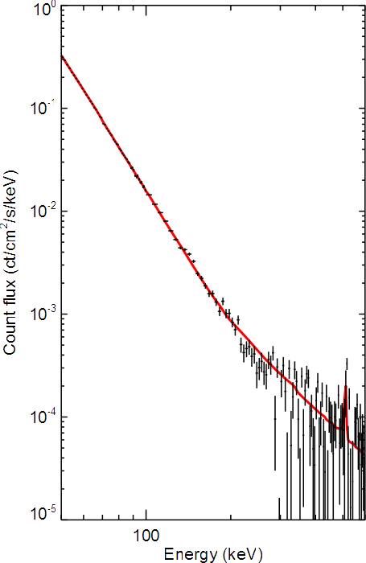
Flare count spectra: 50–600 keV
2003 May 27, X1.4
2005 Sep 13, X1.7
Broken power-law
in photon space
γ₁ ~ 4.5
γ₁ ~ 3.4
γ₂ ~ 1.7
γ₂ ~ 1.6
E_{b} = 190 ± 20 keV
E_{b} = 270 ± 20 keV

Slide 7
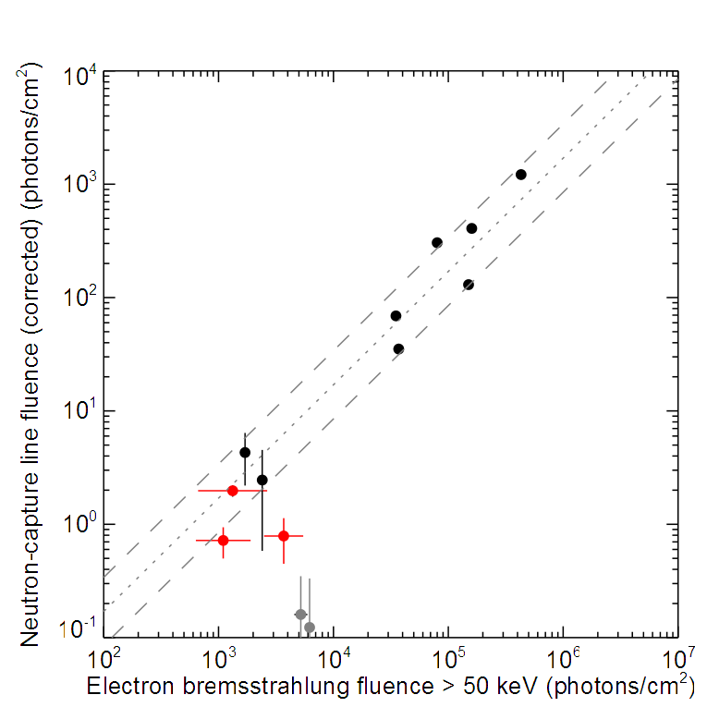
Modified >50 keV correlation
Now excluding the contribution of soft, low-energy bremsstrahlung
Extrapolated the high-energy power law down to 50 keV
The flares with good statistics correlate much better

Slide 8
Date | GOES class | >1 hr | γ_{>50} | γ_{>300} | HA (°) | CME? | Type II?
2002 Feb 26 | C9.6 | N | 3.40 | 2.56 | 79 | none | N
2002 Jul 23 | X4.8 | N | 3.11 | 2.72 | 73 | fast | Y
2003 Apr 26 | M7.0 | N | 2.77 | 2.86 | 73 | slow | Y
2003 Jun 17 | M6.8 | Y | 2.90 | 2.64 | 59 | fast | Y
2004 Nov 10 | X2.5 | N | 3.05 | 2.81 | 47 | fast | Y
2005 Jan 17 | X3.8 | Y | 3.34 | 2.54 | 34 | fast | Y
2005 Jan 19 | X1.5 | Y | 2.55 | 2.62, 2.36 | 51 | fast | Y
2005 Jan 20 | X7.1 | Y | 2.90 | 2.49 | 61 | fast | Y
2003 May 27 | X1.4 | N | 3.4 | 2.73 | 17 | fast | Y
2004 Jul 15 | X1.8 | N | — | 1.73 | 56 | fast | N
2004 Jul 15 | X1.6 | N | 3.54 | 2.05 | 46 | none | N
2004 Jul 16 | X1.3 | N | 4.41 | 3.17 | 43 | none | N
2005 Sep 13 | X1.7 | N | 4.5 | 1.82 | 18 | fast | N

Slide 9
Fitting details
Fitting an electron spectrum using its produced bremsstrahlung does not remove the need for a spectral break (at electron energy ~0.5 MeV)
Isotropic albedo has been included, but it is possible there could be significant beaming
Note that these two flares are very near disc center
Albedo does naturally produce a break at ~250 keV, but the soft index in the 50–100 keV range rules out a single power law with significant anisotropy

Slide 10
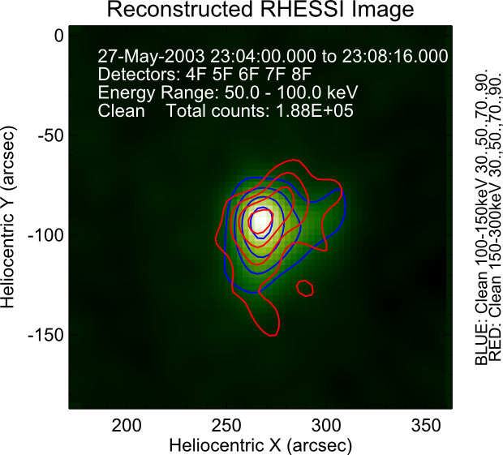
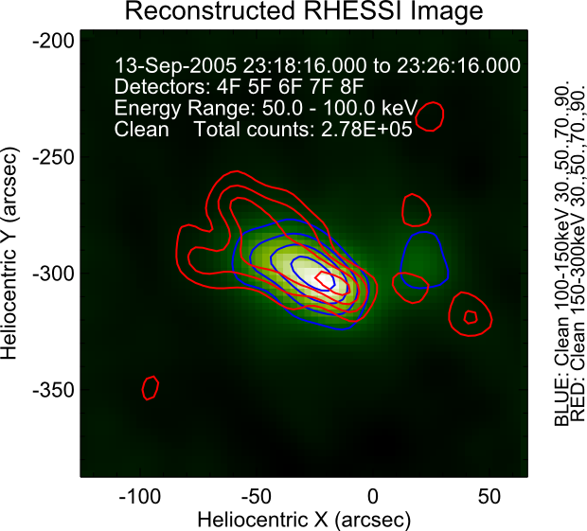
Image comparisons
2003 May 27, X1.4
2005 Sep 13, X1.7
No apparent change in morphology with energy
Possible slight change in morphology >~150 keV
Bkg: 50–100 keV
Blue: 100–150 keV
Red: 150–300 keV
Bkg: 50–100 keV
Blue: 100–150 keV
Red: 150–300 keV

Slide 11
Conclusions
>~20 MeV ions and >300 keV electrons are proportionally accelerated over >3 orders of magnitude in fluence
>~20 MeV ions and >50 keV electrons are not necessarily proportionally accelerated because of soft, low-energy components (<~ 150–300 keV in photon energy, <~0.5 MeV in electron energy)
“Excess” thermal emission is likely associated with the presence of this low-energy component
Imaging is limited by statistics, but does not show a significant change in morphology between the two components

Slide 12
Discussion
These spectral breaks are too large to be consistent with a single power law for the electron spectrum
The increasing contribution of electron-electron bremsstrahlung at higher energies produces a spectral hardening, but typically >~400 keV in the photon spectrum and with a change in spectral index of ~0.5
There may be two acceleration processes:
One process accelerates both >~20 MeV ions and relativistic electrons proportionally
A second process accelerates electrons with a softer spectrum that does not extend significantly above ~0.5 MeV
This second process is dominated by the first process in the larger flares

Slide 13
Bremsstrahlung components
Linked to thermal emission (GOES class)
Flux
~0.5 MeV
Harder component
proportional to >~20 MeV ion acceleration
Softer component
Energy

Slide 14
Electron/proton flux ratios
J_{e} (0.5 MeV) / J_{p} (10 MeV)
Ratio for interacting particles: ~300–10,000
Compared to SEP ratios
Gradual events: ~1–100
Impulsive events: ~100–1000

Slide 16
Gamma rays
corona
Flare
protons, alphas, heavy ions
electrons
n (cm⁻³)
10¹¹
bremsstrahlung
10¹²
10¹³
nuclear de-excitation, positron annihilation
neutrons
Thermalization
time delay of ~ 100 seconds
spatial separation of < 1 arcsec
10¹⁴
neutron-capture
10¹⁵
photosphere
Notes:
Ponder the densities

Slide 17
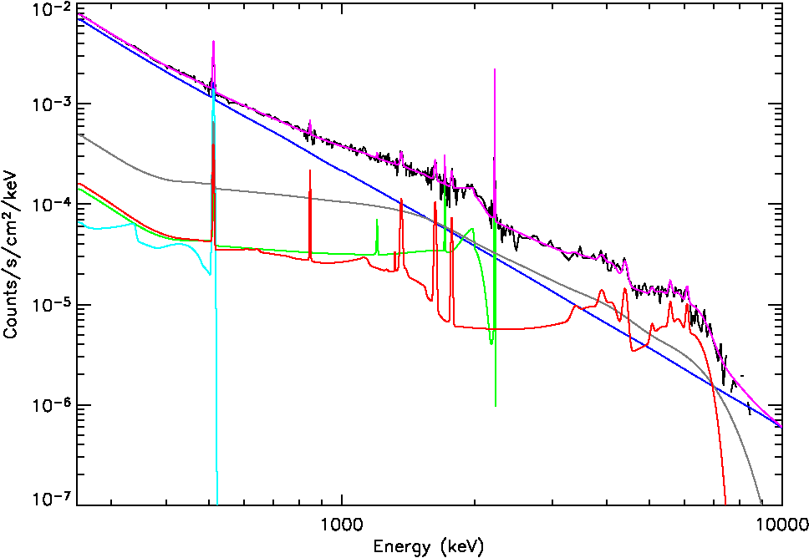
A RHESSI gamma-ray spectrum
X4.8 solar flare on
2002 July 23
total model
nuclear
de-excitation
neutron-capture
positron annihilation
bremsstrahlung

Slide 18
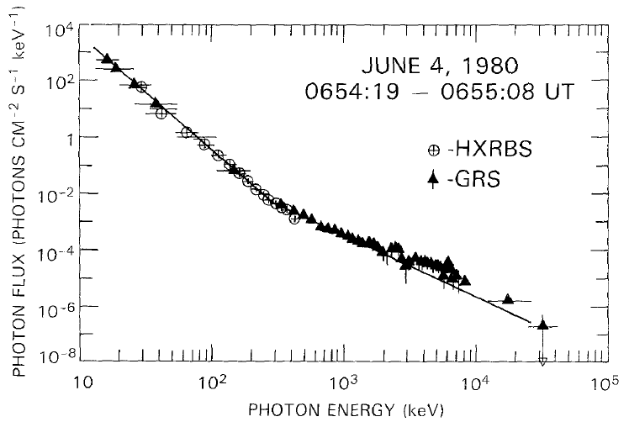
Earlier observation
Significant spectral hardening previously seen at least once by SMM, using both HXRBS and GRS spectra
(Dennis 1988, Sol. Phys.)

