Slide 1
Cloudy SolarSoftware
Enhanced Capabilities for Finding, Pre-Processing and Visualizing Solar Data
RHESSI Workshop 2010, Annapolis, August 2
László I. Etesi (1,5), Brian R. Dennis (2), Kim Tolbert (3), Dominic Zarro (4), Richard A. Schwartz (1), André Csillaghy (5)
(1) The Catholic University of America; (2) NASA Goddard Space Flight Center (3) Wyle Information Systems, Inc.; (4) ADNET Systems, Inc. (5) University of Applied Sciences North-Western Switzerland

Slide 2
What is Cloudy SolarSoftware?
SSW IDL tools and Internet services
Search (VSO and others)
Pre-process (PrepServer)
Visualize
Integrated workflow
Ideal for multi-instrument/multi-wavelength analysis

Slide 3
What are the components?
SHOW_SYNOP
Graphical user interface (GUI) in IDL
Search window
Integrated (remote) pre-processing with PrepServer
Integration with Visualization suite PLOTMAN

Slide 4
What are the components?
PLOTMAN
Graphical user interface (GUI) in IDL
Light curves, images, and spectra
Image rotation and zoom, overlays, multi-window graphics

Slide 5
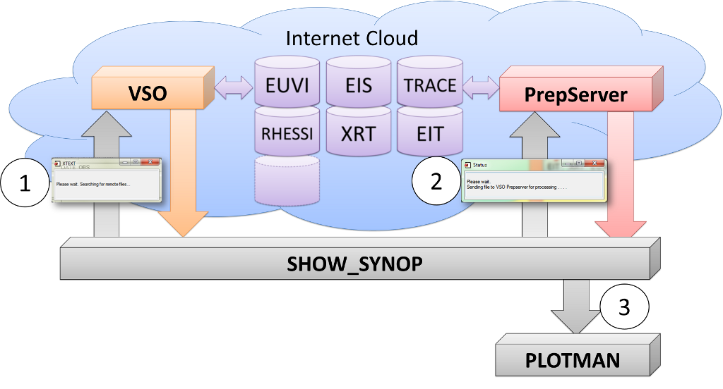
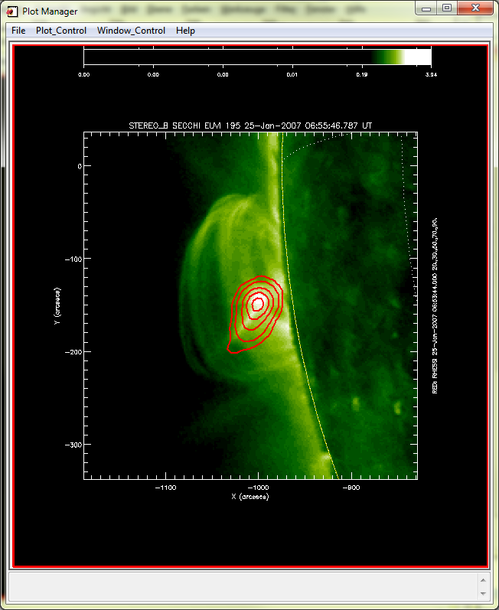
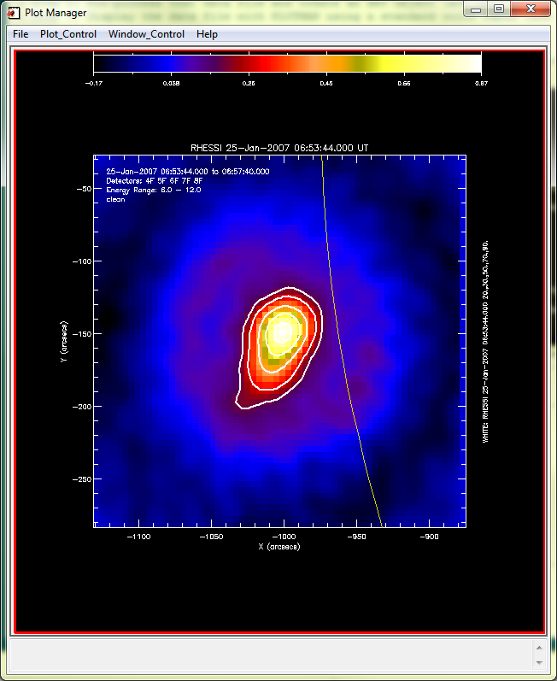
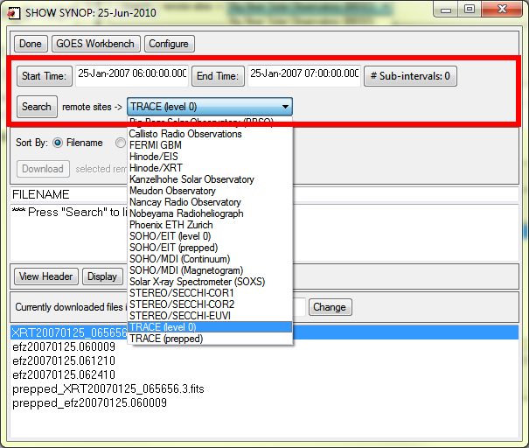
How does everything come together?
PLOTMAN
SHOW_SYNOP

Slide 6
Demo
Instruments
RHESSI
EIS
TRACE
Date
14-Dec-2007 14:14

Slide 7
Reconstruct RHESSI Image
Interval: 14-Dec-2007 14:14:28 - 14:15:00
Algorithm: Clean
Energy bands: 20 – 25 keV
Detectors: 1, 2, 3, 4, 5, 6
Pixel size: 0.5 x 0.5
XY-Offset: 557, -116

Slide 8
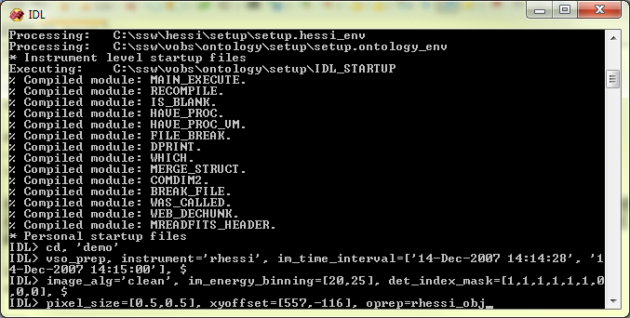
Reconstruct RHESSI Image
Using RHESSI suite
PrepServer:

Slide 9
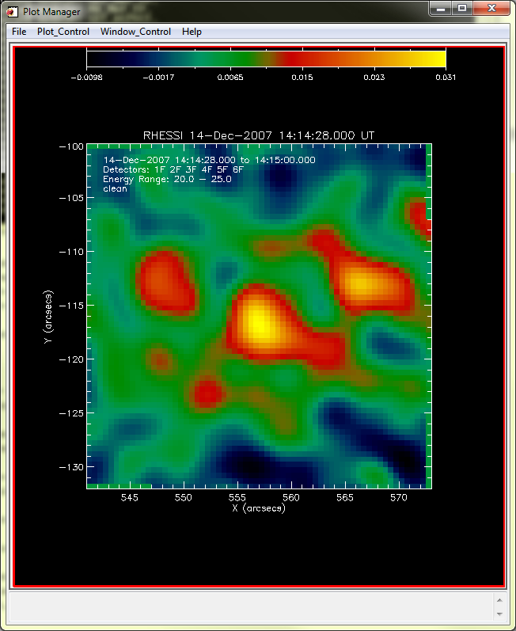
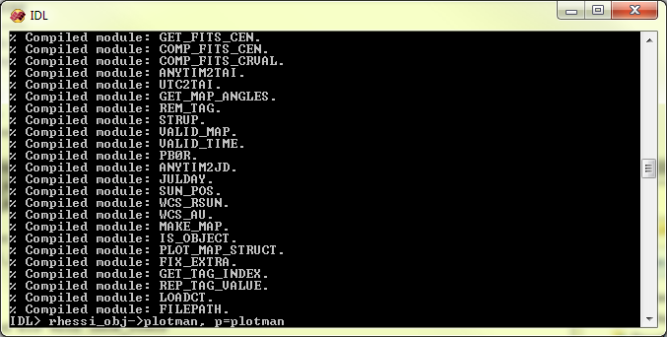
Display RHESSI Image
Plotman
PLOTMAN window

Slide 10
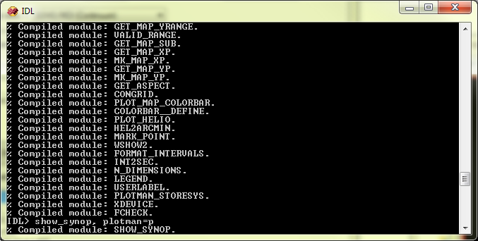
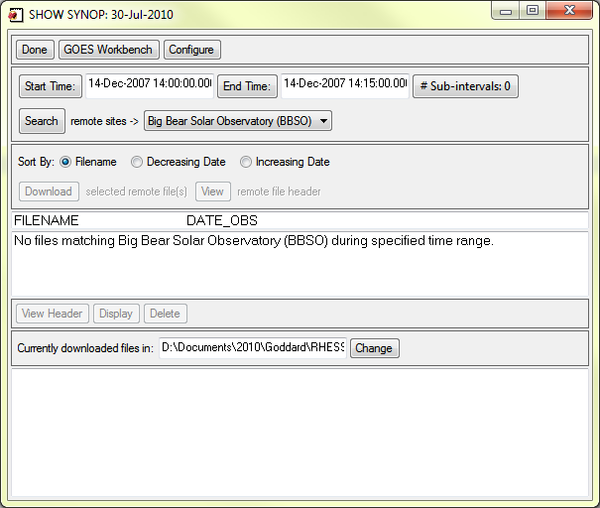
Use SHOW_SYNOP for Searching
SHOW_SYNOP window

Slide 11
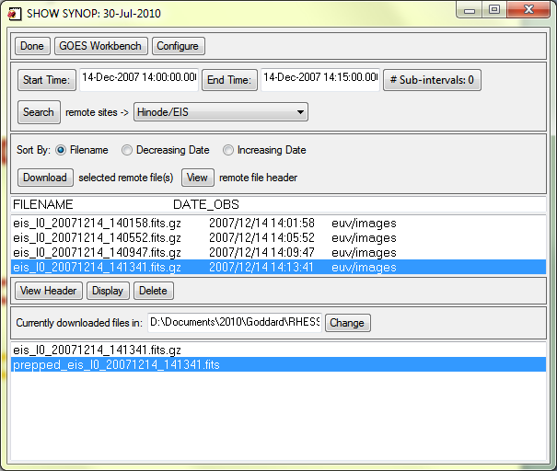
Search, Download, and Pre-Process EIS Data
14-Dec-2007 14:13:41
Zip file
Multiple wavelengths
All wavelenghts are processed
1
2
3

Slide 12
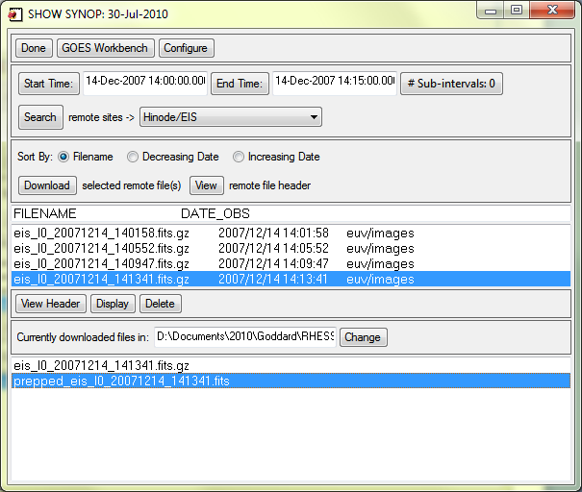
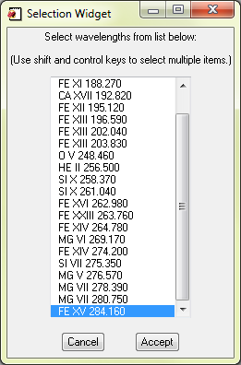
Display EIS Data with PLOTMAN
Select wavelenghts
3

Slide 13
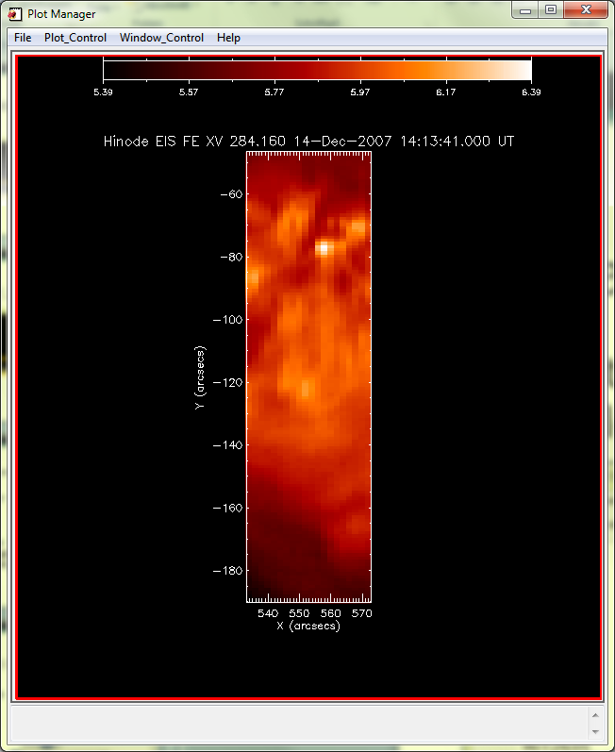
Display EIS Data with PLOTMAN

Slide 14
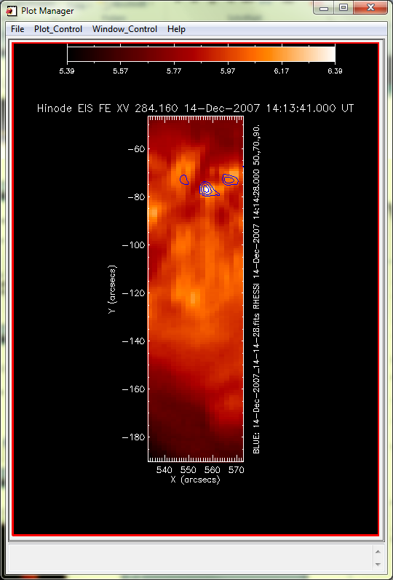
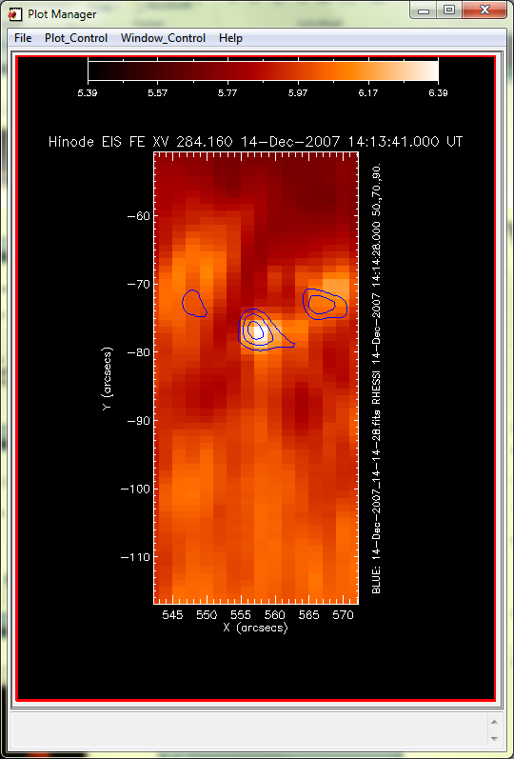
Overlay RHESSI Contours on EIS Data
Use Plot_Control
Image Display Options
Select image for contour
Configure contour

Slide 15
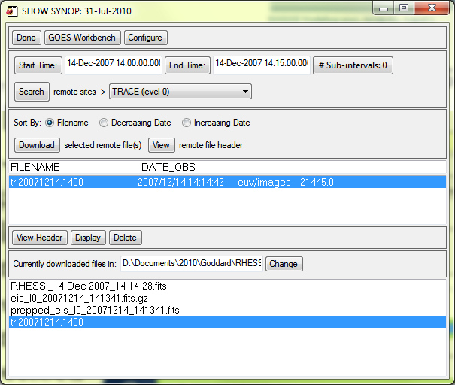
Search, Download, and Pre-Process TRACE Data
14-Dec-2007 14:14:42
Multiple wavelengths
Selected wavelengths are processed
1
2
3

Slide 16
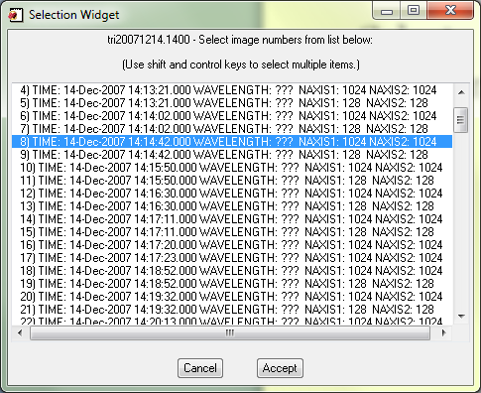
Display TRACE Data with PLOTMAN
Select wavelenghts
3

Slide 17
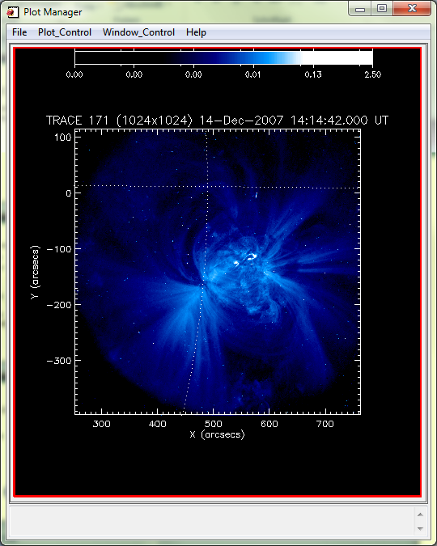
Display TRACE Data with PLOTMAN

Slide 18
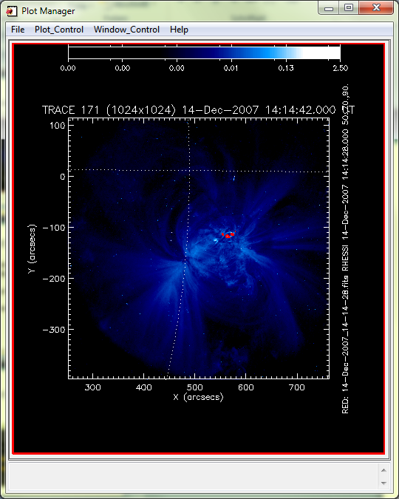
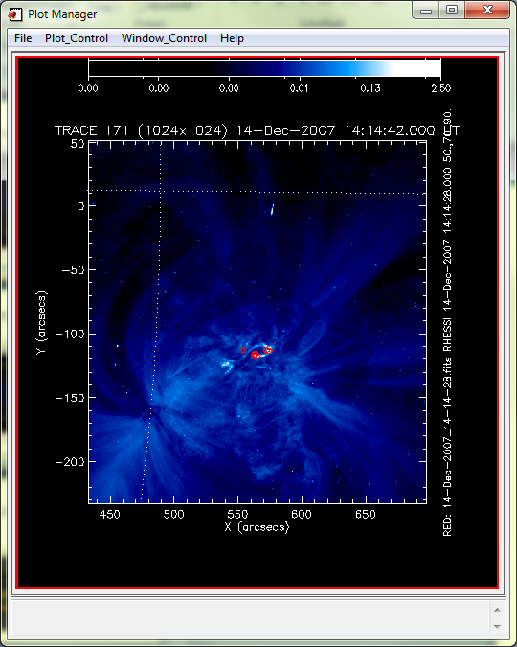
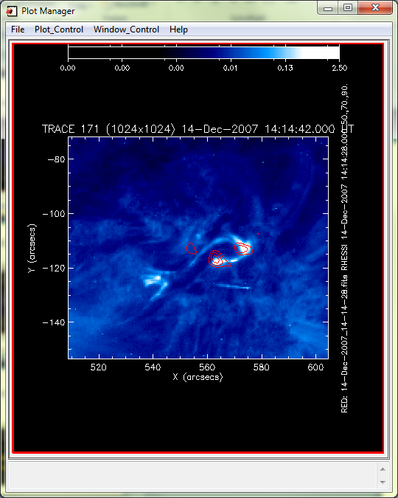
Overlay RHESSI Contours on TRACE Data

Slide 19
Final Images
RHESSI 20-25keV clean image
14-Dec-2007 14:14:28
Hinode/EIS FE XV 284 Å
14-Dec-2007 14:13:41
with RHESSI contours
TRACE 171 Å
14-Dec-2007 14:14:42
with RHESSI contours

