Slide 1
Regularized inversion techniques for recovering DEMs
Iain Hannah,
Eduard Kontar & Lauren Braidwood
University of Glasgow, UK

Slide 2
Introduction & Motivation
Current methods of recovering Differential Emission Measures DEMs(T) from multi-filter data are not satisfactory
Ratio methods, Spine forward fitting
Model assumptions, Slow, Poor error analysis
Instead propose to use Regularised Inversion
Used in RHESSI software to invert counts to electrons
Computationally fast
No model assumption
Returns x and y errors: so $T$ and $DEM$
Applied this to XRT simulated and real data, SDO/AIA simulated data
Still some issues/optimisations needed
Also beginning to work on applying this to EIS with P. Young (NRL)

Slide 3
DEM: What is the problem?
To find the line of sight $DEM(T_{j})$ for $j=0…M$ [cm⁻⁵K⁻¹] is to solve the system of linear equations
This problem is ill-posed
The system is underdetermined and the system of linear equations has no unique solution (Craig & Brown 1986).
Solve via
Ratio Method: assume isothermal, divide $F_{1}/F_{2}$
Forward Fitting: assume model (i.e. spline) and iterate
Inversion: Try to invert/solve the above equation
$$DN_{i}=F_{ij}DEM\left(T_{j}\right)+h_{i}$$
Data observed through $i^{th}$ filter
Noise $h_{i}$
Temperature response of $i^{th}$ filter, $N$ in total
DEM for each $j^{th}$ temperature

Slide 4
Regularised Inversion
Based on Tikhonov Regularisation
RHESSI implementation by Kontar et al. 2004
Applies a constraint to the recast problem to avoid noise amplification, resulting in following least squares problem to solve
$L$ is the constraint matrix, $DEM_{0}$ a “guess” solution
Solved via Generalized SVD
$R$ is the regularized inverse $DEM≅R⋅DN$
Error: Difference between true and our solution
$${\left\|F∙DEM−DN\right\|}^{2}+λ\left\|L∙(DEM−DEM_{0})\right\|=min$$
$$δDEM=\left(RF−I\right)DEM_{true}+Rh$$
Temperature resolution
(x error) from $RF≠I$
Noise propagation (y error)

Slide 5
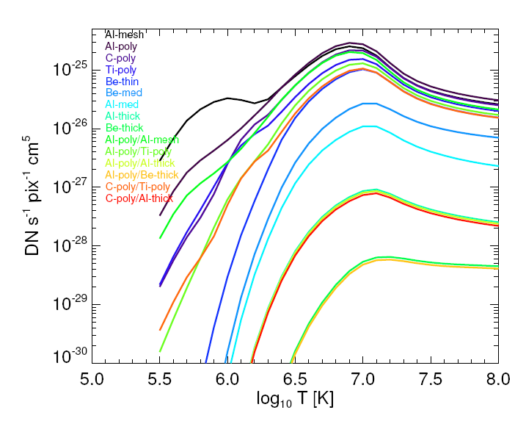
XRT Filter Response
Added complications:
With simulated DEM do not know duration so error estimate tricky
Time dependent surface contamination on XRT CCD
With real data do not get all filters & saturated pixels
15 possible filter combinations

Slide 6
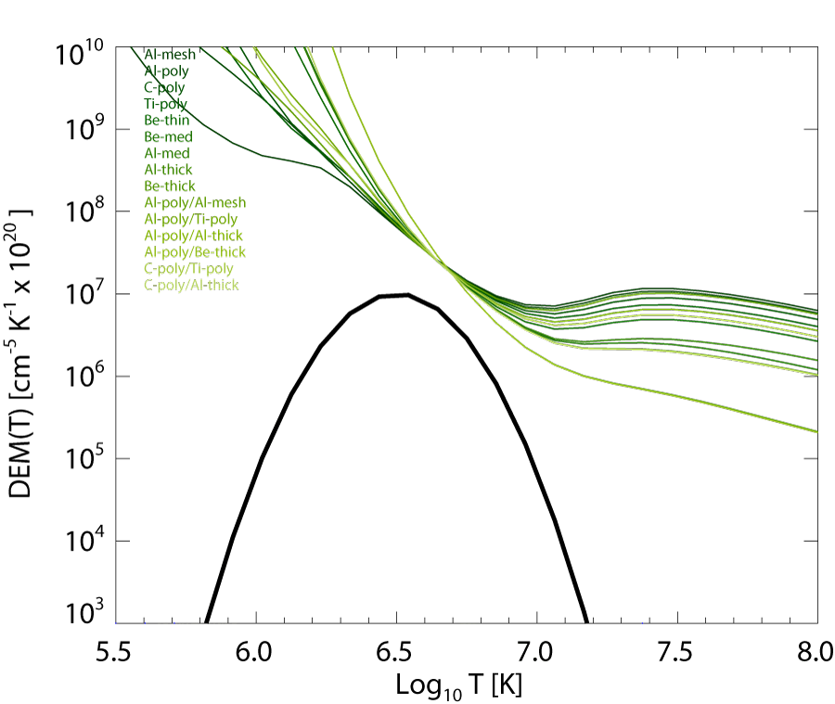
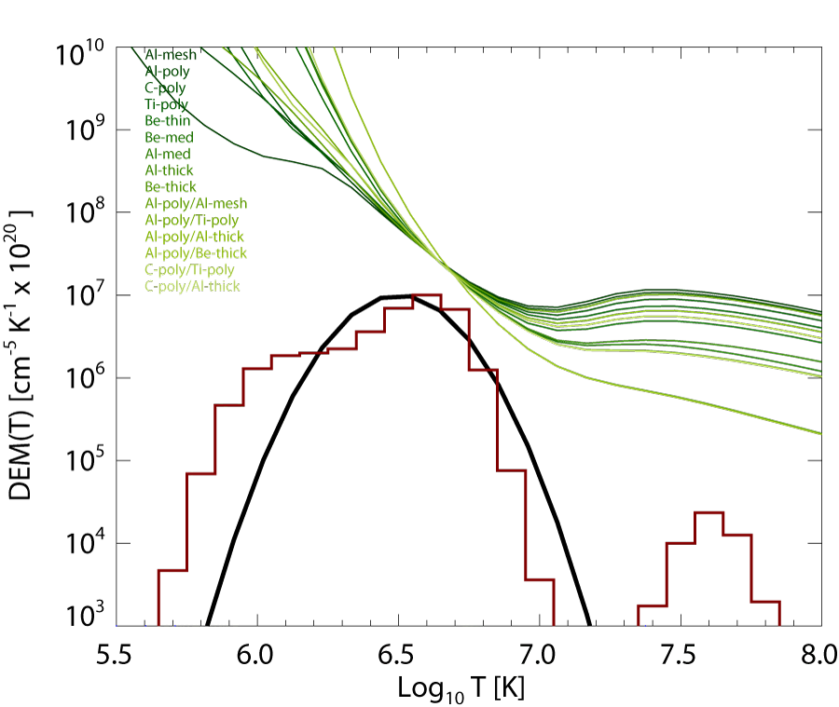
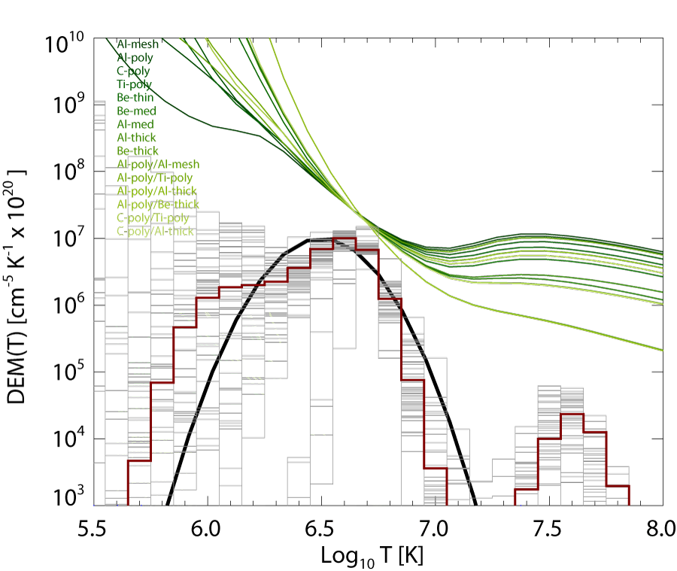
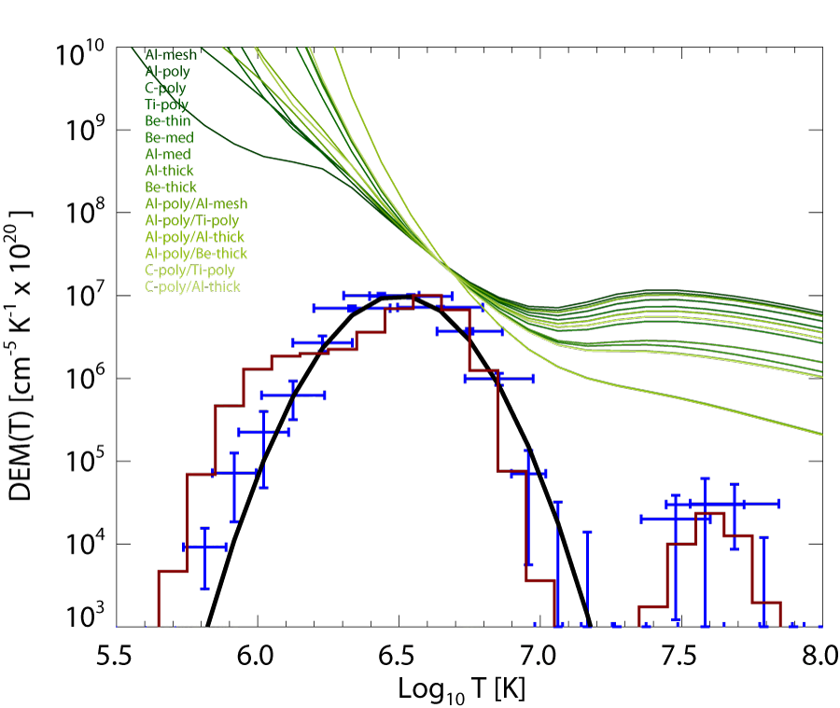
XRT: Simulated DEM
Using all filter combinations and 12-Nov-2006 (pre-contamination)
Ratio Method
Forward Fit
Forward Fit MC Errors
Regularized Inversion

Slide 7
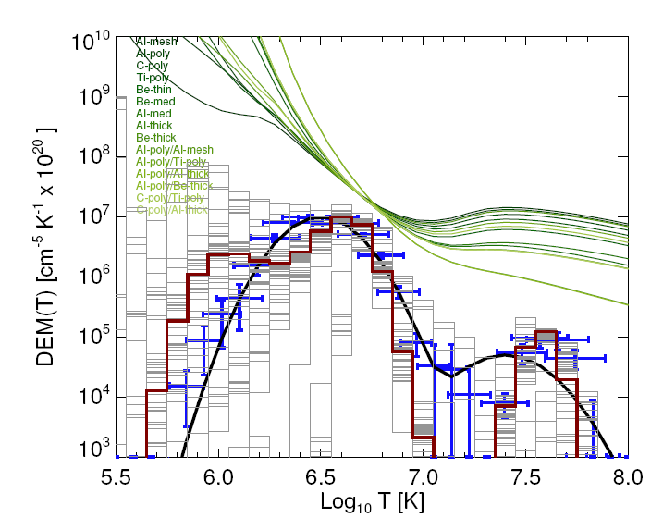
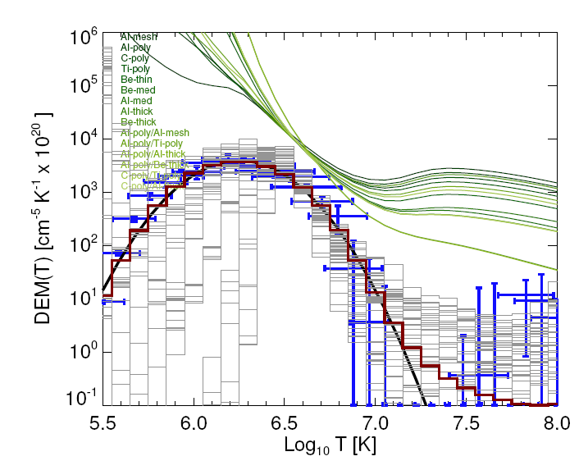
XRT: Simulated Data
More simulated examples, still all filters combinations
Two Gaussians
Fainter source

Slide 8
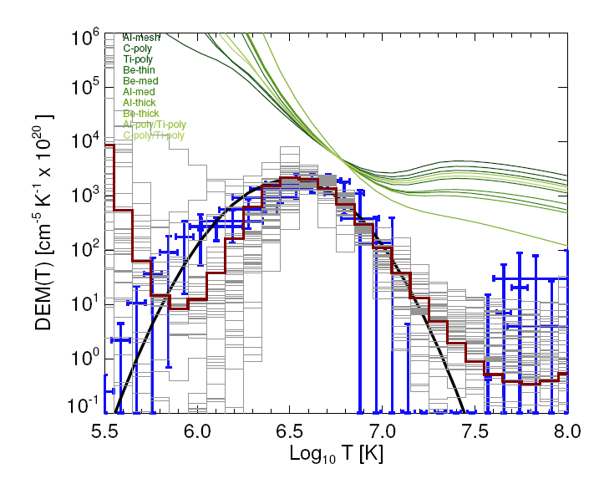
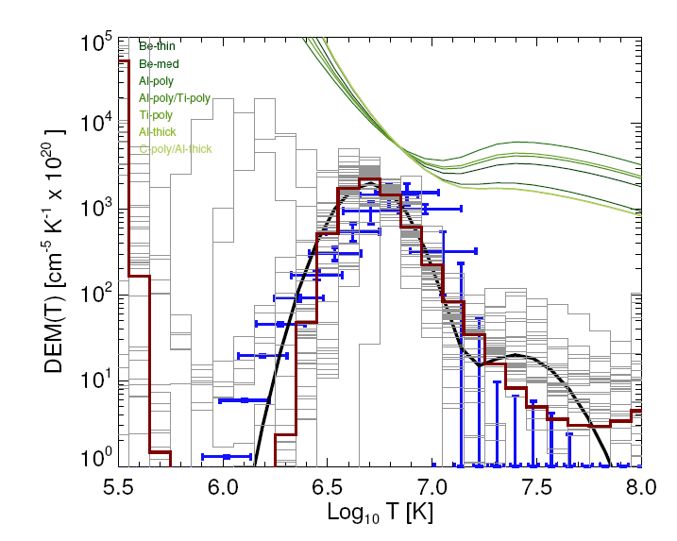
XRT: Simulated Data
Now using more realistic filter combinations and durations
Same combinations as
Schmelz et al. 2009
(XRT data tricky….)
Same combinations as
Reeves & Weber 2009
(XRT data on next slide)

Slide 9
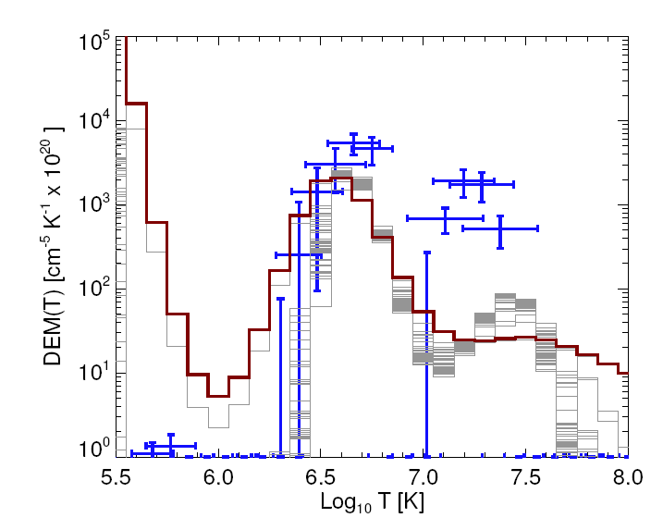
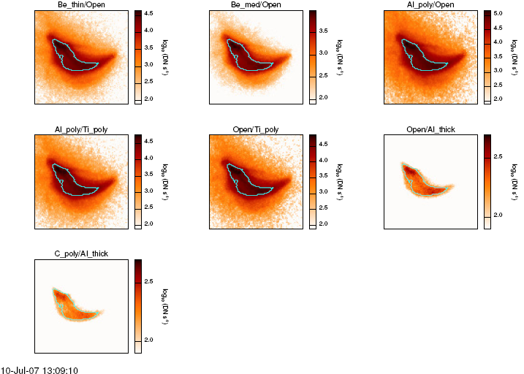
XRT: 10-Jul-07 13:10
7 filter combinations of post flare loops (C8 12:35UT)
Summed over indicated region of maps
Produces single $DN±σDN$ per map

Slide 10
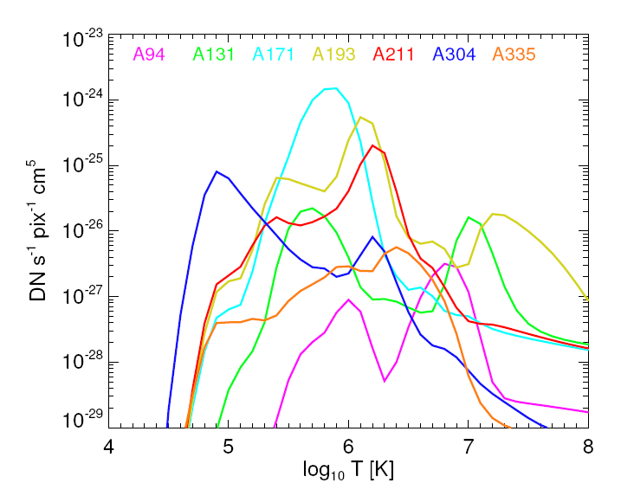
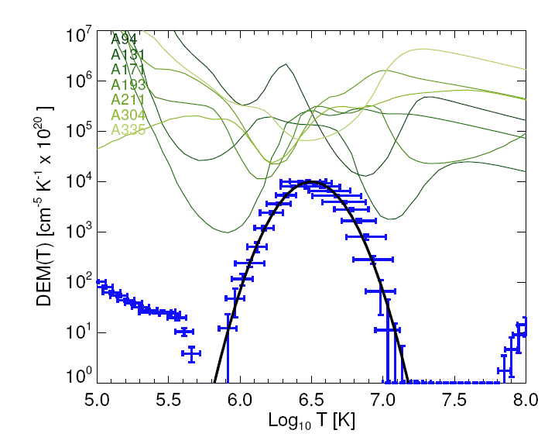
SDO/AIA Temperature Response
Very preliminary but huge potential
Not sure if temperature responses are correct
Regularized Inversion working but some issues…..

Slide 11
Conclusions & Future Work
Regularized Inversion provides a fast, model independent way of recovering a DEM with error estimates in both T and DEM
Though some bugs to sort out
With XRT tricky because of temperature response, contaminations and available data
SDO/AIA looks very promising
Though some bugs to sort out in regularized inversion implementation
EIS should also provide some useful data
Awaiting temperature responses from Peter Young
No doubt there will be bugs to sort out…..

