Slide 1
Tracing the magnetic connectivity between the solar surface, corona and inner heliosphere
using combined X-ray and radio observations
N.Vilmer (LESIA-CNRS-Observatoire de Paris, France)‏
K. Rackovic (LESIA&Department of Astronomy, University of Belgrade) & M. Maksimovic (LESIA)

Slide 2
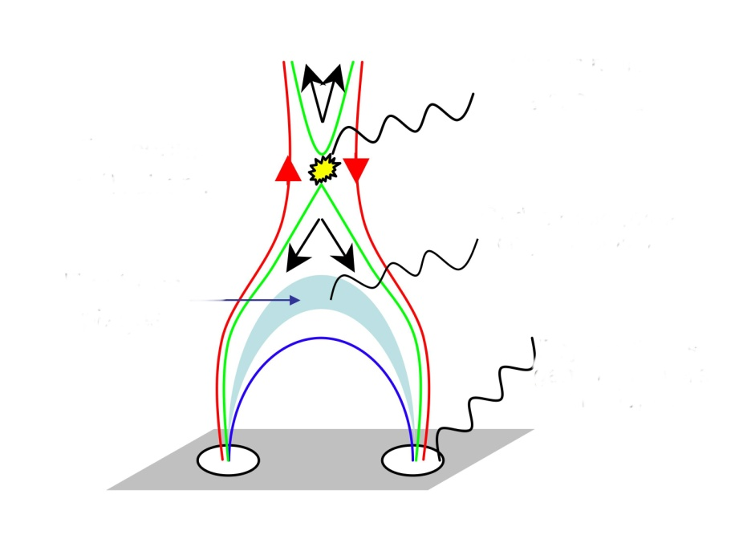
Acceleration
region
X-rays
From Krucker

Slide 3
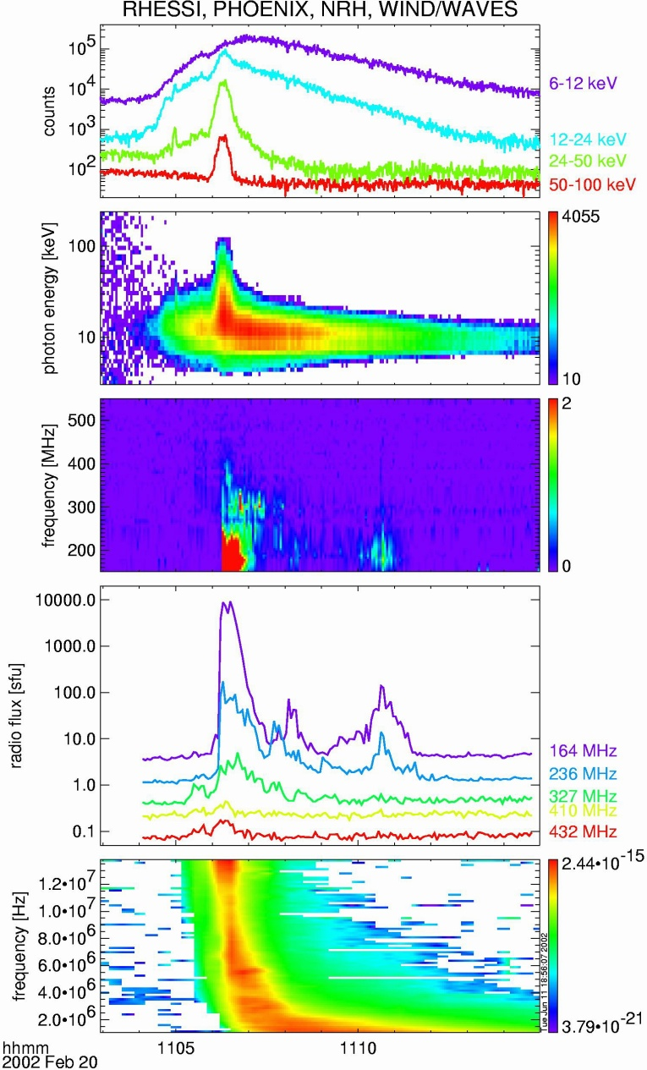
Electron acceleration associated with magnetic reconnection ? A simple flare.
HXR from the low atmosphere (chromosphere) - e precipitated downward to n_{e} > 10¹² cm⁻³, bremsstrahlung with ambient p, hν<energy(e)
Radio emission (type III) from outward propagating e beams, ν=2ν_{pe}∝√n_{e}, start < 400 MHz : n_{e} < 10⁹ cm⁻³, energy some keV
⇒ Acceleration region in the corona, injects particles downward (chromosphere) & upward (high corona, IP space)
Vilmer et al. 2002 Solar Phys

Slide 4
Electron acceleration associated with magnetic reconnection ? A simple flare.
Comparison of images at ≠ times at decimetric wavelengths (NRH) and above 30 keV over EIT
Images at highest frequencies??
Closest to the X-ray sites??
Vilmer & Krucker & Lin & RHESSI Team (2002)

Slide 5
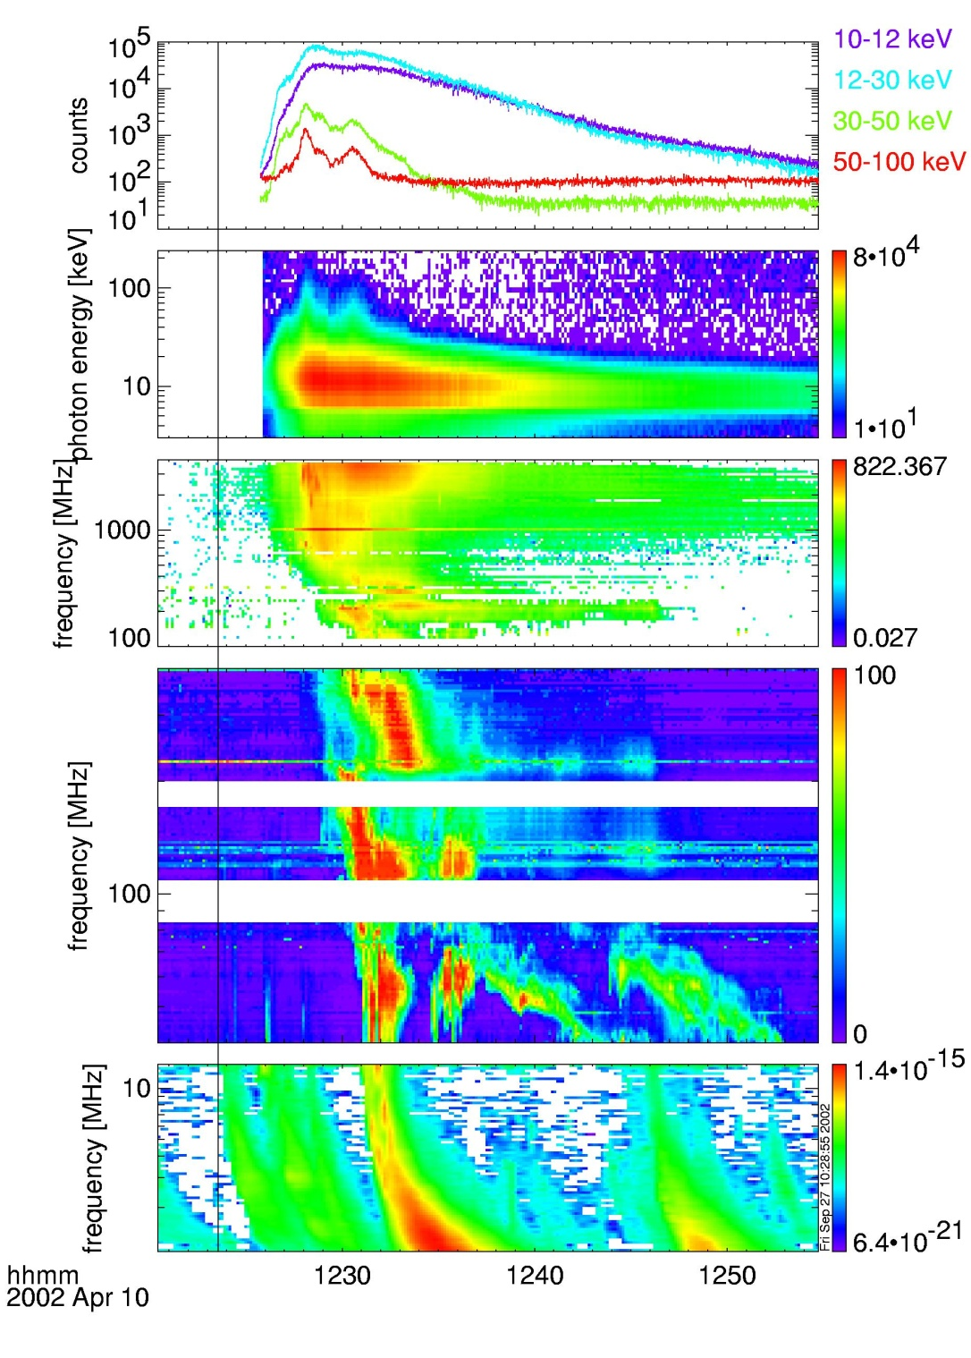
Electron acceleration and injection in the interplanetary medium? A more complex flare.
HXR from the low atmosphere (chromosphere) - e precipitated downward to ne > 1012 cm-3,
Radio emission (type III) from outward propagating e beams,
Radio composite spectra
3 GHz to 1 MHz
Acceleration region in the corona, injects particles downward & upward but several sites for the high corona or IP space
Vilmer et al. 2003
Types III
(corona)
Types III
(IP)

Slide 6
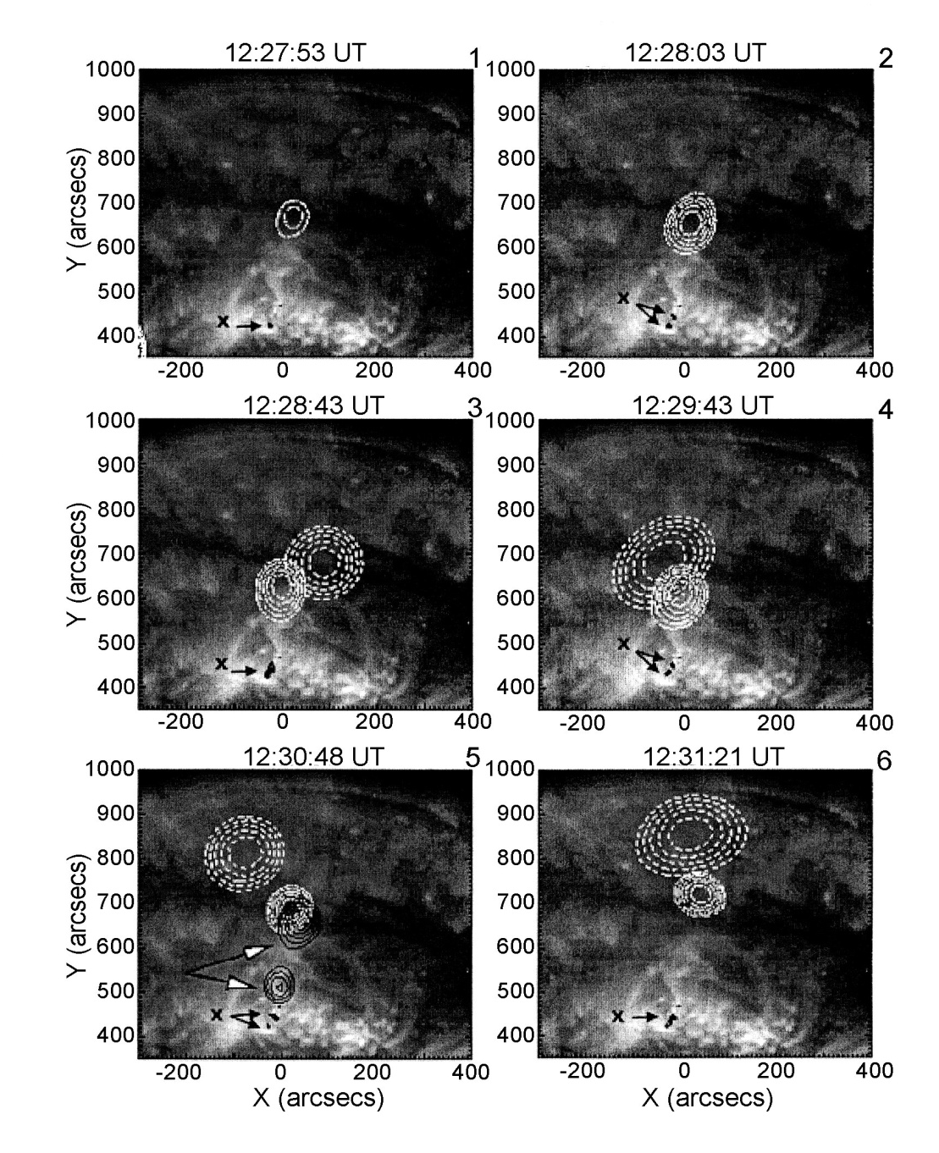
RHESSI 40-65 keV and
432 (black), 327 and 164 MHz contours on EIT images
First, electron acceleration and injection in low corona (Xray and 432 MHz radio emissions)
Later on electron production higher in the corona in connection with type III in the interplanetary medium and electron injection in the corona
-Interest of large band radio imaging spectroscopy to follow electron paths towards the IP
Tracing the magnetic connectivity between the solar surface, corona and IP with combined X-ray and Radio observations
(one of the key question of Solar Orbiter)
Vilmer et al., 2003

Slide 7
A Systematic Work in Progress:
- Start from the list of solar radio bursts from NOAA
Select events between 08:30 and 15h30 UT and in the 150-432 MHz range (i.e. observed by the NRH). Removal of events reported by several observatories.
(see Saint-Hilaire, Vilmer and Kerdraon in preparation)
Select events observed by RHESSI and WIND/WAVES using the RHESSI quick look site (http://sprg.ssl.berkeley.edu) and the Radio Monitoring Survey at LESIA (http://secchirh.obspm.fr)
Some statistics:
From 14 February 2002 to 30 September 2002:
1080 events in the list (i.e. bursts reported by NOAA and observed with the Nançay Radioheliograph)
596 events (55%) have a signature in WIND/WAVES (i.e. at frequencies below 12 MHz)
357 events for which the RHESSI spacecraft is in the night.
181 events for which the RHESSI spacecraft is in the SAA (no solar observations)
Among the 542 events with RHESSI observations at the time of the radio burst
224 events with a X-ray signature with RHESSI (41%)
163 events with both X-ray signature with RHESSI and a signature in WIND/WAVES (30%)

Slide 8
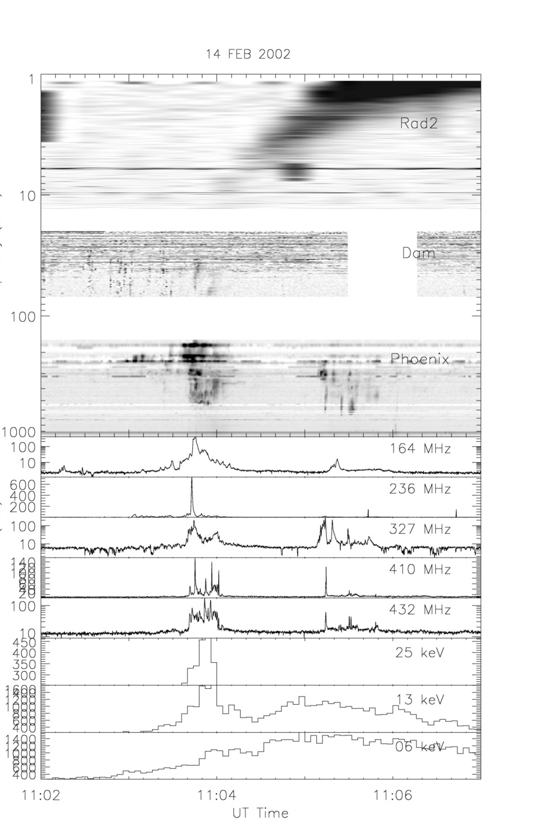
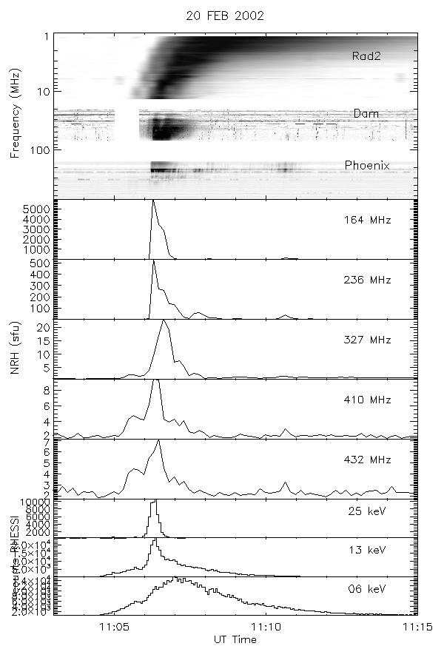
Quasisimultaneous observations of the hardest
X-ray emission and decimetric to hectometric type III bursts

Slide 9
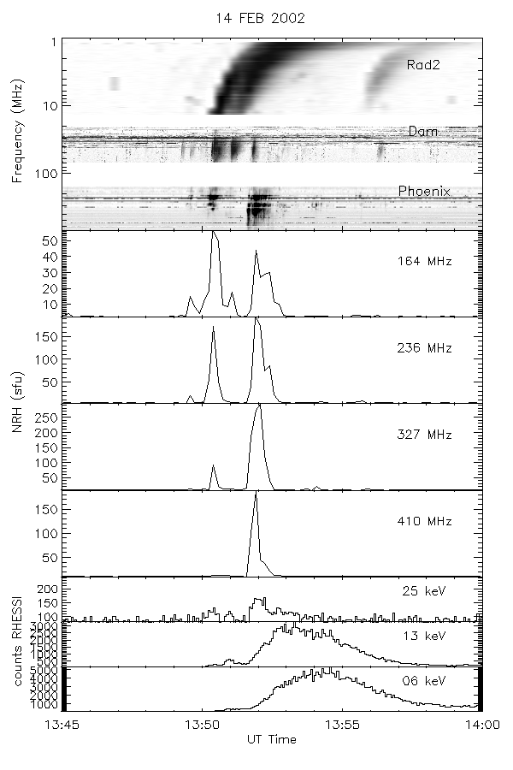
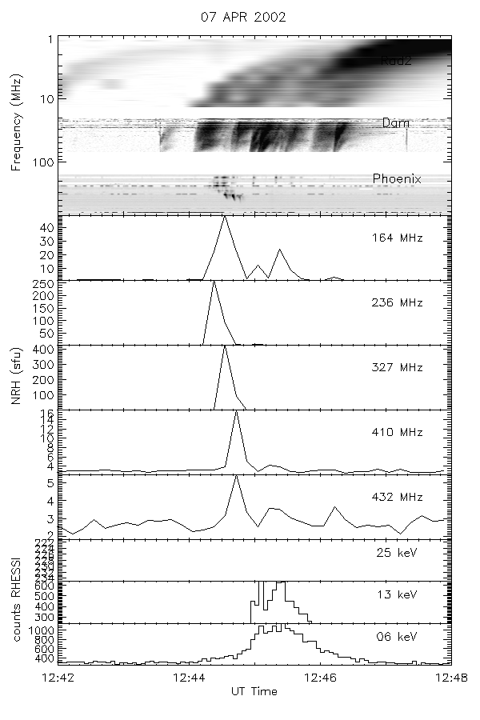
Metric to hectometric emissions first!

Slide 10
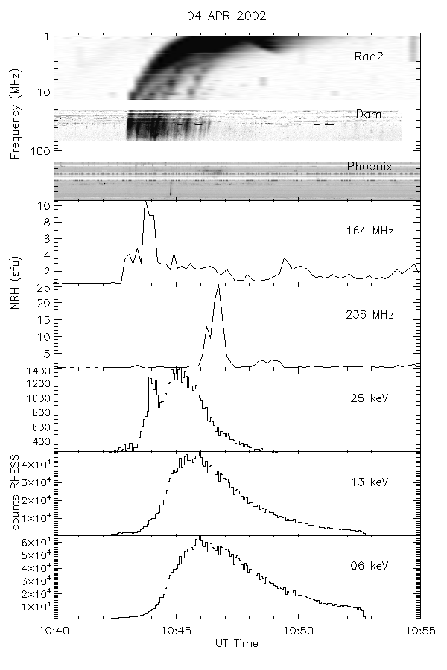
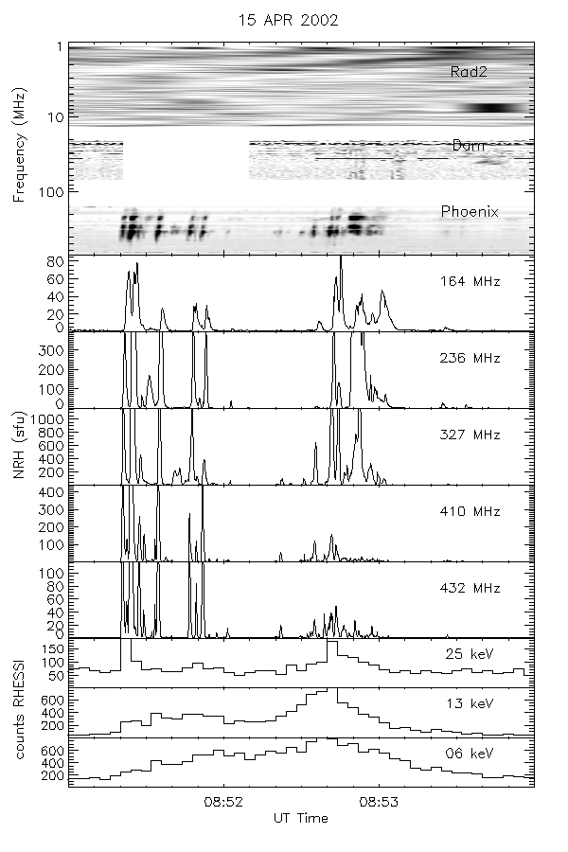
No emission below 100 MHz!
Faint metric/decimetric emissions

Slide 11
Preliminary conclusions:
The relationship between HXR emissions and radio emissions from beams propagating in the corona and in the interplanetary medium is not always as simple as expected from simple scenarios:
Our preliminary results based on 8 months of observations suggest that:
Only around 50% of the bursts observed by the NRH in the 450-150 MHz range are detected below 10 MHz by WIND/WAVES
Only around 30% of events can be clearly followed from the HXR domain to the radio domain below 10 MHz
For these events, the link between all emissions is not simple, varies from flare to flare and even in the course of flares.
Possible interpretations:
Magnetic field connections from the flare site to the corona ?
Need to study the spatial configurations of HXR emissions and of radio emissions at different heights(frequencies) provided by RHESSI and the Nançay Radioheliograph observations to understand the connectivity and changes in connectivity.
-Variations of the properties of the electron beams
of the acceleration heights, sites
Characteristics of electrons deduced from RHESSI observations
Numerical simulations of electron beam propagation and production of Langmuir waves (see e.g. Reid, Vilmer, Kontar in preparation)
All these questions will be addressed in the context of the preparation of the combined observations of X-ray and radio bursts with STIX and RPW on Solar Orbiter

