Slide 1
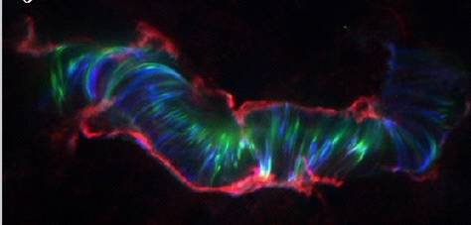
The Correlation Between HXR and UV Footpoints Emission
Jiong Qiu¹, Wenjuan Liu¹, Nicholas Hill², Maria Kazachenko¹
Physics Department, Montana State University
2. Physics Department, Grinnell College
UV and EUV of the Bastille-day flare
Notes:
1
1
1
\

Slide 2
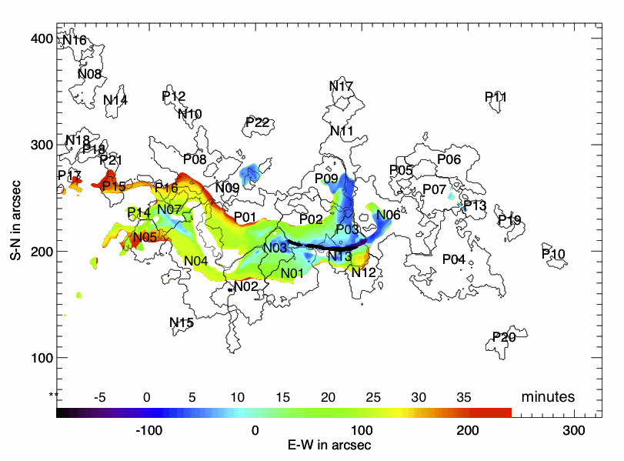
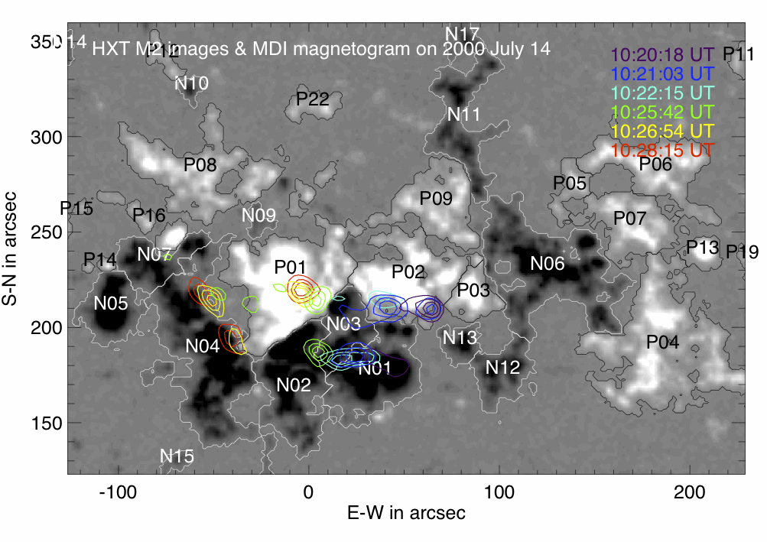
UV (1600 A) front from TRACE
Brightening spreads parallel along the PIL (“zipper effect”) as well as perpendicular to the PIL (e.g. Moore et al. 2001) - not exactly a 2D picture.
Some Properties:
Hard X-ray sources exhibit apparent “motion” as well, but they usually appear as kernels other than ribbons, as has been known and considered as evidence of 3D nature of 2-ribbon flares.
HXR (33-53 keV) images from HXT
Notes:
2
2
2

Slide 3
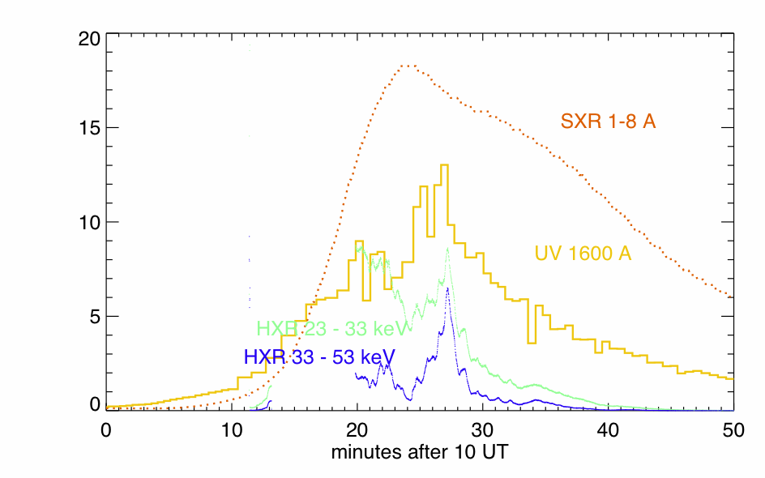
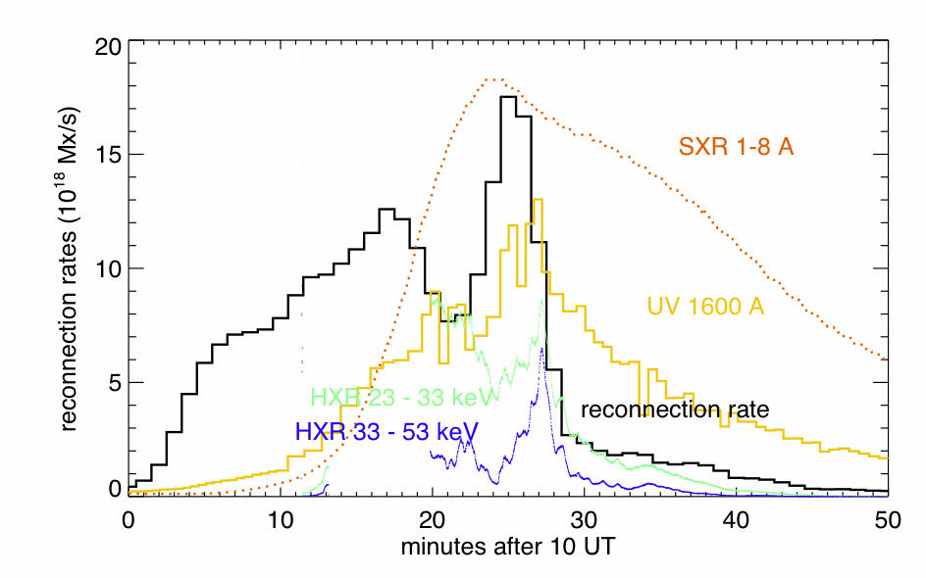
UV emission rises and peaks along with HXRs, but decays more gradually.
The reconnection rate, inferred from UV images and magnetogram, precedes UV and HXR emissions.
Notes:
3
3

Slide 4
“New” questions from the re-visit:
Q1: What is the relationship between UV and hard X-ray emissions in two-ribbon flares?
Q2: How is energy release related, or not, to the pattern of magnetic reconnection in an N-dimension ( 3 > N > 2) manner?
Notes:
4
4
4

Slide 5
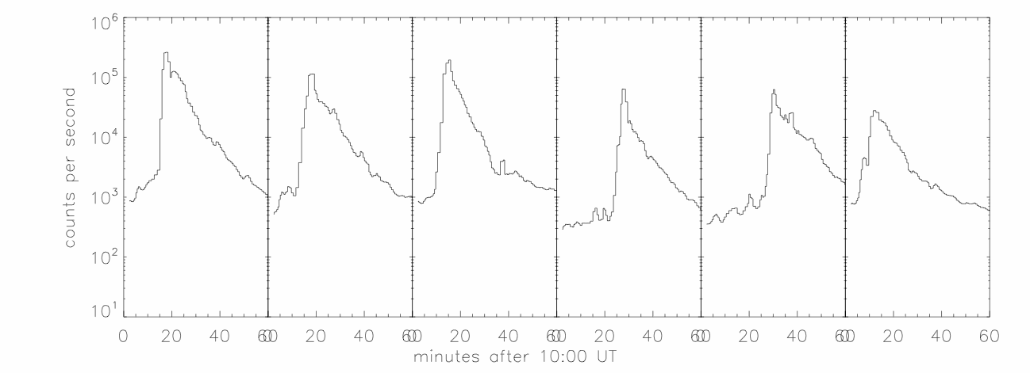
Time profiles of UV emission in single pixels (1”x1”)
rapid rise, reaching the peak nearly instantaneously
gradual smooth exponential decay
Notes:
5
5

Slide 6
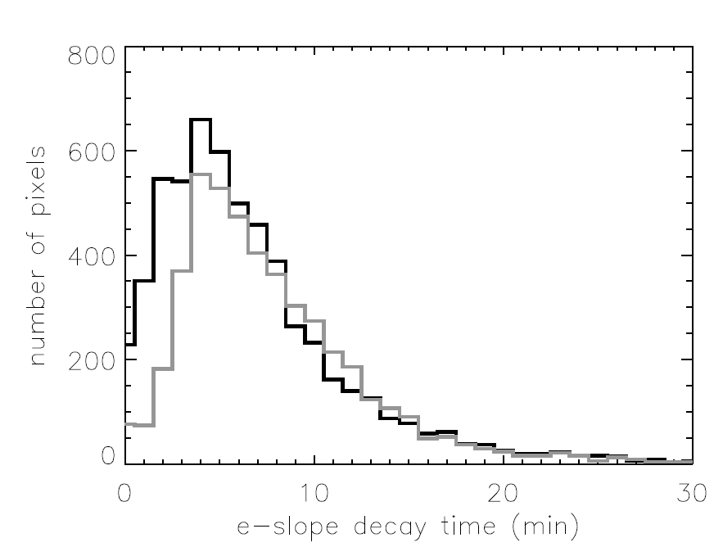
Gradual “cooling” of UV emission
~5500 pixels
~4500 pixels
e-slope decay time: 5-10 minutes
Notes:
6

Slide 7
Question: What is the relationship between UV and hard X-ray emissions in two-ribbon flares?
Quick answer:
- simultaneous HXR (> 20keV) and UV emission (rise and peak) by electrons precipitation.
- elongated “cooling” (5-10 min) of UV emission at the same locations but not apparently related to HXR producing process.
the “moving” precipitation along the PIL (at a few tens km/s) and substantial “cooling” time (5-10 min) in the UV band may explain extended UV ribbons.
Implication: imaging UV being a proxy of electron precipitation and instantaneous energy release.
Notes:
7
7
7

Slide 8
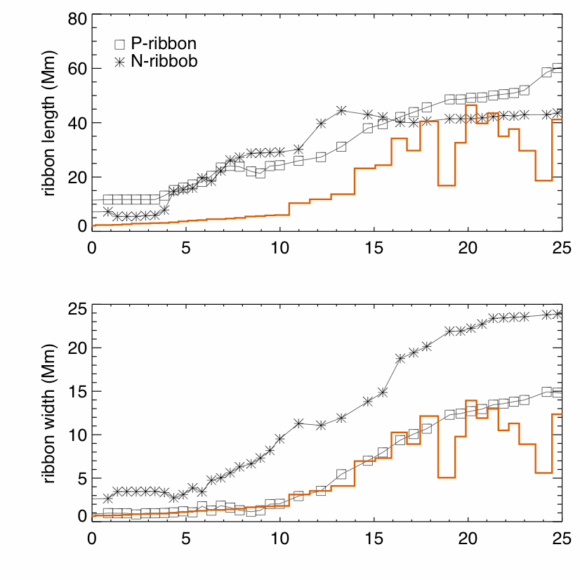
ribbon length
along PIL
HUV
ribbon width
perpendicular to PIL
HUV
first phase (0-25 min)

Slide 9
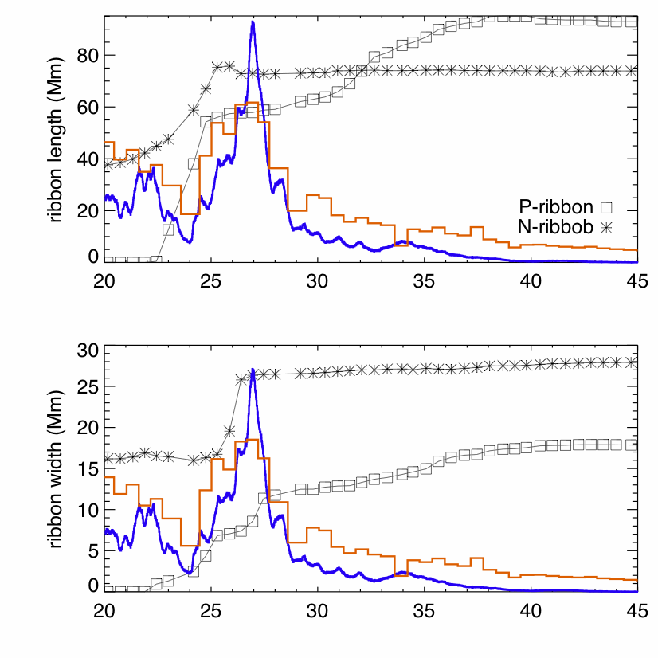
ribbon length
along PIL
HXR
HUV
HXR
ribbon width
perpendicular to PIL
HUV
second phase (25-45 min)

Slide 10
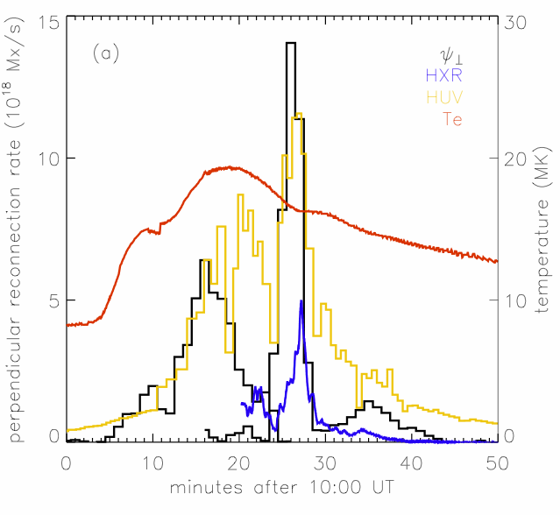
Such patterns indicate that the reconnection rate may be divided into components due to parallel ( ) and perpendicular expansions ( ), respectively -- organized 2.5D, but wrt PIL.
HXR
HUV
Te
Non-thermal emission (HXR and HUV) evolves along with reconnection rate due to perpendicular expansion (reconnection rate in 2D).
Notes:
10
10

Slide 11
Question: How is energy release related to the pattern of magnetic reconnection?
Quick answer: in a 2.5D model (as permitted by the organized 2-ribbon evolution), perpendicular expansion of UV ribbons, is strongly correlated with instantaneous (maybe non-thermal) energy release as reflected in radiation signatures.
Acknowledgement: we thank Drs. Nightingale, Tarbell, Longcope for discussions. This work is supported by NSF ATM-0748428 and NSF REU program at Montana State University.
Notes:
11
11

