Slide 1
The Chromosphere, an accelerator?
Dr Rim Turkmani Imperial College
In collaboration with
Prof. John Brown Glasgow University

Slide 2
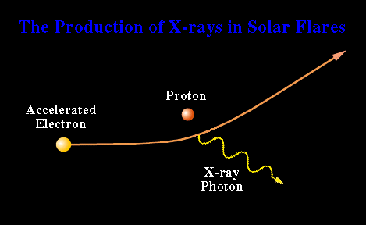
Collisional Thick Target Model
Brown 71
Hudson 72

Slide 3
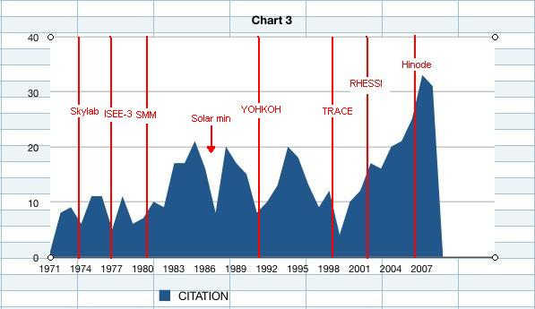
Collisional Thick Target Model
Brown 71, 563 citations in 39 years

Slide 4
Chromosphere since TTM 71

Slide 5
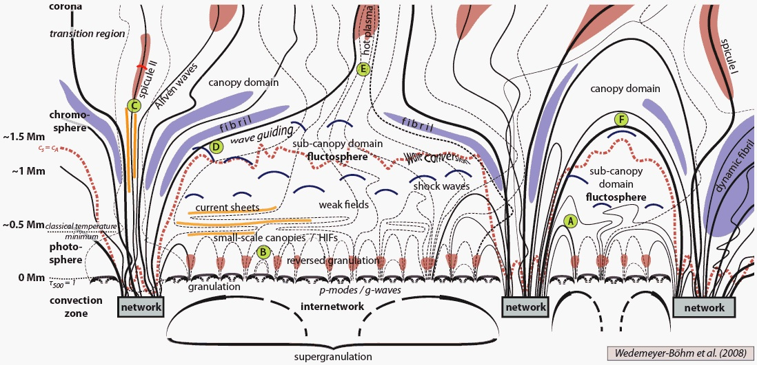
Chromosphere since TTM 71
Notes:
He et al ApJ 2009EXCITATION OF KINK WAVES DUE TO SMALL-SCALE MAGNETIC RECONNECTION IN THE CHROMOSPHERE, He et al 2009 (SOT observations)

Slide 6
Physics of the Chromosphere
Main source of electromagnetic emission → essential to be understood although very complex
Thickness: About 10 pressure scale heights, 1000 km (beck et al 09)
Complex because the magnetic fields are highly twisted because of the shift from gas dominance region in the photosphere to field dominance in the corona
The Lorentz forces are strong near the bottom. At the photosphere they so large that the inferred electrical currents are not field aligned (De Rosa 09)
Additional resistivity that is irrelevant in the corona: Cowling resistivity: Ion -neutral collisions lead to an increased resistivity for currents flowing across magnetic field lines

Slide 7
Merits of Collisional TTM
Provides a ‘cartoon’ scenario for flare impulsive phase emissions roughly fitting observations
Collisional transport is easy to work with even though we know it cannot really be valid!
Separates acceleration site from HXR (TT Injection) source → no acceleration in HXR source.
Prediction of bright footpoints and the decrease of source height with energy broadly agrees with data
Predicts roughly right amount of plasma evaporation and heating though there are several unresolved issues of detail

Slide 8
CTTM Weaknesses & Issues
Weakness of albedo HXR spectral features => downward beaming << CTTM unless scattering, mirroring and return current isotropisation are strong enough (Kontar et al)
Interplanetary and radio versus HXR electron spectral index data do not ‘agree’ with CTTM (Kontar, Krucker et al) IF one ignores the very different locations and poorly known physics of these populations
Evaporation chokes off electron beam penetration
Electron beam heating is hard to reconcile with some impulsive thermal source locations and timing and with the evolution of SXR plasma EM(t) and T(t)
The large electron beam power required (in ANY) bremss HXR source requires very energy efficient acceleration
The one-off coronal acceleration of each HXR source electron demands high beam density and total number of electrons processed

Slide 9
HXR Source Requirements
Regardless of model, observed HXR flux fixes required value of source non-thermal EM
For a large HXR event

Slide 10
HXR Source Requirements
For any thick target model the N₁ source electrons of life t need ‘replenished’ at a rate
For the CTTM collisional case t =tcoll ~ 1/n and F ₁ is independent of n
If there is LOCAL REACCELERATION inside the HXR source t is increased and F₁ reduced. In other words the photon yield per electron is increased

Slide 11
How might CTTM be modified to reduce electron requirements and to agree better with data?
The CTTM bremss model electron power demands can NOT be reduced since long range Coulomb losses (to plasma heating) scale with bremss output
BUT the key TTM assumption that makes electron numbers large is that electron energies E(t) decay monotonically by collisions (and other losses) in the HXR source, ignoring any energy gain processes in the HXR source which could prolong radiation lifetimes beyond collisional and hence increase HXR output per electron.
Such a Local Reacceleration Thick Target Model LRTTM was proposed by Brown, Turkmani, Kontar, MacKinnon and Vlahos
(2009 A&A 508,993)

Slide 12
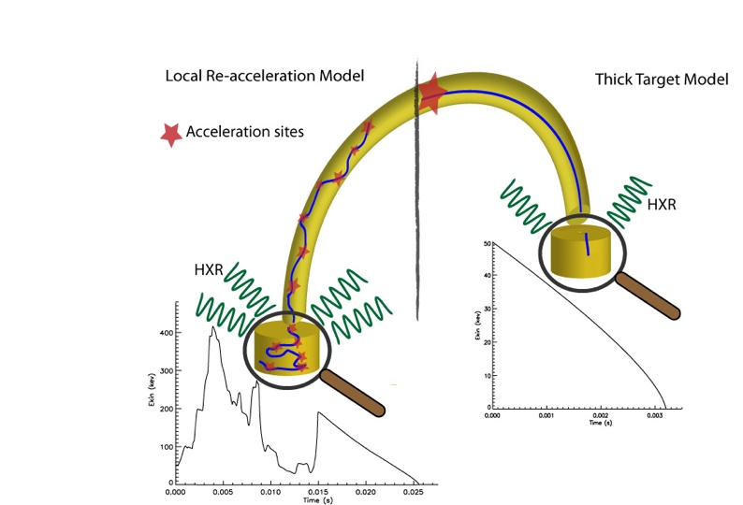
Local Re-acceleration Model LRM
Thick Target Model LRTTM was proposed by Brown, Turkmani, Kontar, MacKinnon and Vlahos (2009 A&A 508,993)
In LRMs electrons are locally confined and continuously re-accelerated, with lifetimes much longer than collisional, radiating HXRs throughout reacceleration volume V.
If net acceleration rates are a signiﬁcant fraction of collisional loss rates, and if electrons are contained in a dense LRM plasma by scattering, the net radiative HXR output per fast electron can be substantially increased over the TTM, and so fast electron number requirements reduced

Slide 13
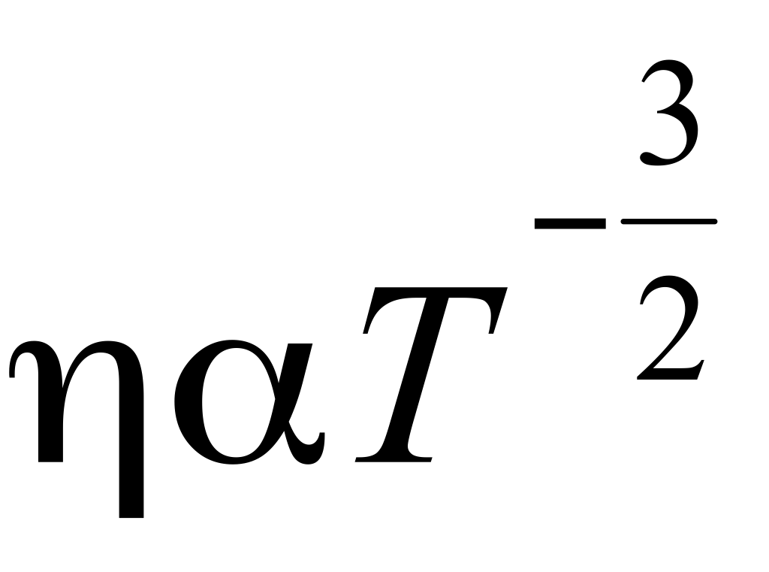
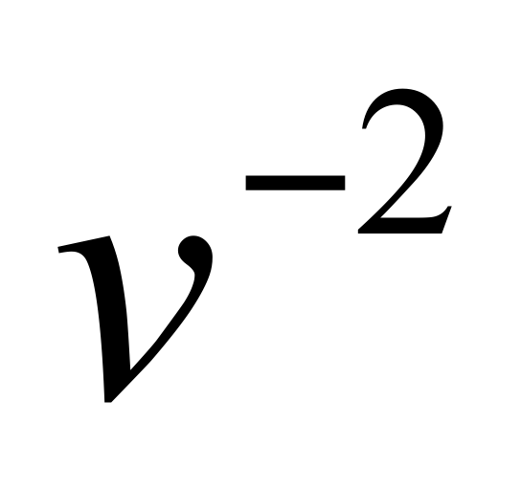
Re-acceleration at the footpoints?
Usually not considered because of the smaller volume, high density and colder plasma
Resistivity is higher at the colder photospher since
The electric field required to offset collisional losses scales with n/T
Within the same region, this electron field drops as which means that a much smaller electric field is needed to accelerate the electrons of the tail of the distribution or electrons initially accelerated at the corona.
The Dreicer field vs Velocity for the Photospher and the Corona
Notes:
1 statvolt=300 volt– 1 statvolt/cm = 300 v/cm= 30000 v/m

Slide 14
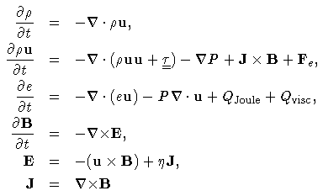
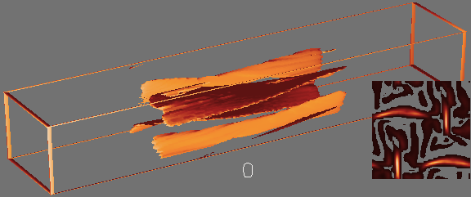
3D MHD experiments of flaring Loops
3D MHD experiment of slender magnetic flux tubes, including density stratifications, the effect of anisotropic heat condition and optical thin radiation.

Slide 15
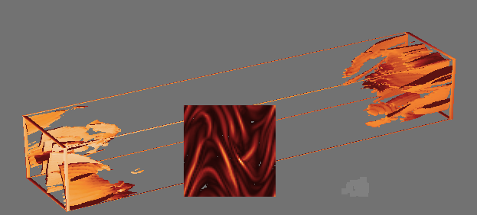
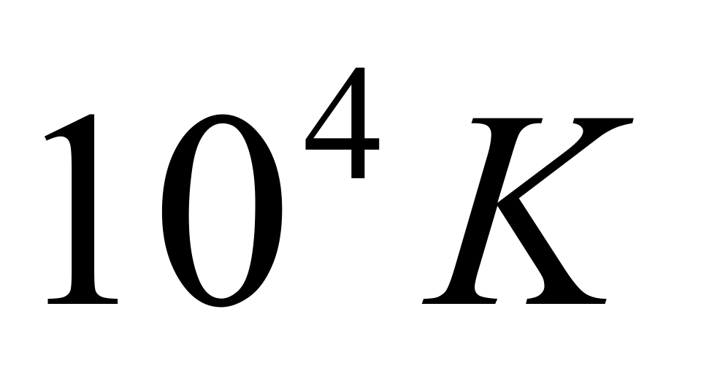
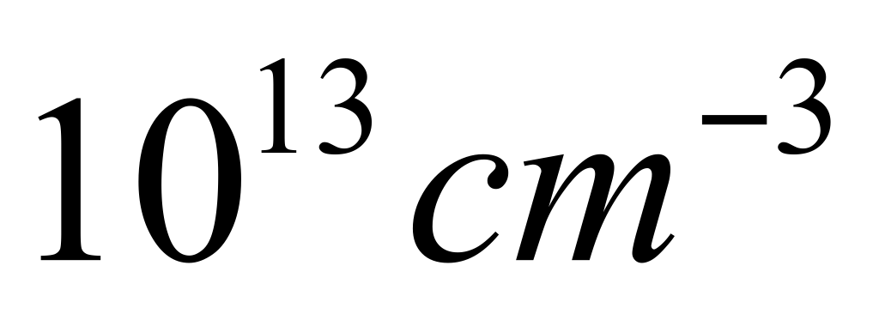
Test particle simulation of LRM
Test particle experiments are carried out using the electric and magnetic fields of the footpoints of stressed coronal loop as a background
Collisions are included:
Temperature: ,density
Only electrons are considered
To avoid complexity, only electrons with similar initial energy are considered every time, for example E*=50 Kev

Slide 16
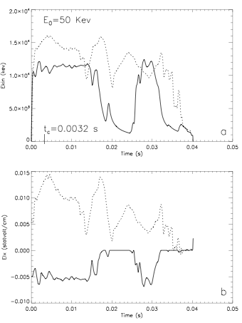
Examples of re-accelerated coronal electron
An example of two re-accelerated coronal electrons which arrive to the chromosphere with an initial energy of E=50 kev, and panle a shows the temporal evolution of kinetic energy of two accelerated electrons. t_c is the collisional time for these electrons and it is marked on the x-axise
Panle b shows the main component of the electric field which these two electrons undergo

Slide 17
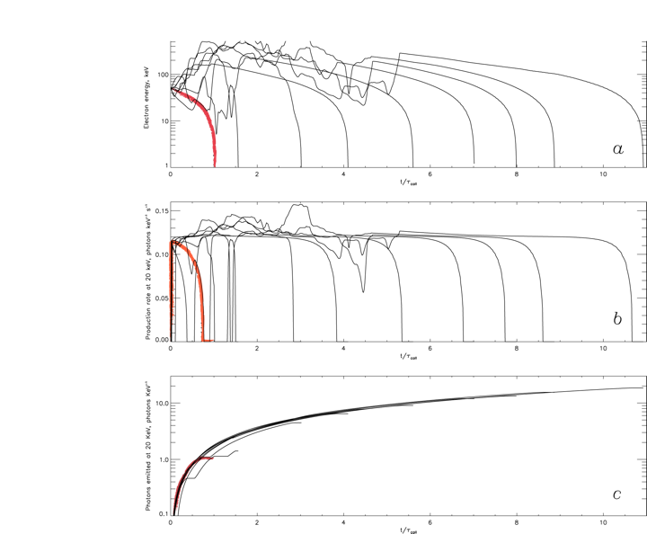
Examples of Electrons with E∗ = 50 keV
Trajectories E(E∗, t)
Relative photon production
rate at 20 keV.
Relative cumulative photon
production
ζ (ǫ , t)dt keV−1 at ǫ = 20 keV

Slide 18
Results
65% of electrons underwent varying amount of re-acceleration
Life time enhancement: up to 20 X, average 5 X
Photon Yield enhancement: average value 10X
eps= 10, 20, 30, 40, 45, 49 Kev
Gain in photon yield= 5, 10, 15, 50, 100, 800

Slide 19
Correlation between the HXR flux and B strength at particular foot point
From Liu et al 2009
Logarithmic HXR flux at 50 keV
vs. the corresponding magnetic field strength for E-FP (diamonds)
and W-FP (plus signs).

Slide 20
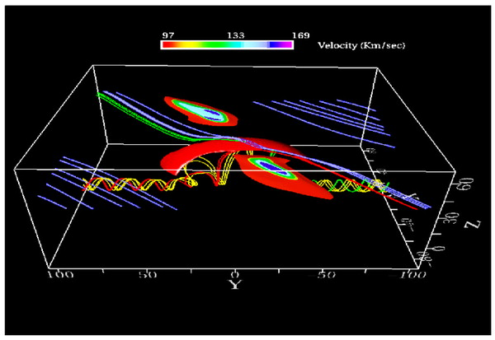
Examples of mechanisms which generate electric field in the Chromosphere
Currents resulting from the interaction between the emerging flux and the pre-existing magnetic field
Galsgaard et al 2004
Notes:
Location and effect of the reconnection taking place at a later time than shown in Fig. 1. The image shows the current sheet as an arch-shaped red isosurface, isosurfaces of the two high-speed jets, and various sets of magnetic field lines.

Slide 21
Examples of mechanisms which generate electric field in the Chromosphere
Electric currents generated by Alfven waves
Goodman and Kazeminezhad 06, 09
When realistic electrical conductivity tensor is included in MHD simulations of chromosphere, a new picture emerges. Magnetic activities then result in more than one current; there is the field aligned current, the Pedersen current (carried by ions), and the Hall current.

Slide 22
Examples of mechanisms which generate electric field in the Chromosphere
Density gradience has been shown to be responsible of generating electric field both in the corona (Vranjes and poedts 2009 ) and the chromosphere (Vranjes and poedts 2006)
The authors show that an alternative source of energy is able to generate such currents, that is the energy provided by the omnipresent gradients of the background plasma parameters (density temperature and magnetic field). This is beyond standard MHD (needs multi component)In collisional plasma: density gradient + magnetic field -->electrostatic drift wave + electromagnetic drift Alfven wave
Density gradient + electrons colliding with ions --> instability of electrostatic drift mode which is coupled to dispersive Alfven mode

Slide 23
Conclusion
Re-acceleration and/or Acceleration at the footpoints! Why not!
Large increase in photon yield is achieved, and reduction in electron number/beam density
Results are independent of the coronal acceleration mechanism

