Slide 1
The effect of turbulent density perturbations on electron transport in solar flares
Iain Hannah
Eduard Kontar, Hamish Reid
University of Glasgow, UK

Slide 2
Introduction & Motivation
RHESSI's HXR observations have challenged the standard interpretation of flare energy release/transport
Difference in spectral index between coronal sources and footpoints
No definitive “dip” in mean electron spectrum
Number of electrons that need to be energised (“number problem”)
Collisional transport (thick target model) is not enough
+non-collisional transport (i.e wave-particle interactions) can help
For dips and spectral indices
But makes the number problem worse........
......is there a way to improve this?
Wave refraction from turbulent perturbations in the background plasma
See Eduard’s talk as well

Slide 3
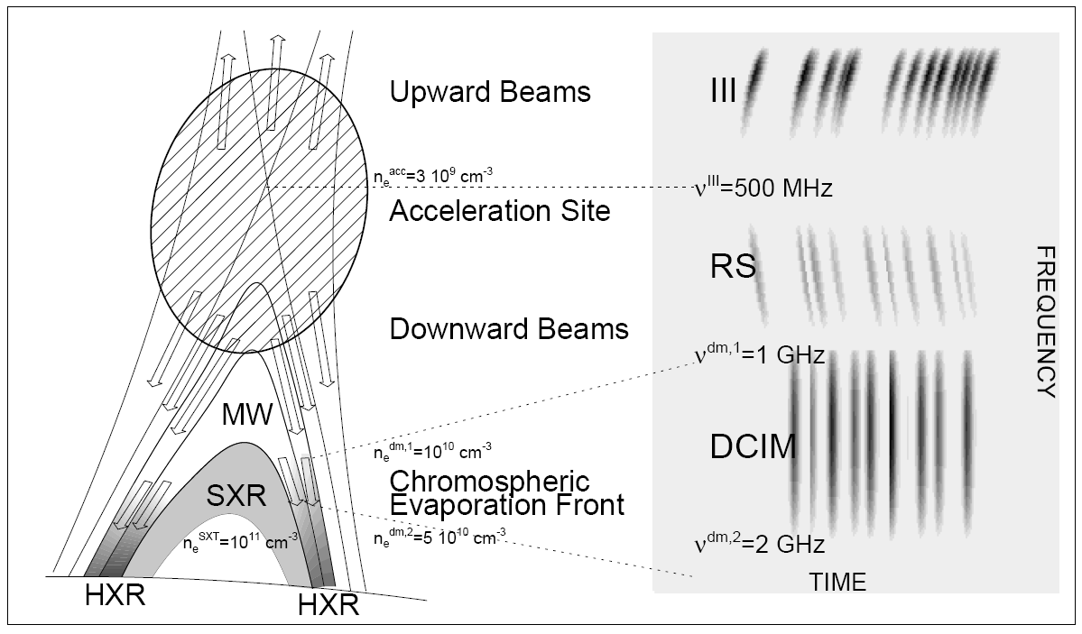
Wave-particle interactions
We are going to consider the background plasma response in form of electron-beam driven Langmuir waves
In addition to Coulomb collisions
This is a non-collisional process occurring faster than collisions
So may have an important effect
Zheleznyakov & Zaitsev 1970
Also get downward radio bursts so know that Langmuir waves are present
Reverse Slope (RS)
e.g. Klein et al 1997, Aschwanden & Benz 1997
etc
Aschwanden & Benz 1997

Slide 4
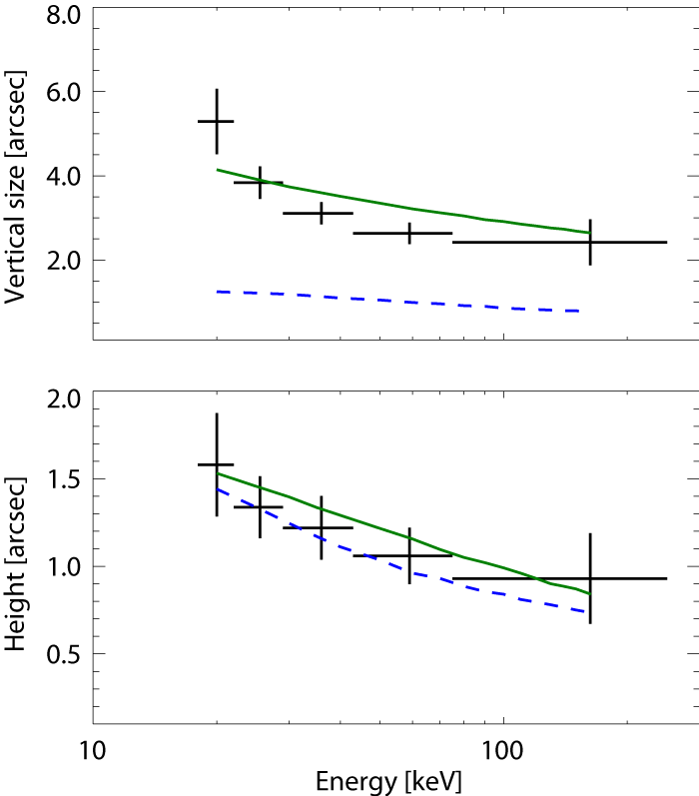
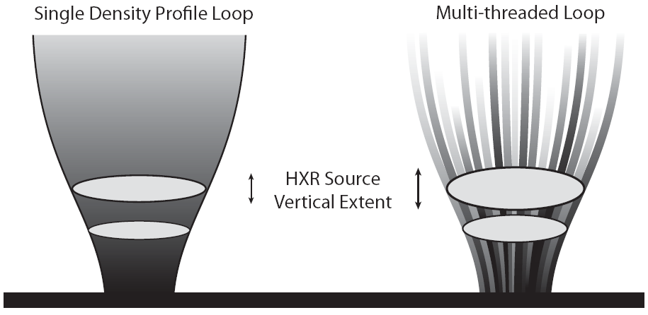
Injected Electron Beam
In the steady-state case Langmuir waves have little effect
i.e. Hamilton & Petrosian 1987
We follow an instantaneously injected electron beam both spatially (1D) and temporally
Modest number of electrons ${10}^{34}$erg
small flare or multiple beams for a larger flare
Justification from Observations:
Often impulsive/bursty
HXR footpoint size cannot be fitted with single coronal density profile
multi-threaded loop (multiple beams)
Kontar et al. 2010
Single Density Profile
Multi-threaded Loop

Slide 5
1D Quasi-linear Relaxation
We are numerically solving
Electron distribution $f(v,x,t)$, Wave energy density $W(v,x,t)$
Coulomb collisions for e⁻ and waves $γ_{Cf}, γ_{Cw}$Landau dampening $γ_{L}$
Spontaneous emission of waves$Sf$
Inhomogeneous background plasma $n(x)$ (so $ω_{p}(x)$):
shift of wave number due to the variation of the local refractive index.
Kontar A&A 2001, 375, 629-637
$$\frac{∂f}{∂t}+v\frac{∂f}{∂x}=\frac{4π^{2}e^{2}}{m^{2}}\frac{∂}{∂v}\left(\frac{W}{v}\frac{∂f}{∂v}\right)+γ_{Cf}\frac{∂}{∂v}\left(\frac{f}{v^{2}}\right)$$
$$\frac{∂W}{∂t}+\frac{3v_{T}^{2}}{v}\frac{∂W}{∂x}+\frac{v^{2}}{L}\frac{∂W}{∂v}=\left(\frac{πω_{p}}{n}v^{2}\frac{∂f}{∂v}−γ_{Cw}−2γ_{L}\right)W+Sf$$
$$L^{−1}=\frac{ω_{p}}{{∂ω_{p}}/{∂x}}$$

Slide 6
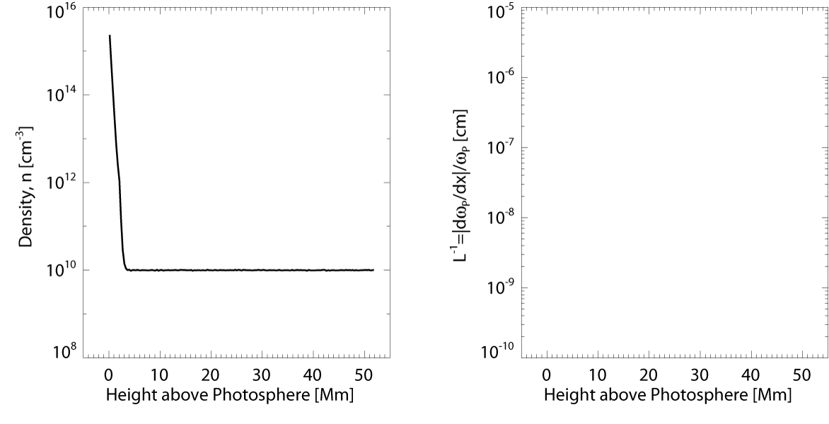
Inhomogeneous Background Plasma
Inhomogeneous background plasma $n\left(x\right)$

Slide 7
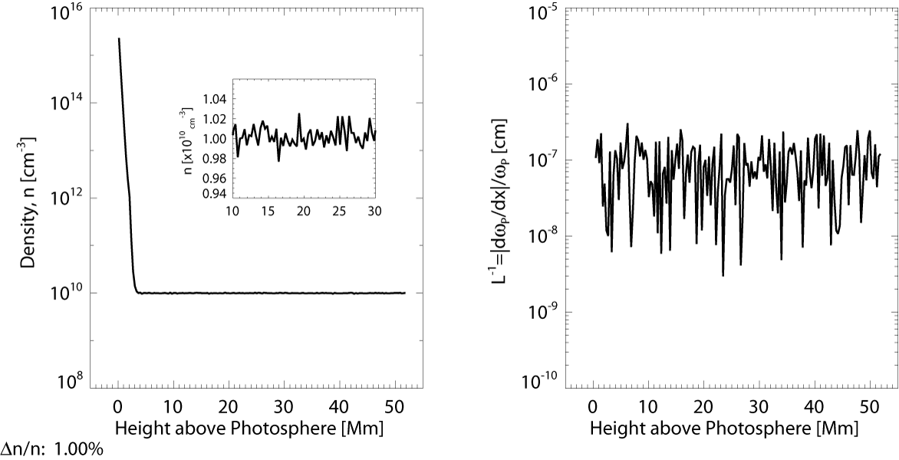
Inhomogeneous Background Plasma
Inhomogeneous background plasma $n(x)$ + turbulent perturbation
1000 perturbations randomly drawn from a $β=5/3$Kolmogorov-type power density spectrum with $Δn/n≈1\%$and wavelengths ${10}^{3.5}<λ<10^{6}$ cm
$$n\left(x\right)=n_{0}\left(x\right)\left[1+C\sum_{i}^{N}{λ_{i}^{β/2}sin\left({2πx}/{λ_{i}}+φ_{i}\right) }\right]$$

Slide 8
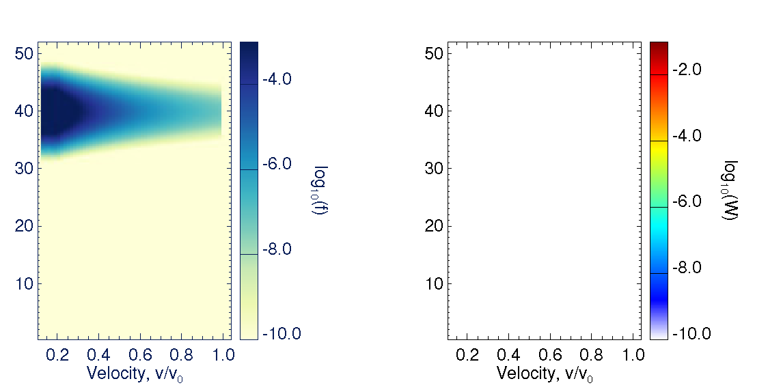
Initial Distribution
Instantaneous injection of power law $−2δ$above cut-off in velocity, gaussian in x-space
Take thermal background of waves, so $W\left(t=0\right)≈0$
$$f\left(v,x,t=0\right)∝n_{B}v^{−2δ}e^{−x^{2}/d^{2}}$$
f(v,x,t=0)
W(v,x,t=0)
E_{C}=15 keV, n_{B}=10⁸cm⁻³, δ=4, d=2x10⁸ cm, T=1MK
v₀=2.6x10¹⁰ cms⁻¹, v_{min}=7v_{T}=2.7x10⁹ cms⁻¹

Slide 9
Coulomb Collisions Only
Similar to thick-target approximation but adds time and spatial dependence
Fastest electrons move down to chromosphere first.
All electrons lose energy to heat background plasma via collisions leaving grid to the left
Left edge is $7v_{T}$
$$\frac{∂f}{∂t}+v\frac{∂f}{∂x}=γ_{Cf}\frac{∂}{∂v}\left(\frac{f}{v^{2}}\right)$$
f(v,x,t=0)

Slide 10
Electron Beam and Waves
Addition of wave-particle interactions although no ∂W/∂v term
Δn(x)≠0 but no wave refraction
f(v,x,t=0)
W(v,x,t=0)

Slide 11
Beam, Waves and ∂W/∂v
All terms, including wave refraction
f(v,x,t=0)
W(v,x,t=0)

Slide 12
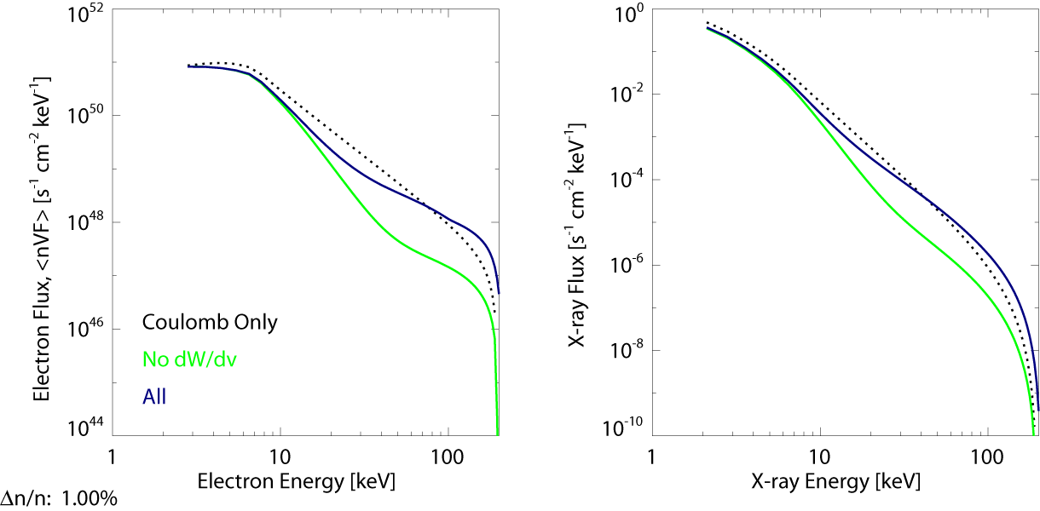
Electron and X-ray Spectra
Spatially integrated and temporally averaged spectra
Need to estimate beam cross- sectional area A to get volume from 1D
Acceleration & more HXR emission when including wave refraction
$$I\left(ε,t\right)=\frac{A}{4πR^{2}}\sum{\left[n(x)\frac{f\left(v,x,t\right)}{m_{e}}Q(ε, E)\right]dEdx}$$

Slide 13
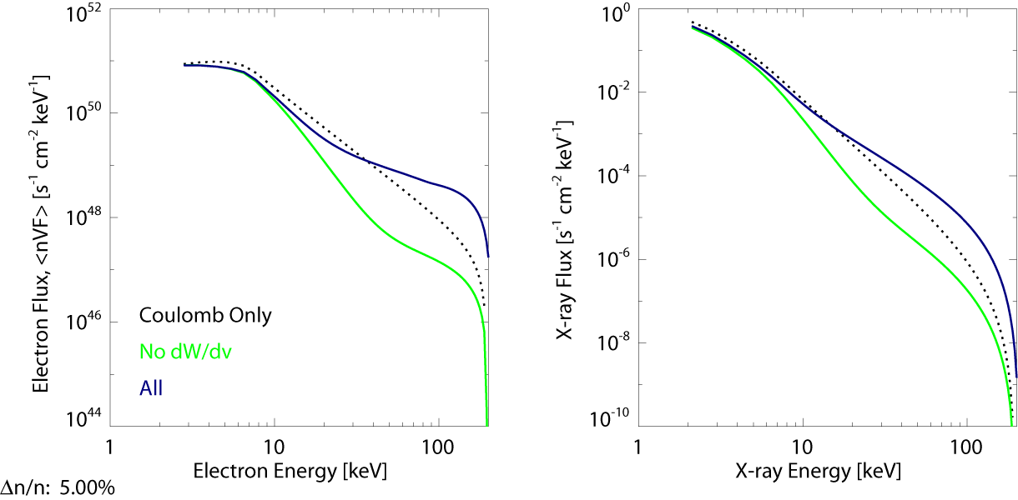
Electron and X-ray Spectra
Spatially integrated and temporally averaged spectra
Need to estimate beam cross- sectional area A to get volume from 1D
Acceleration & more HXR emission when including wave refraction
Higher turbulence/density perturbations greater effect
$$I\left(ε,t\right)=\frac{A}{4πR^{2}}\sum{\left[n(x)\frac{f\left(v,x,t\right)}{m_{e}}Q(ε, E)\right]dEdx}$$

Slide 14
Conclusions & Future Work
The inclusion of Langmuir waves for an instantaneously injected electron beam modifies the electron distribution and hence HXRs
Addition of turbulent density perturbations ($∂n/∂x$) in the background plasma produces more HXR emission than collisional transport
Also see Eduard’s talk
This work is just a step towards a more complete treatment of particle transport in flares
Only 1D, no magnetic field convergence, pitch angle scattering etc
Working on including processes to allow radio emission to be calculated
Use HXR and radio to constrain the processes and model parameters

