Slide 1
Return-Current Losses and their Impact on Solar Flare Emissions
Gordon D. Holman
NASA/Goddard Space Flight Center
The return current neutralizes the current carried by accelerated electrons as they stream from the acceleration region in the corona to and through the hard X-ray source region in the lower transition region and chromosphere.
The return current is primarily carried by cospatial electrons in the thermal plasma.

Slide 2
Why is the Return Current Important?
It allows the electron beam to exist.
It resupplies electrons to the acceleration region.
It directly heats the coronal part of flare loops.
The induced electric field that drives the return current also decelerates the streaming, accelerated electrons. This modifies the electron distribution and, therefore, the hard X-ray emission.

Slide 3
Purpose of this Work
To better understand the impact of return-current losses on solar flare hard X-ray emission
Extend earlier work by Knight & Sturrock (1977), Emslie (1980), Diakonov & Somov (1988), and Litvinenko & Somov (1991) to derive relatively simple analytic expressions for return-current losses alone for comparison with results from more elaborate numerical simulations obtained by Zharkova & Gordovskyy (2006) – “ZG06”

Slide 4
Properties of the ZG06 Electron Distribution Function
Single power law
Low-energy cutoff: E_{LC} = 8 keV
High-energy cutoff: E_{HC} = 384 keV
Pitch angle distribution ∝ exp{−[(μ − 1)/Δμ]²},
where μ is the pitch angle cosine and Δμ = 0.2
The electron distribution is exp{−25} smaller at 90° pitch angle than at 0°. Therefore, a 1-D model should be adequate.

Slide 5
One-Dimensional Model
Assumptions:
  Injected single-power-law electron flux density distribution (electrons s⁻¹ cm⁻² keV⁻¹)
  F(E, x=0) = (δ-1)E_{c}^{δ-1}F_{e0}E^{−δ}
  with low-energy cutoff E_{c}.
  Steady state, return-current electric field strength
  E = ηJ, where η is the classical (collisional) resistivity and J(x) is the current density.
  J(x) = eF_{e}(x), where F_{e}(x) = is the total beam electron flux density (electrons s⁻¹ cm⁻²).
  Electrons are lost from the beam when E = E_{th} = k_{B}T, where T is the ambient plasma temperature.

Slide 6
Results
  The electron flux density distribution at position x is
  F(E,x) = (δ-1)E_{c}^{δ-1}F_{e0}[E+V(x)]^{−δ}
  above a cutoff at Max{E_{th}, E_{c}−V(x)}. V(x) = is the potential drop at distance x. Thus, V(x) behaves as a new low-energy cutoff to the flux density distribution, increasing with distance x.
  The effective cutoff energy does not increase above E_{c} until the critical distance
  x_{rc} = (E_{c} − E_{th})/(eE_{rc0}),
  where E_{rc0} = eηF_{e0} is the electric field strength at
  x = 0 and F_{e0} is the total injected electron flux density. Below x_{c} the total electron flux density is constant (F_{e}(x) = F_{e0} for x ≤ x_{c}).

Slide 7
1-D Results (continued)
  For x >> E_{c}/(δeE_{rc0}), F_{e}(x) = F_{e0}[(δeE_{rc0}/E_{c})x]^{−(δ-1)/ δ}
  Since the resistivity η ≈ constant × T^{−3/2}, until collisional losses become important the return current losses are not sensitive to the plasma density.
  Electron energy as a function of distance is
  E(x) = E₀ − V(x). Therefore, all electrons lose the same amount of energy with distance x.
  For x ≤ x_{rc} , V(x) = eE_{rc0}x
  For x >> E_{c}/(δeE_{rc0}), V(x) = E_{c}[(δeE_{rc0}/E_{c})x]^{1/ δ}

Slide 8
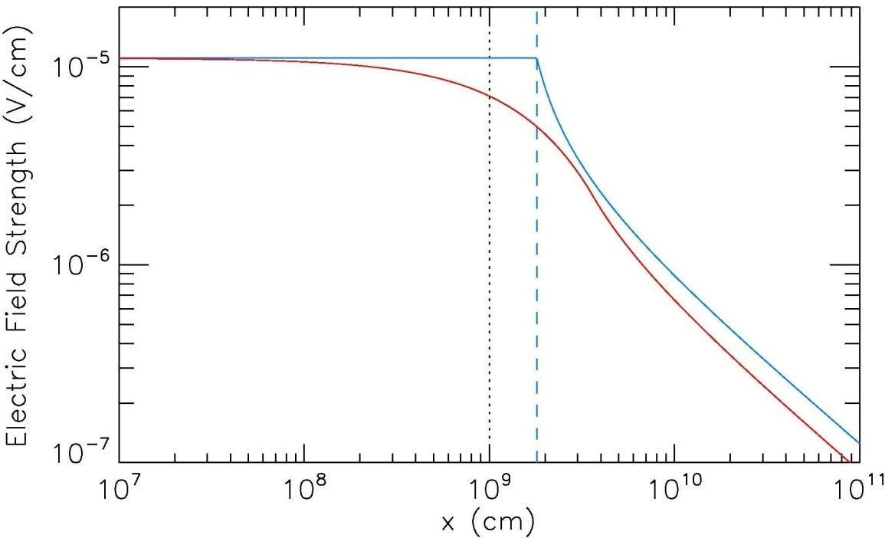
More about the Return-Current Electric Field Strength
Return-current losses decrease at the same time the electric field is having its greatest impact on the electron distribution, since the electric field strength is proportional to the total nonthermal electron flux density. Other losses to the electron distribution, including collisional losses and, in a 2-D model, the scattering of electrons through 90 pitch angle, also decrease the return-current electric field strength.
E_{rc0}
The figure on the right shows the typical change in the electric field strength with distance in the 1-D model with return-current losses only (blue curve) and for an initially isotropic electron pitch angle distribution (red curve).
x_{rc}

Slide 9
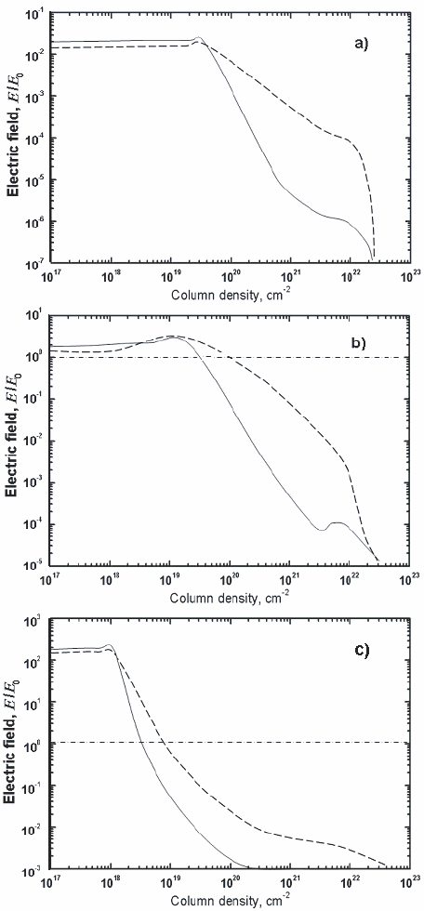
Return-Current Electric Field Strength from Zharkova & Gordovskyy 2006 (ZG06), Fig. 1
δ = 3
δ = 7
10⁸ erg cm⁻² s⁻¹
The electric field strength is normalized to the Dreicer field, E_{D} = 2πe³n lnΛ / (k_{B}T).
It is plotted against column density,
N(x) = ∫n(x)dx.
The dashed curve is for an electron power-law index δ of 3 and the solid curve is for an index of δ = 7.
Results for three initial electron beam energy flux densities P_{e0} are shown: a) 10⁸, b)10¹⁰, and c) 10¹² erg cm⁻² s⁻¹.
3
7
10¹⁰ erg cm⁻² s⁻¹
10¹² erg cm⁻² s⁻¹
7
3

Slide 10
Modeling the ZG06 Electric Field Results
The 1-D model is applied since (1) the electron distribution is exp{−25} smaller at 90° pitch angle than at 0° and (2) the electric field structure vs. column density computed by ZG06 shows the sharp drop off characteristic of the 1-D model.
Collisional losses should affect the electric field strength at column densities N ≥ E_{c}²/2K ≈ 8²/(6 × 10⁻¹⁸) = 1 × 10¹⁹ cm⁻². The results in panel (c) are modeled with return-current losses only since the evolution before N = 10¹⁹ cm⁻² should be unaffected by collisional losses.
From Fig. 1c, N_{rc} ≡ n⋅x_{rc} ≈ 1 × 10¹⁸ cm⁻² and E_{rc}/E_{D} ≈ 150. These two equations together determine the plasma density n and temperature T. For E_{th} > 0, no solution could be found! Setting E_{th} = 0, these equations give T = 600 MK and n = 7 × 10⁷ cm⁻³, extreme values, even for the flaring corona!

Slide 11
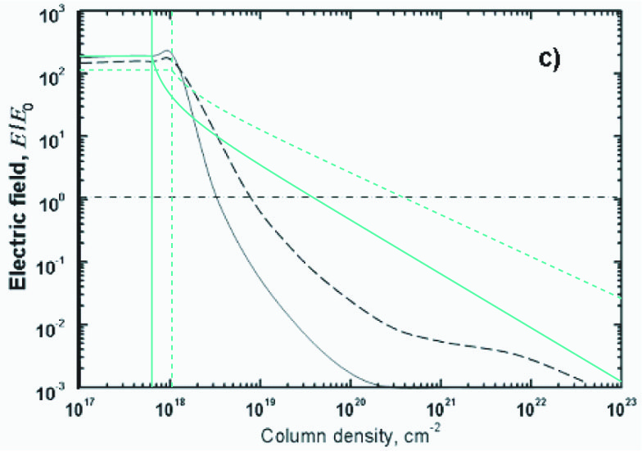
Comparison of Analytical and Numerical Models for E/E_{D}
P_{e0} = 10¹² erg cm⁻² s⁻¹
In the analytical model, n & T are taken to be constant with
n = 7 × 10⁷ cm⁻³ & T = 600 MK.
3
7
3
7
N_{rc}
7
3

Slide 12
Comparison of Analytical and Numerical Models for E/E_{D}
P_{e0} = 10¹² erg cm⁻² s⁻¹
Exponential downward increase in density, decrease in temperature.
n₀ = 7.5 × 10⁷ cm⁻³
T₀ = 3,000 MK
L_{n} = 1 × 10¹⁰ cm
L_{T} = 3 × 10⁹ cm
3
7
3
7
N_{rc}
7
3

Slide 13
X-ray Spectra
Comparison of Computed Spectra with ZG06
The Electron Distribution Function
1-D model
Assume V(x) is approximately constant in the thick-target emission region (≡ V_{TT}). This is likely to be correct for case (c) addressed above (P_{e0} = 10¹² erg cm⁻² s⁻¹).

Slide 14
Comparison of Computed Spectra with ZG06
P_{e0} = 10¹² erg cm⁻² s⁻¹
= 7
V_{TT} = 14 keV
= 3
V_{TT} = 130 keV
Thick-target bremsstrahlung spectra computed with F(E) ∝ (E+V_{TT})^{−δ}, normalized to the flux at 4 keV. These are compared to spectra from Fig. 10b of ZG06 for δ = 3 (diamonds) and δ = 7 (squares). The best fits to the ZG06 spectra determined the values for V_{TT}.

Slide 15
Interpretation of the Spectral Results
The spectra from the numerical model of ZG06 are will fitted by the spectra computed from the 1-D analytical model at and below 100 keV.
Agreement is not good above 100 keV, however, especially for δ = 3. The spectrum for δ = 3 falls off rapidly above 100 keV in the analytical model because the value of V is high in the thick-target region, where the high-energy cutoff has decreased to 384 keV – 130 keV = 254 keV. The ZG06 spectrum does not show a cutoff significantly below the initial value of 384 keV.
This decrease in the value of the high-energy cutoff with increasing potential drop V qualitatively explains why the spectral index at 100 keV becomes somewhat larger as the value of P_{e0} increases (seen in Fig. 11 of ZG06).

Slide 16
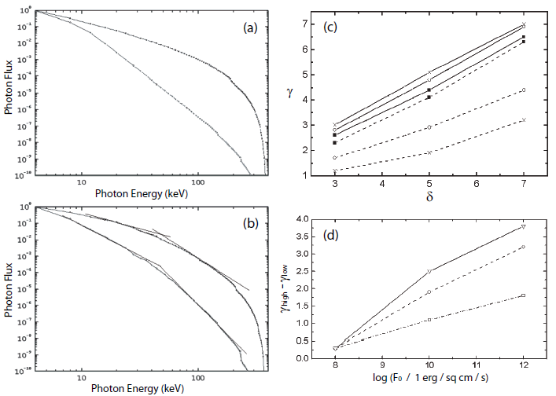
Spectra and Spectral Indices from ZG06
δ = 3
γ_{high}
δ = 7
γ_{low}
10⁸
10¹⁰
P_{e0} = 10⁸ erg cm⁻² s⁻¹
10¹² erg cm⁻² s⁻¹
20 keV
δ = 7
100 keV
δ = 5
δ = 3
P_{e0} = 10¹² erg cm⁻² s⁻¹

Slide 17
Potential Drop V vs. Column Density N from the 1-D Model with Constant n & T
384 keV
E_{HC}
130 keV
V_{TT}(δ = 3)
Large difference in V_{TT} for δ = 3
δ = 3
δ = 7
14 keV
V_{TT}(δ = 7)
8 keV
E_{LC}
Collisional
Losses
Thick-Target Region
Notes:
Plotted in the following frame is the potential drop (green curves) for the same 1-D model used above to model the return-current electric field. The dotted red curve for collisional losses shows that the thick-target region ranges in column density N from approximately 1 × 10¹⁹ cm⁻² to 2 × 10²² cm⁻².
The analytical results are in qualitative agreement with the values for V_{TT} deduced from the fits to the ZG06 spectra in that V_{TT} for δ = 3 is expected to be higher than for δ = 7. Quantitatively, the value of V(N) at the beginning of the thick-target region is close to the value of 14 keV deduced for δ = 7, but much less than the value of 130 keV deduced for δ = 3.
In the analytical model, V is not approximately constant in the thick-target region as assumed in fitting the ZG06 spectra, but increases as x^{1/δ} for x >> x_{rc}. The analytical model, however, does not account for collisional losses, and the increasing density and decreasing temperature of the flare plasma with increasing N(x).

Slide 18
Conclusions
The simple analytical model does an excellent job of explaining the qualitative features of return-current losses.
Substantial quantitative differences between the analytical and numerical model results indicate that quantitative comparisons of simplified numerical model computations with analytical and semi-analytical model results now need to be pursued.

