Slide 1
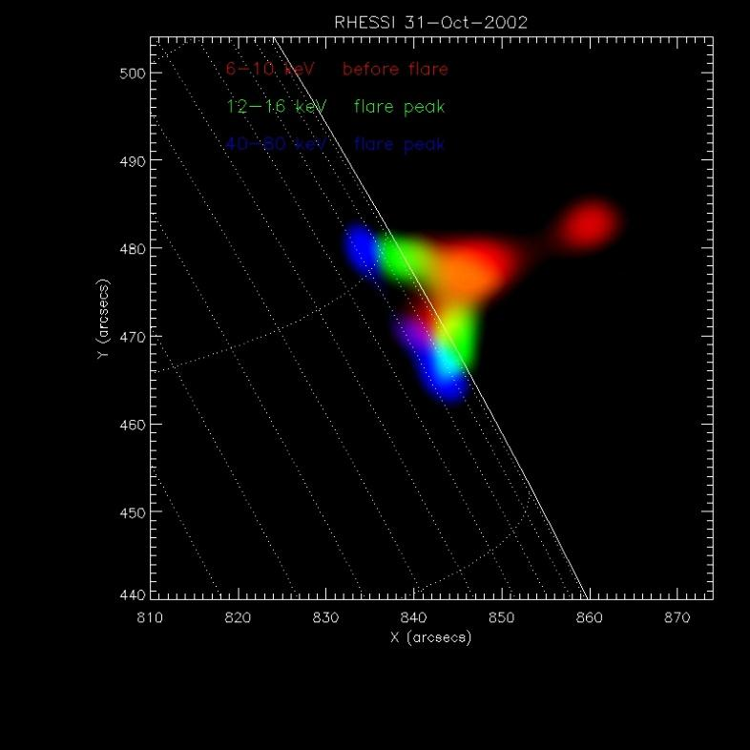



Flare HXR Spectral Breaks
Nonuniform Ionization Thick-target
and
Density Structure in Flaring Loop
Yang Su NASA, CUA, PMO
yang.su@nasa.gov
Gordon D. Holman NASA
Brian R. Dennis NASA

Slide 2
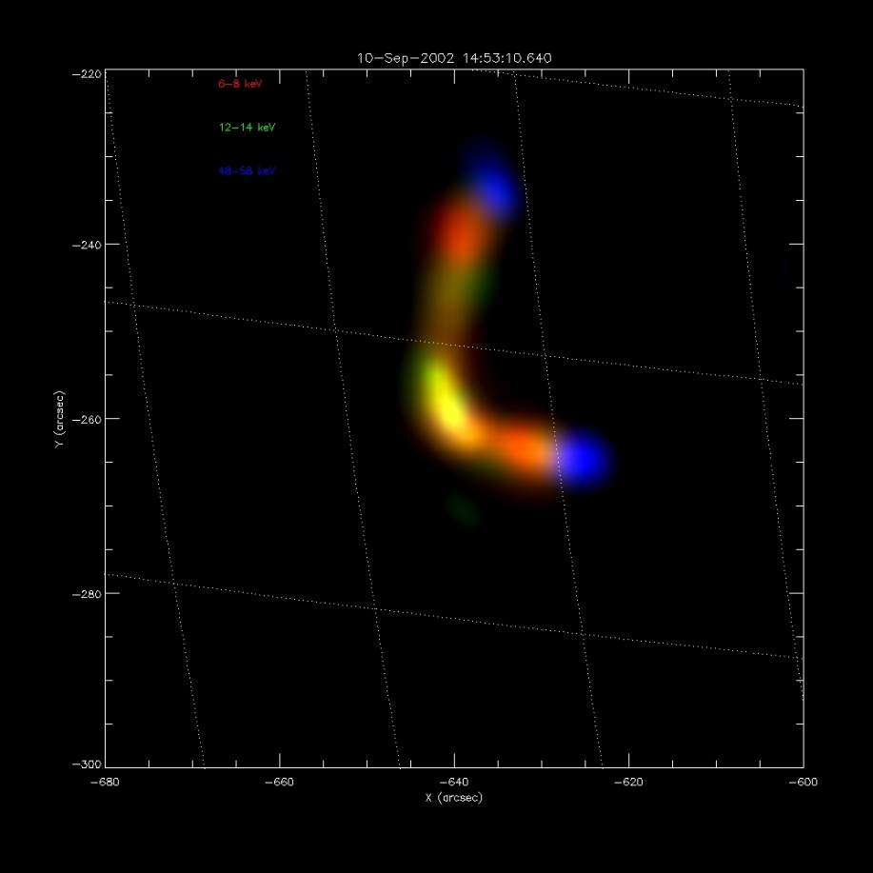
Appetizer
RED : Low energy
Green:
Blue: High energy

Slide 3
Menu
Nonuniform ionization (NUI) thick target and photon spectral breaks (turn over?)
Evidence for the full spectral features of NUI
Density distribution along the flare loop and its time evolution

Slide 4
Dish 1/3 NUI
Solar flare HXR spectra
  often have a spectral break (turn over?) that evolves with time (Dulk et al. 1992; Lin & Schwartz 1987)
  break energy: typically between ~50 and 150 keV
Spectral breaks are important to understand
  acceleration mechanisms
  electron propagation and energy losses
  relationships between flare X-ray sources, radio sources, and particles

Slide 5
Dish 1/3 NUI
Processes that affect the spectra directly:
  Instrumental effects, such as pulse pile-up (Smith et al. 2002) and non-solar background counts
  Additional components, such as:
    Albedo photons reflected by photosphere (Kontar et al. 2006; Kontar & Brown 2006; Zhang & Huang 2004)
    Emission from thermal plasma

Slide 6
Dish 1/3 NUI
Processes that affect the photon spectra indirectly through features in the distribution of the accelerated electrons:
  Non-power-law electron distribution from the acceleration process, e.g.
    a double power-law electron distribution
    a low-energy cutoff (Gan et al. 2002; Sui et al. 2007)
    a high-energy cutoff (Holman 2003)
  An anisotropic electron pitch-angle distribution (Petrosian 1973; Massone et al. 2004)
  Beam-plasma instability (Holman et al. 1982; Melrose 1990)
  Return current energy losses (Knight & Sturrock 1977; Zharkova & Gordovskyy 2006)
  Nonuniform target ionization (Brown 1973; Brown et al. 1998; Kontar et al. 2002)

Slide 7

Dish 1/3 NUI
x(N)=$\left\{\begin{aligned}1 N≤N∗ \\ 0 N>N∗\end{aligned}\right.$
Nonuniform target ionization
Electron energy losses are lower in un-ionized or partially ionized plasma than in fully ionized plasma (Brown 1973),
where x(N) is the ionization rate, E is electron energy and N is column density.
We use the bremsstrahlung cross section from Haug, which closely approximates the full relativistic Bethe–Heitler cross section instead of the Kramers approximation.

Slide 8
Dish 1/3 NUI
Why do we need NUI
Thick Target assumes that the non-thermal electrons injected into a fully ionized target lose all their energy due to Coulomb collisions and also produce bremsstrahlung X-ray emission (Brown 1971).
In reality, high-energy electrons can penetrate into the lower atmosphere that is colder and un-ionized
Therefore, the nonuniform ionization thick-target model (NUI) was presented (Brown 1973, Kontar et al. 2002, Su et al. 2009).

Slide 9

Dish 1/3 NUI
Effective column density M:
E₀²= 2K’M=2K’$\int_{0}^{N}{\left(λ+x\left(N\right)\right)}dN$
Relation between M and column density N :
M=$\left\{\begin{aligned}\left(λ+1\right)N N≤N∗ \\ λN+N∗ N>N∗\end{aligned}\right.$

Slide 10
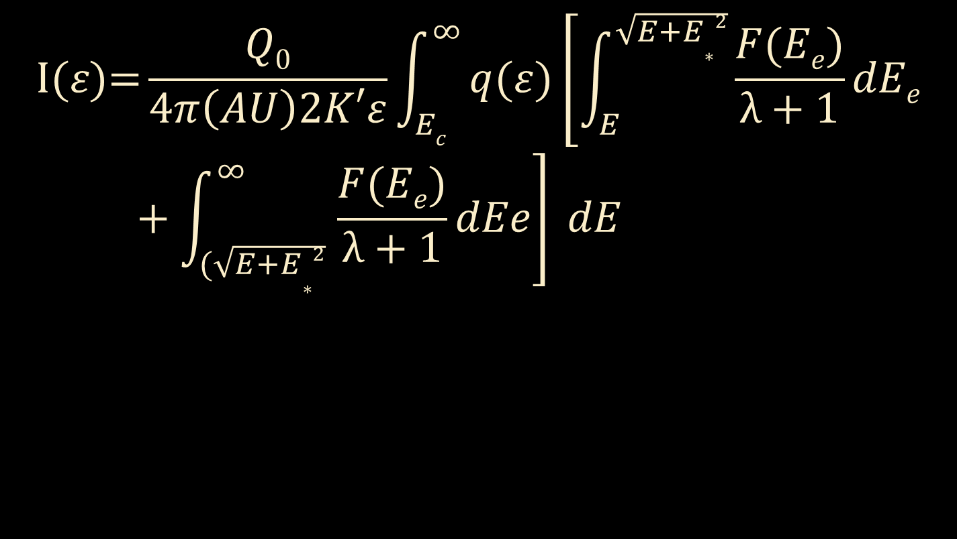
Dish 1/3 NUI
$$\text{I}\text{(}ε\text{)=}\frac{Q0}{4π\left(AU\right)2K′ε}\int_{Ec}^{∞}{q(ε)\left[\int_{E}^{\sqrt{E+E∗2}}{\frac{F(Ee)}{λ+1}dEe}+\int_{(\sqrt{E+E∗2} }^{∞}{\frac{F(Ee)}{λ+1}dEe}\right] }dE$$

Slide 11
Dish 1/3 NUI
Comparison of two thick target models:
Fully Ionized target and Nonuniform ionization target

Slide 12
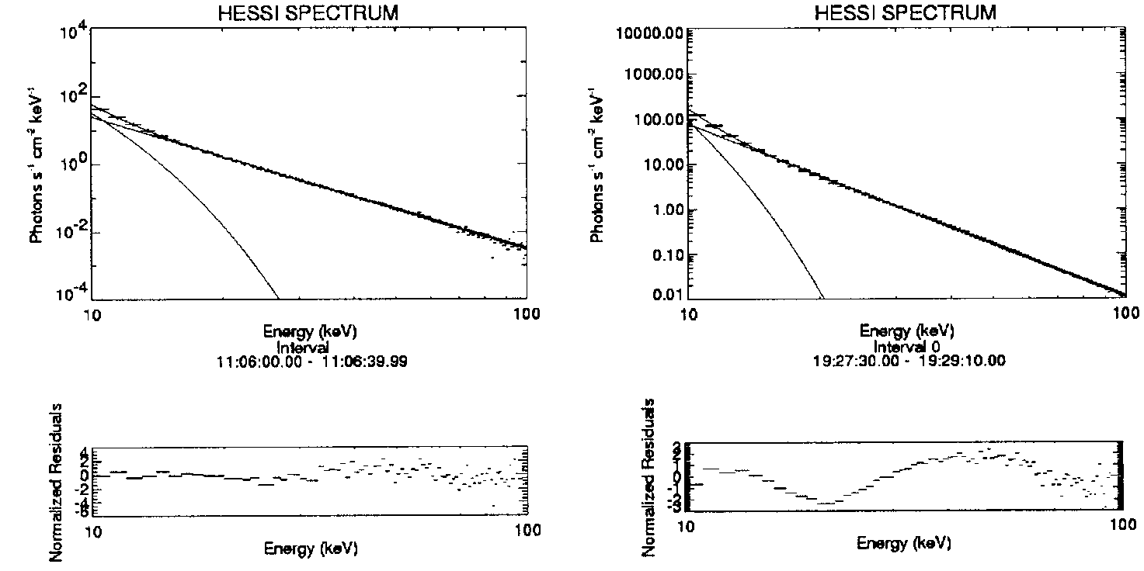
Dish 1/3 NUI

Slide 13
Dish 1/3 NUI
Monte Carlo Method (available in OSPEX)
to determine the uncertainty on each fit parameters
Get best-fit parameters by fitting the measured count rate spectra
Add background to the expected count flux (model flux) and use the Monte Carlo method to randomly vary the total counts in each energy bin following a Poisson distribution.
The new count rate spectrum is fitted again to get new parameters.
Repeat steps 1-3 for 2000 times to obtain a probability distribution for each parameter.
Find the 95% confidence interval of the distribution (~4σ range).

Slide 14
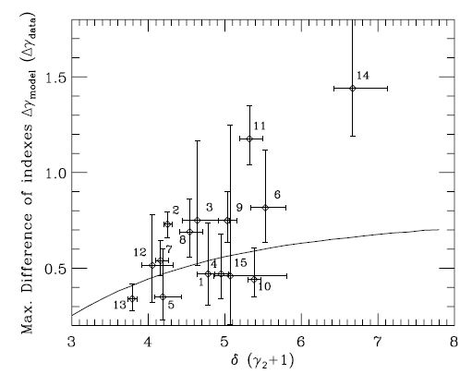
Dish 1/3 NUI
The upper limit ∆γ_{model} =γ_{max}-γ_{min} as a function of δ (the solid line)
an upper limit between ∼0.2 and 0.7 that depends on the power-law index δ
∆γ_{data} =γ₂-γ₁

Slide 15
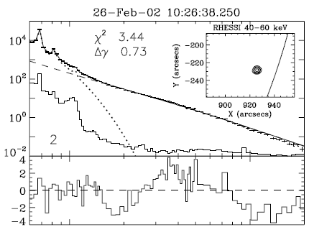
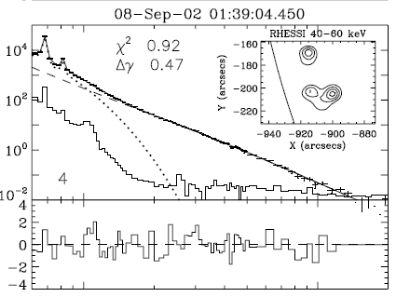
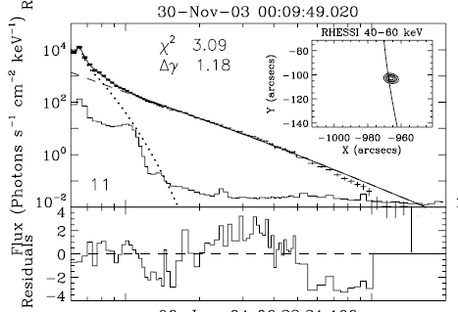
Dish 1/3 NUI
Three examples
poor χ² and systematic variations in residuals

Slide 16
Dish 1/3 NUI
RHESSI flare sample
2002 February 12 - 2004 December 31. Non-solar and particle events were excluded.
12-25 keV count rate > 300 counts s⁻¹ detector⁻¹. the 50-100 keV count rate required to be at least 3σ above the background count rate.
Radial distance > 927″ from disk center (>~ 75 degrees longitude at the solar equator). This minimizes the impact of albedo on the X-ray spectrum (Kontar et al. 2006)
Detector corrected count rate live times> 90%. This minimizes the impact of pulse pile-up (Smith et al. 2002; Kašparová et al. 2007).
This gave a final sample size of 20 flares.

Slide 17
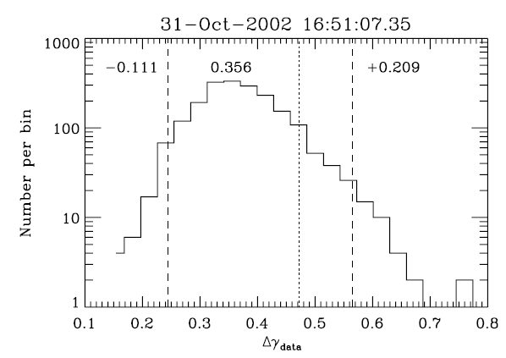
Dish 1/3 NUI
Example of distribution of Δγ_{data}

Slide 18
Dish 1/3 NUI
Photon spectral index γ for five models with δ=4

Slide 19
Dish 1/3 NUI
There is an upper limit (between ∼0.2 and 0.7) on ∆γ_{data}, which depends on δ.
In 20 flares
  5 have single power-law , 15 have spectral break
  ∆γ_{data}: 0.34 - 1.45
  E*: 31 - 107 keV
At least 6 flares can not be explained by nonuniform ionization alone.
All the four flares that have a single source show a spectral break with ∆γ_{data} between 0.5 and 1.2.
All the five flares which do not show a spectral break have at least two sources.
A linear function does not give a better fit (for current data).

Slide 20
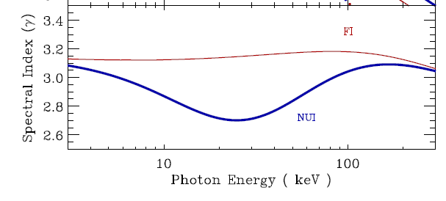
Dish 2/3 Evidence For Both breaks
The upward break usually can not be observed.
When can we see the upward break?
  δ is large (electron distribution power-law is steep)
  E* is large enough
  Thermal emission is weak

Slide 21
Dish 2/3 Evidence For Both breaks
GOES X1.2 class flare
31 Oct. 2002 16:51:08 UT
Intervals 1-6 (8 s each)
It has the largest E* (107.2 keV) in the sample of 20 flares (Su et al. 2009).

Slide 22
Dish 2/3 Evidence For Both breaks
Time evolution of E*
Column density of fully ionized plasma increased with time

Slide 23
Dish 2/3 Evidence For Both breaks

Slide 24
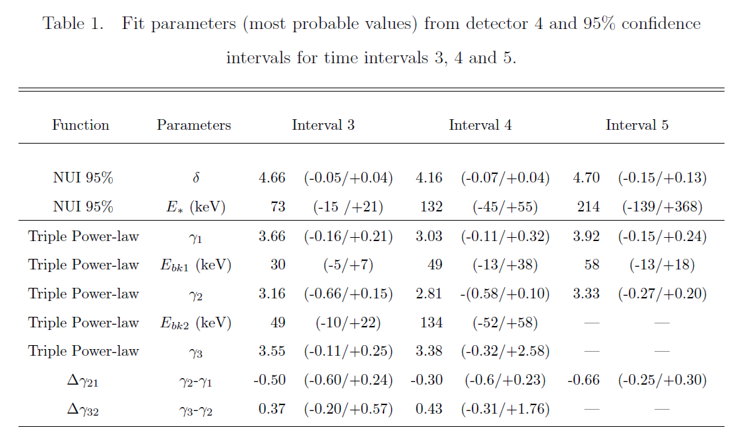
Dish 2/3 Evidence For Both breaks

Slide 25
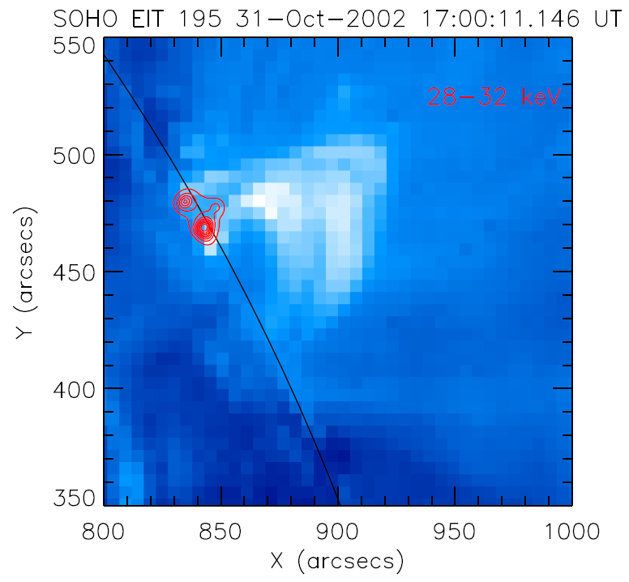
Dish 2/3 Evidence For Both breaks
Decay phase, EIT 195

Slide 26
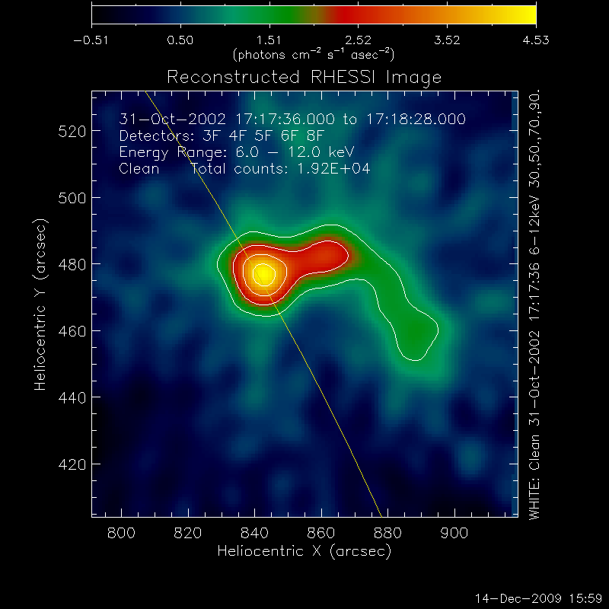
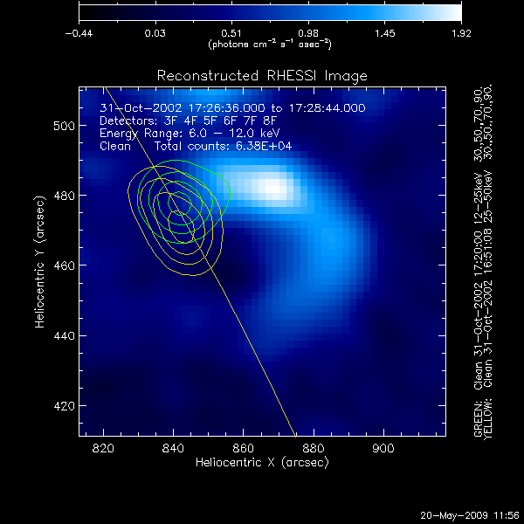
The 6-12 keV images at 17:17 UT and 17:26 UT
Dish 2/3 Evidence For Both breaks

Slide 27
Dish 2/3 Evidence For Both breaks
Interval 3:
  Upward break at 30 keV and downward break at 49 keV
  Single T : 21 MK
  E* is about 65 keV.
Interval 4:
  Upward break at 49 keV and downward break at 134 keV
  Two T : 19 MK, 41 MK
  E* is about 117 keV
Interval 5:
  Upward break at 58 keV
  The downward break moved out of the observation range.
  Two T : 15 MK, 41 MK
  E* is about 214 keV.
The column density N* continued to increase during the HXR peak and the spectral index followed a soft-hard-soft time evolution.

Slide 28
Dish 3/3 Density Distribution
Spectra for upper source and lower source (at depth E_{R})
Ratio of lower source and upper source (Lower/Upper)
N_{R}=2.26×10¹⁷ E_{R}²
  (E_{R} in keV, E_{R} < E*)
Occulted flare
and the upper source

Slide 29
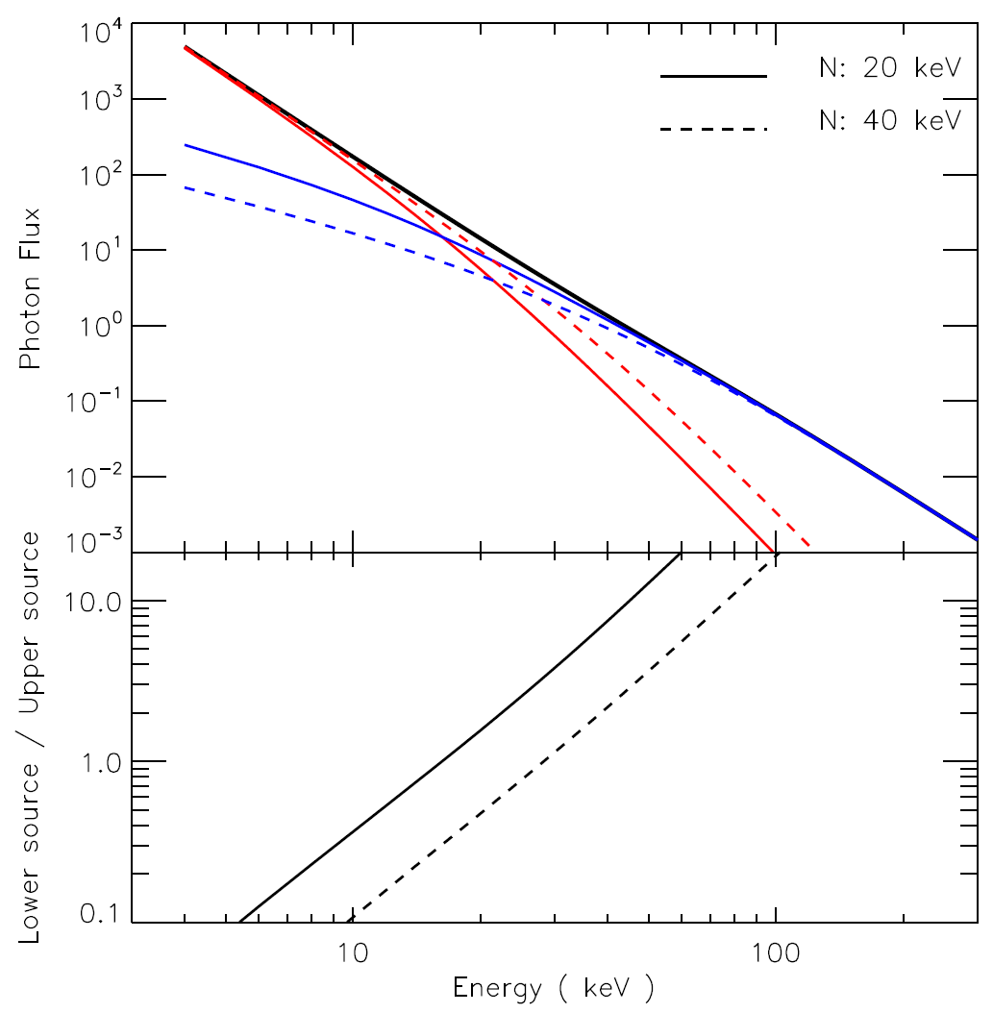
Dish 3/3 Density Distribution
e⁻
x=1
E_{R}
E*
x=0

Slide 30
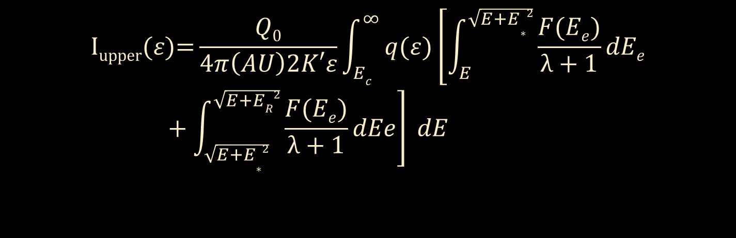

Dish 3/3 Density Distribution
For E_{R} < E*
$$\text{I}\text{upper}\text{(}ε\text{)=}\frac{Q0}{4π\left(AU\right)2K′ε}\int_{Ec}^{∞}{q(ε)\left[\int_{E}^{\sqrt{E+ER2}}{\frac{F(Ee)}{λ+1}dEe}\right] }dE$$
For E_{R} > E*
$$\text{I}\text{upper}\text{(}ε\text{)=}\frac{Q0}{4π\left(AU\right)2K′ε}\int_{Ec}^{∞}{q(ε)\left[\int_{E}^{\sqrt{E+E∗2}}{\frac{F(Ee)}{λ+1}dEe}+\int_{\sqrt{E+E∗2} }^{\sqrt{E+ER2}}{\frac{F(Ee)}{λ+1}dEe}\right] }dE$$

Slide 31
Dish 2/3 Evidence For Both breaks
Explanations for upward break
  An additional thermal component at high temperature.
    a temperature of 51, 71 and 89 MK would be needed for interval 3, 4 and 5, respectively, to explain the upward break.
  A combination of two or more nonthermal spectral components with different slopes.
    the sum of spectra from two or more sources with different spectral indexes
    the rapid changing spectra with time that have different spectral indexes at different sub time intervals within the integration time.
  Acceleration mechanism
  Nonuniform ionization in the thick target region.

Slide 32
Dish 3/3 Density Distribution
Previous methods
Emslie and Machado 1987, Veronig and Brown 2004, and Liu et al. 2009
Brown et al. 2002 and Ashwanden et al. 2002.
  Exponential density distribution
Prato et al. 2009
  Power-law density distribution
One has to assume a density distribution first.

Slide 33
Dish 3/3 Density Distribution
Use the flux ratios of the two sources at different energies

Slide 34
Dish 3/3 Density Distribution
Fit results for three E_{R}
Wider energy bins

Slide 35
Dish 3/3 Density Distribution
Direct fit to the spectra from two sources.
E_{R} -> N_{R} -> Densities (n)
Notice the flattening in the spectra of lower source

Slide 36
Dish 3/3 Density Distribution
1.1×10¹¹, 3.5×10¹¹ and 1.7×10¹² cm⁻³ at the depth of 4.7, 7.1 and 8.5 Mm below the top of the loop ,respectively.

Slide 37
Dish 3/3 Density Distribution
Assumed power-law density distribution

Slide 38
Dish 3/3 Density Distribution
Assumed double power-law density distribution

Slide 39
Dish 3/3 Density Distribution
30-34 keV for interval 2—6 , D1-D8

Slide 40
Dish 3/3 Density Distribution
Ratio VS Depth
Data
Ratio VS Column density
Model

Slide 41
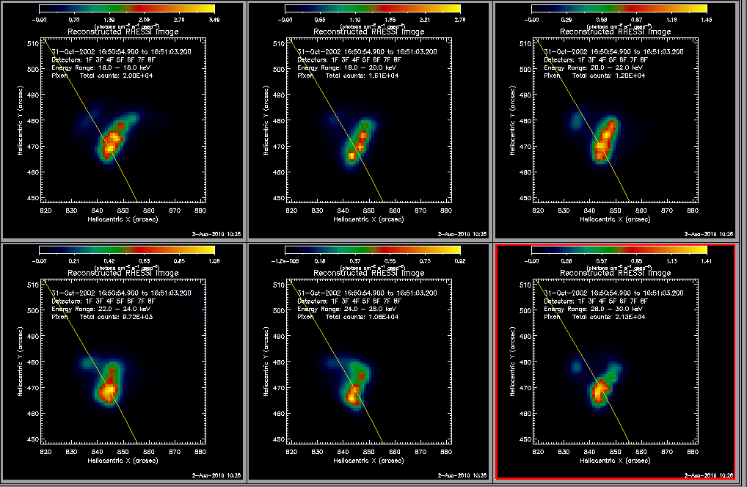
Dish 3/3 Density Distribution
Interval 3, before peak

Slide 42
Dish 3/3 Density Distribution
Interval 3 as example

Slide 43
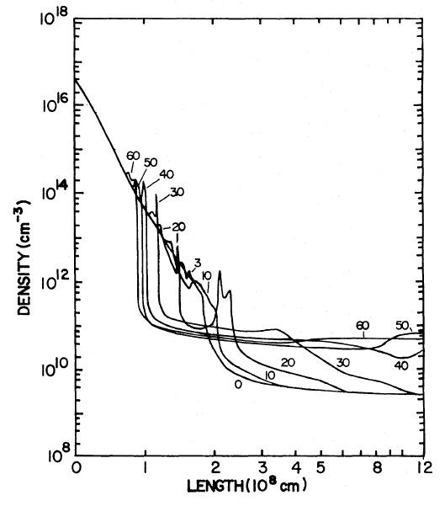
Dish 3/3 Density Distribution
Density distribution and time evolution
Emslie and Nagai 1985

Slide 44
Dish 3/3 Density Distribution
Log-log plot of density-depth distribution

Slide 45
Dish 3/3 Density Distribution
Advantages:
  No need to assume the density distribution.
  Can obtain results from single image.
  Can improve results using images in multiple energy bands.
  Takes nonuniform ionization into account.
Disadvantages:
  Need good images (with extended source structure)
  May need good imaging spectroscopy to get electron distribution

Slide 46
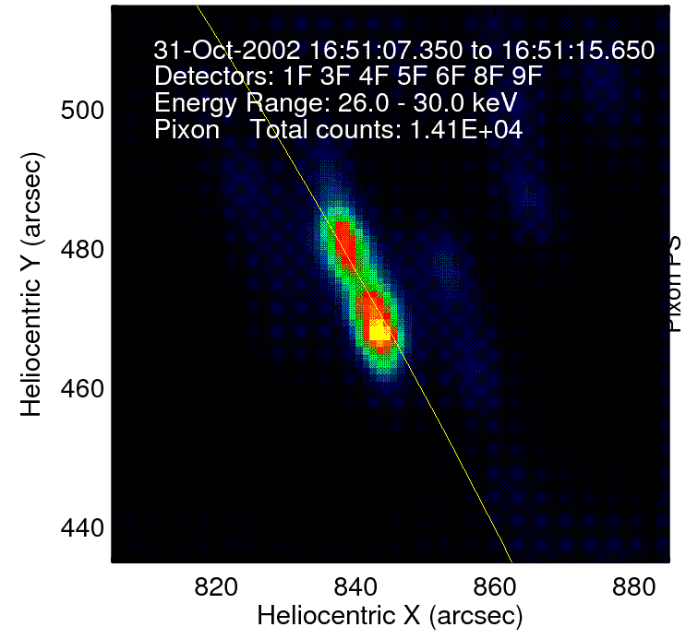
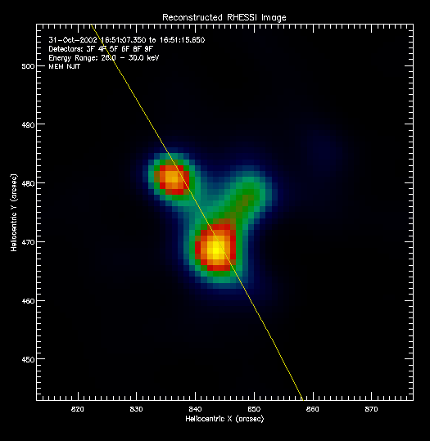
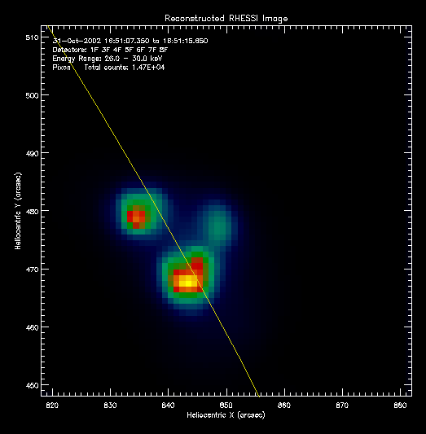
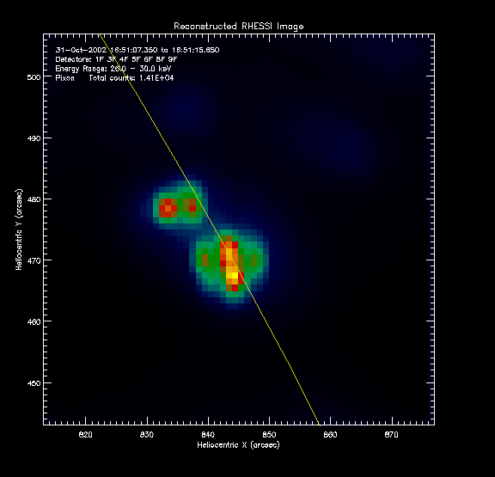
Other stuff
Pixon D1-D9 MEM D3-D9 Pixon D1-D9
Variable flux correction on off
Image center can change the structure

Slide 47
