Slide 1
Elemental Abundances MESSENGER SAX & RHESSI
Brian Dennis
31 October 2012

Slide 2
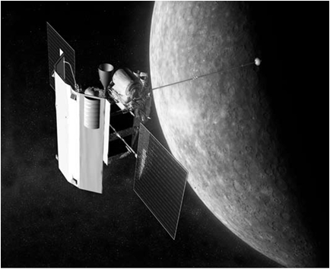
Mercury MESSENGER Solar Assembly for X-rays (SAX)
Si-PIN solid-state
300 µm thick
1 to 10 keV
~300 eV resolution at 6 keV
0.12 mm²
3 x 25 µm Be foils
Mounted on sunshade

Slide 3
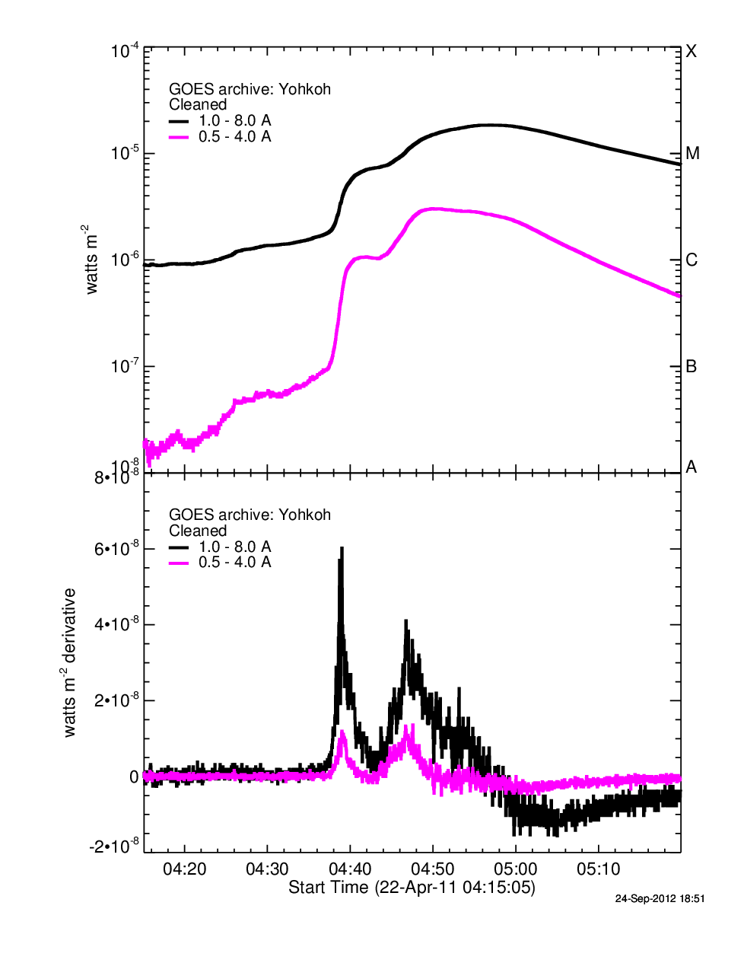
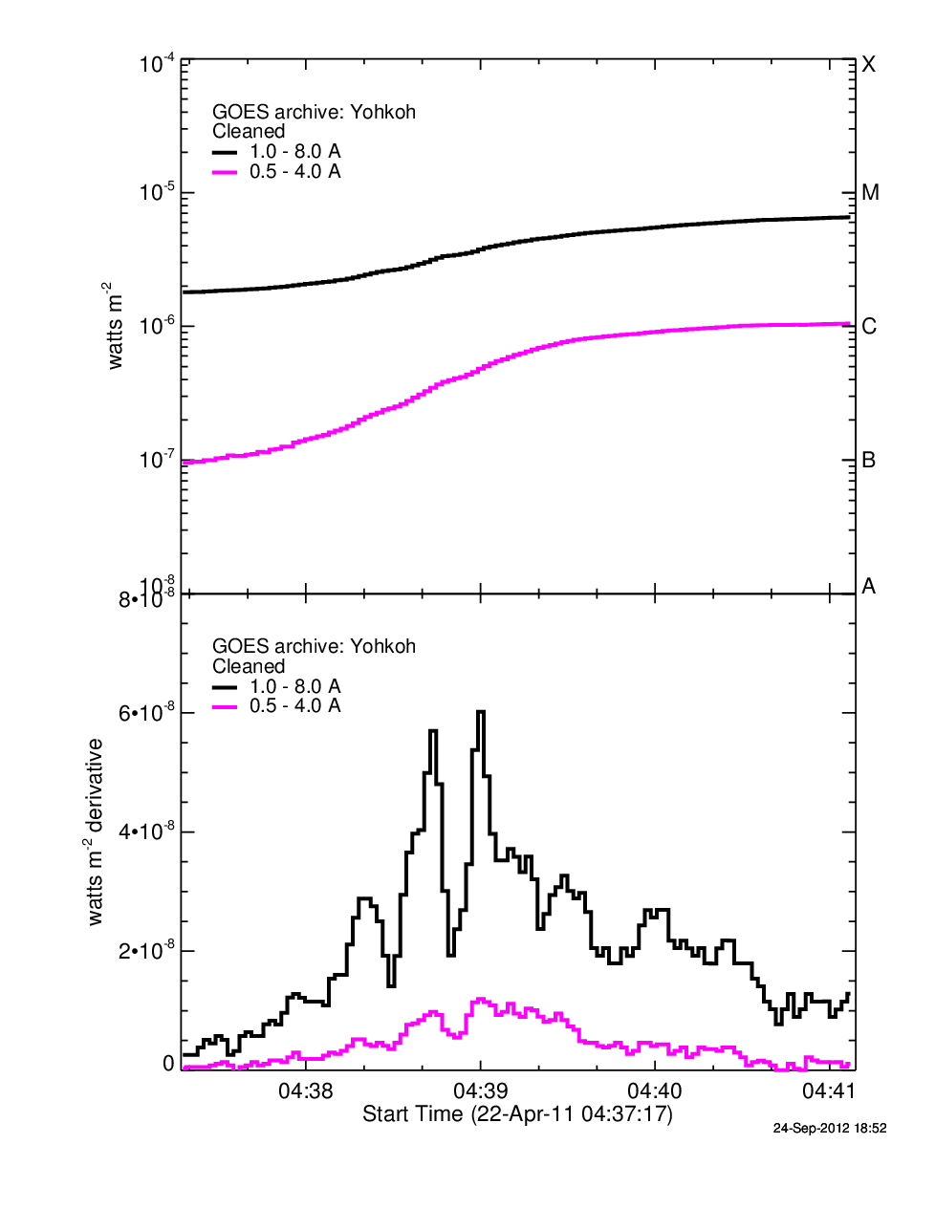
GOES Light Curves 22 April 2011

Slide 4
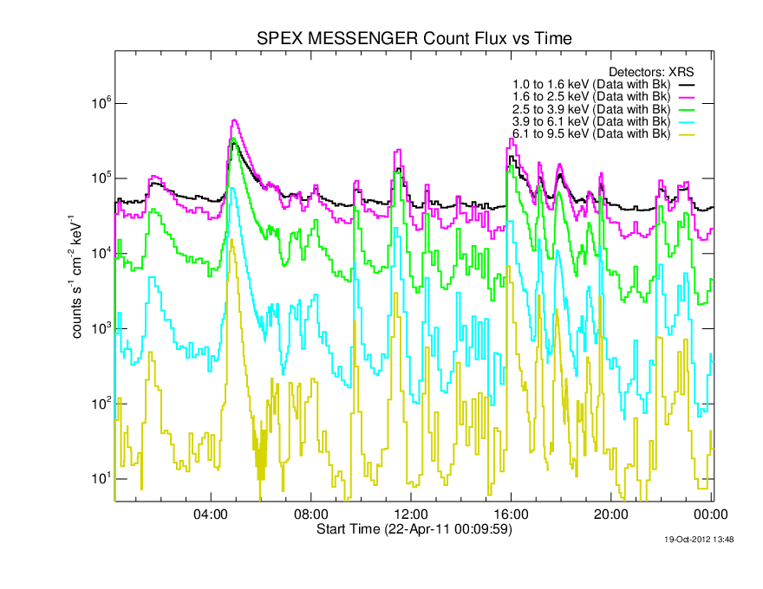
MESSENGER Light Curve 22 April 2011

Slide 5
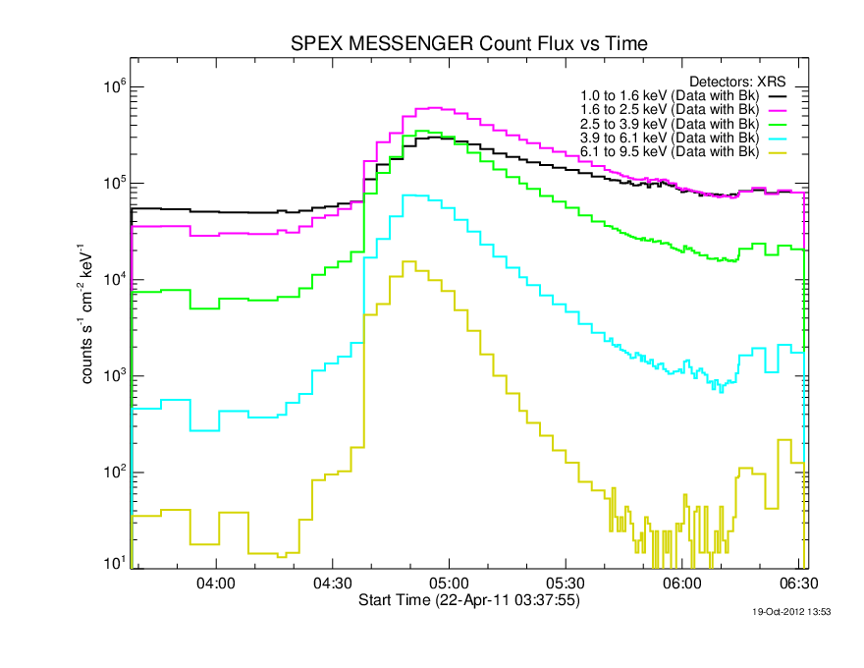
22 April 2011
Interval of Interest
RHESSI
MESSENGER

Slide 6
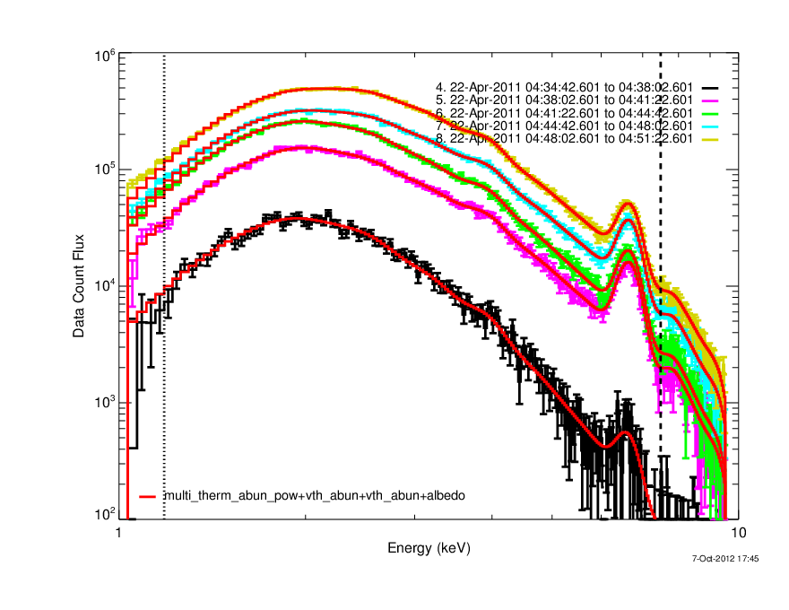
MESSENGER Count-Flux Spectra

Slide 7
MESSENGER Spectral Components

Slide 8
RHESSI Count-Flux Spectrum 22 April 2011 04:54:44 to 04:58:00 UT
Detector 4
Multitherm_abun_pow + thick2
Fe abundance = 0.53 x CHIANTI coronal

Slide 9
RHESSI Count-Flux Spectrum 22 April 2011 04:54:44 to 04:58:00 UT
Detector 4
Multitherm_abun_pow + thick2
Fe abundance = 0.7 x CHIANTI coronal
Fitted energies: 6 to 7.5 keV and 12 to 22 keV

Slide 10
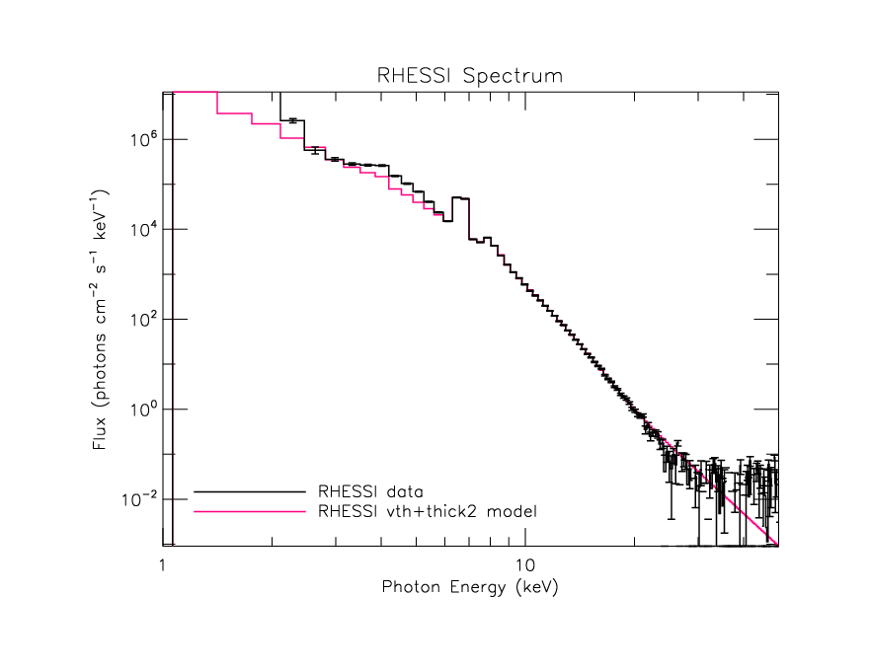
Photon Spectra

Slide 11
Combined Photon Spectra 22 April 2011 04:54:44 – 04:58:04 UT

Slide 12
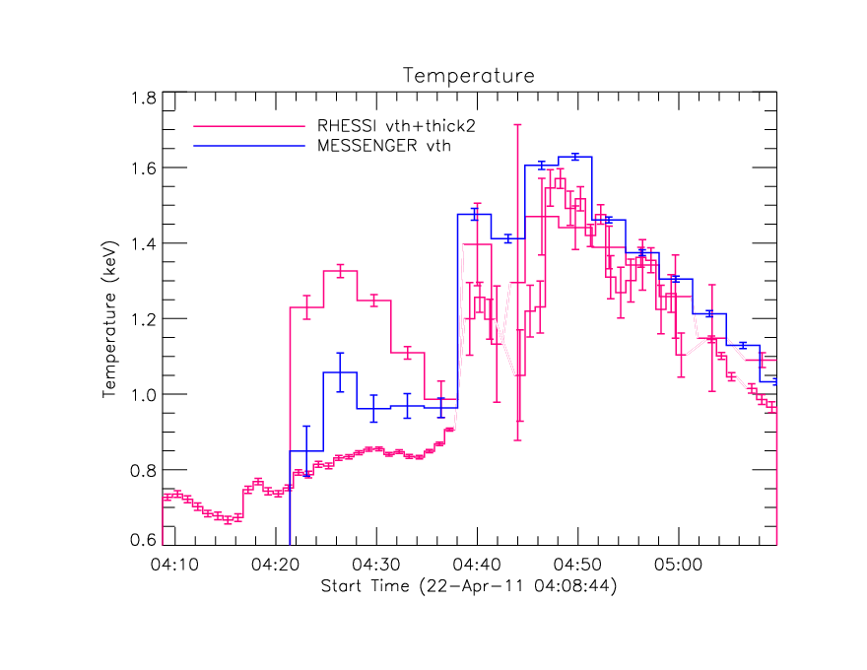
Temperature & Emission Measure
Interval of interest
Interval of interest

Slide 13
Fe Abundance
Interval of interest

Slide 14
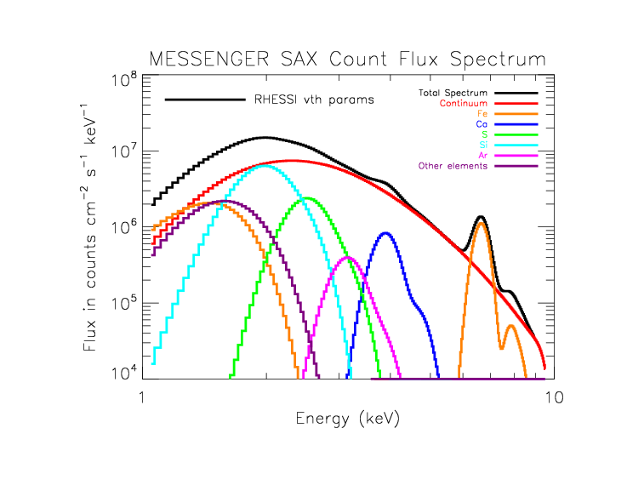
Fe-abundance Difference 22 April 04:54:44 to 04:58:00
MESSENGER best-fit parameters
T, EM, element abundances
RHESS best-fit parameters
T, EM, Fe-abundance
Other elemental abundances - fixed Coronal (Phillips’ best estimates)

Slide 15
Why the different Fe abundances?
MESSENGER gives 0.3 ± 0.1 x CHIANTI coronal
RHESSI gives 0.8 ± 0.2
Same time interval.
MESSENGER fit from 1.5 to 9 keV
Similar result if fit from 5 to 9 keV
RHESSI fit from 6 to 20 keV
Similar results for different spectral models:
vth_abun + thick2
multitherm_abun_pow

Slide 16
Assume MESSENGER is Correct Fe abundance = 0.35
Fit from 12 to 22 keV with Fe abundance = 0.35

Slide 17
Assume MESSENGER is Correct Fe abundance = 0.35
Detector #4
Fit from 12 to 22 keV
with Fe abundance = 0.35

Slide 18
Line and Continuum Spectra

Slide 19
RHESSI Detector 9 Spectrum Fe abundance set to 0.3

Slide 20
Conclusions
Why do MESSENGER SAX & RHESSI Fe abundances differ by factor of ~2?
MESSENGER
SAX simple Si diode
1 to 9 keV
Ca XIX peak at 3.9 keV – Ca abundance = ~1x coronal
RHESSI
Lower end of energy range
Unknown spectral features at ~8 and 10 keV
Excess counts below 6 keV in A1 and A3 attenuator states (K-escape?)
Excess counts below 6 keV in A0 state (Hannah)
SOXS observed 22 April 2011 flare!!!!

Slide 21
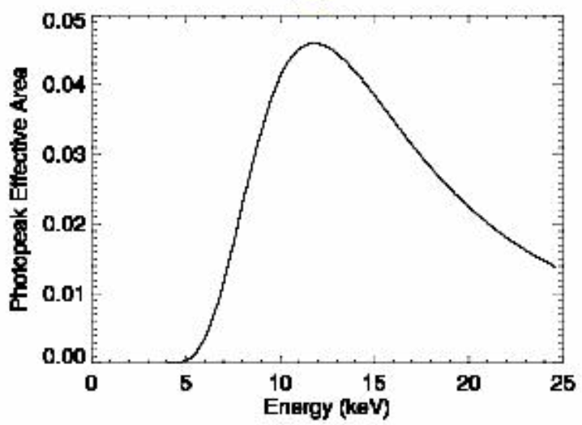
SOXS Launched on 8 May 2003 De-orbited on 2 May 2011
S.No. | Parameter | Detector-Si | Detector-CZT
1. | Detector Thickness (cm) | 0.03 | 0.2
2. | Al Thickness (micron) | 50+20 | 100+20
3. | Be Thickness (micron) | 25.4 (1mil) | 254 (10mil)
4. | Kp Thickness (micron) | 150 | 150
5. | Geometric Area (cm²) | 0.091 | 0.18
Silicon

Slide 22
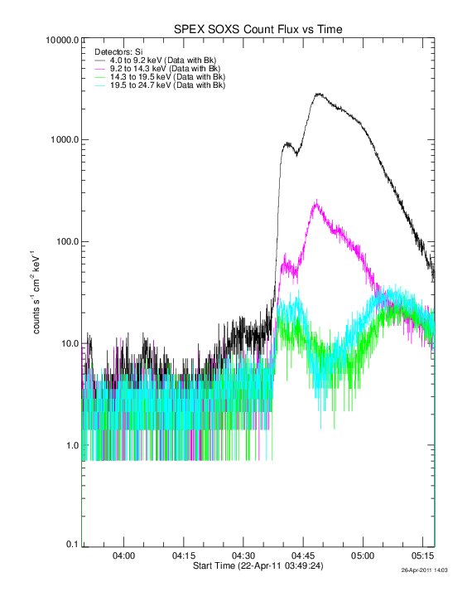
SOXS Observations 22 April 2011

Slide 23
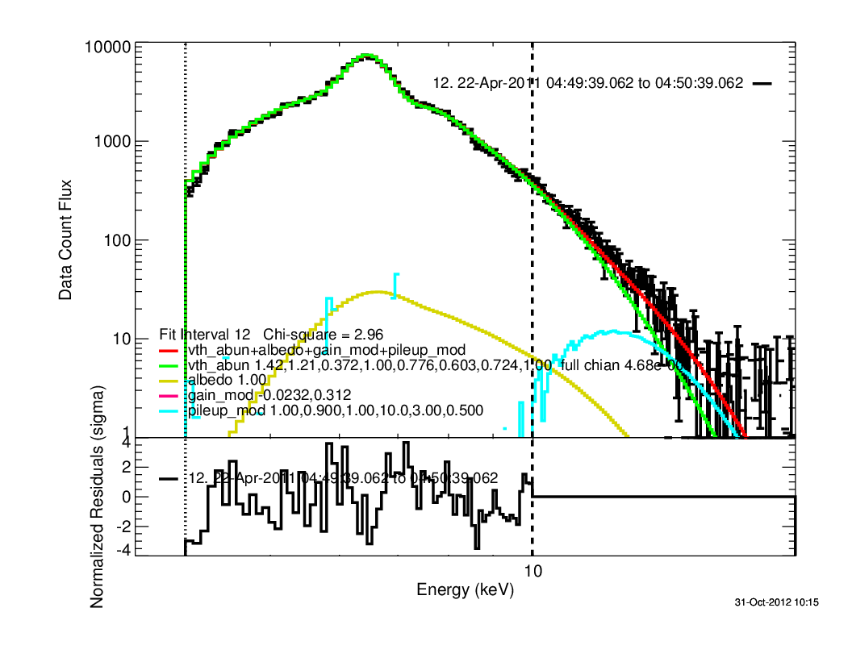
SOXS 22 April 2011
Fe abun. = 0.37

Slide 24
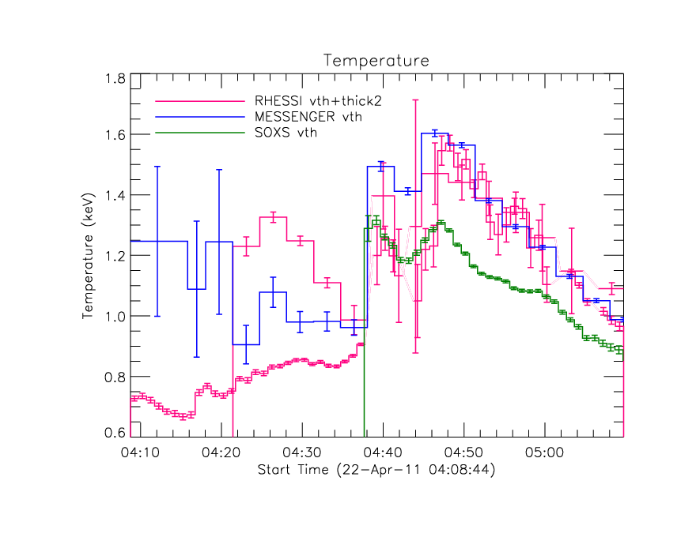
22 April 2011 Temperature
Fe Abundance

Slide 25
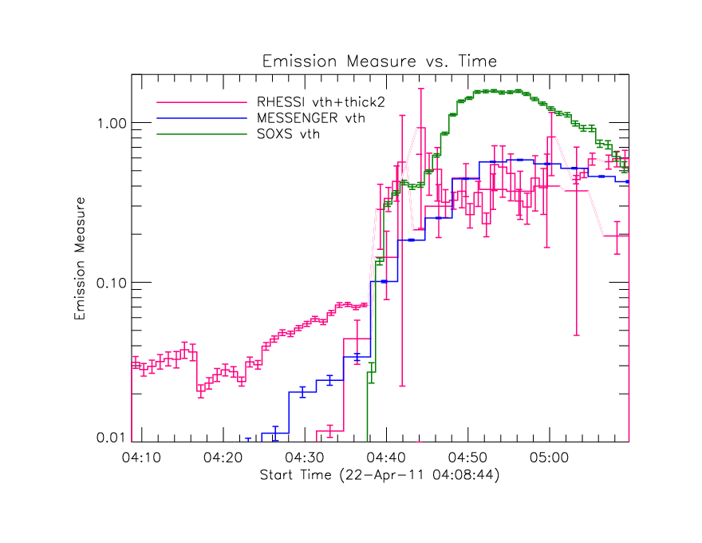
22 April 2012 Temperature & Emission Measure

Slide 26
SOXS 22 April 2011
Temperature: 1.5 keV (fixed)
Fe abundance: 0.53

Slide 27
RHESSI 22 April 2011
vth + thick2, Fe abundance = 0.83

