Slide 1
GOES M9 Flare 20 October 2012 18:05 18:14 18:19 UT AR 11598
Brian Dennis
24 October 2012

Slide 2
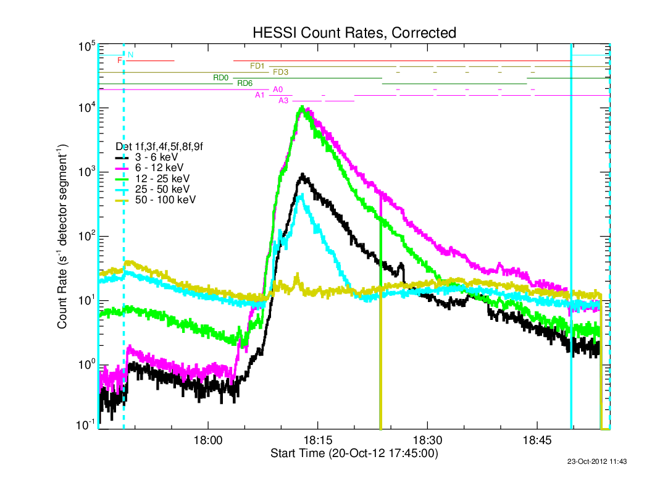
GOES M9 Flare AR 11598, 20 October 2012 18:05 18:14 18:19 UT

Slide 3
GOES M9 Flare AR 11598, 20 October 2012 18:05 18:14 18:19 UT
Detectors #1 and 6 have finest energy resolution.
Fe line complex at 6.7 keV
“Background” lines at ~8 and ~11 keV.

Slide 4
GOES M9 Flare AR 11598, 20 October 2012 18:05 18:14 18:19 UT
vth + thin2
Fe abundance
= 4.95 x coronal!!!

Slide 5
GOES M9 Flare AR 11598, 20 October 2012 18:05 18:14 18:19 UT
vth + thin2
Fe abundance
= 0.6 x coronal
Systematic residuals

Slide 6
GOES M9 Flare AR 11598, 20 October 2012 18:05 18:14 18:19 UT
multitherm_abun_pow + thin2
Fe abundance
= 0.6 x coronal
Reduced chi-squared
= 0.91

Slide 7
Conclusions
Detectors 1, 3, 6, 7, 8, 9 are working well.
Detector 6 has remarkably good energy resolution.
Detector 3 has lower sensitivity as always
Use visibility normalization to determine relative detector sensitivities –
1.03,0.00,1.11,0.00,1.01,1.06,0.94,0.92,0.96

Slide 8
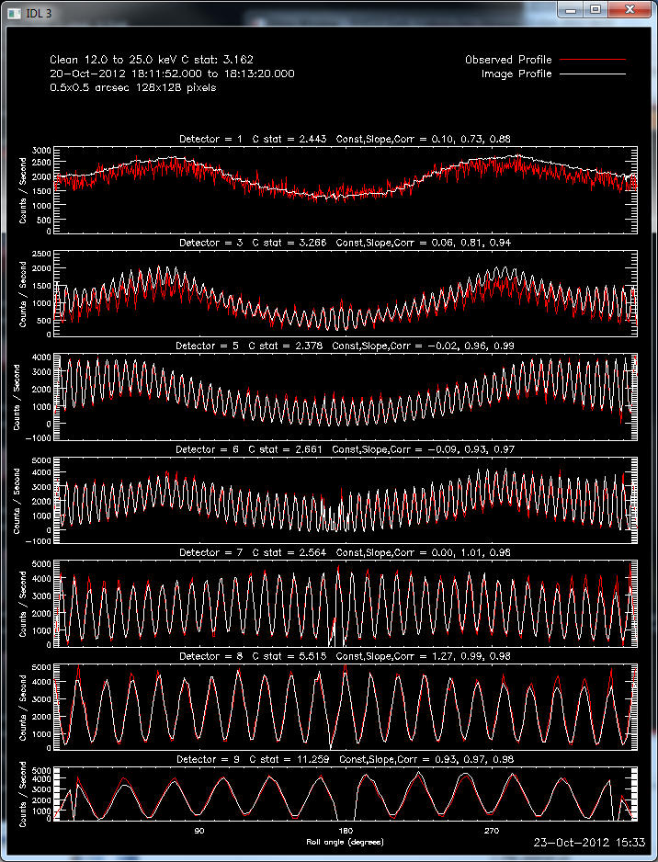
22 Oct. 2012 18:11:52 to 18:12:20 UT 12 to 25 keV
MEM-NJIT
CLEAN

Slide 9
GOES X2 Flare 23 October 2012 AR 11598
Brian Dennis
24 October 2012

Slide 10
23 October 2012

Slide 11
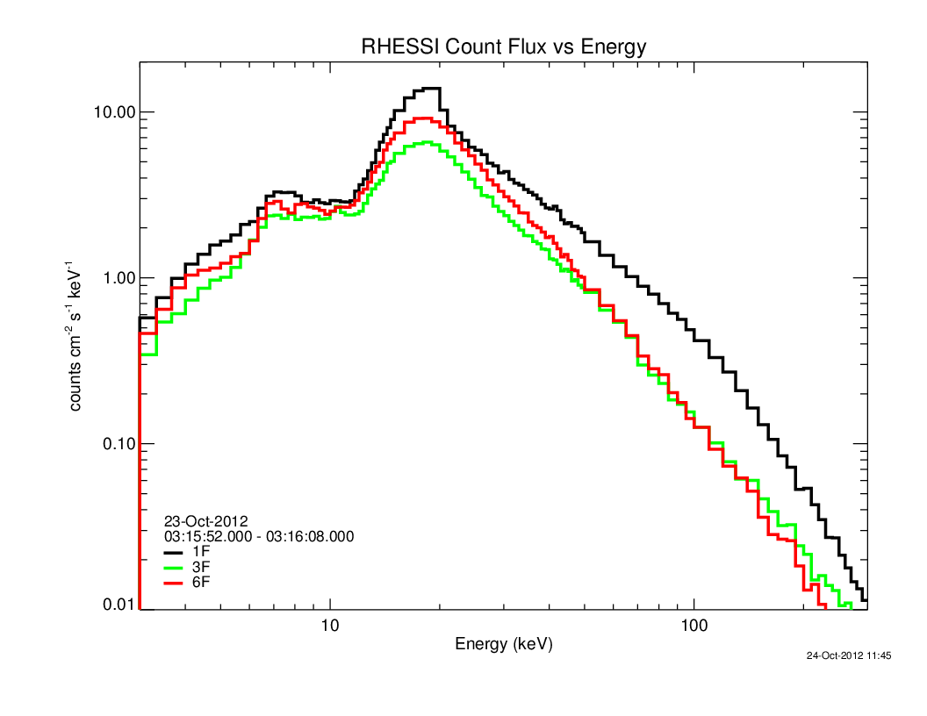
23 October 2012

Slide 12
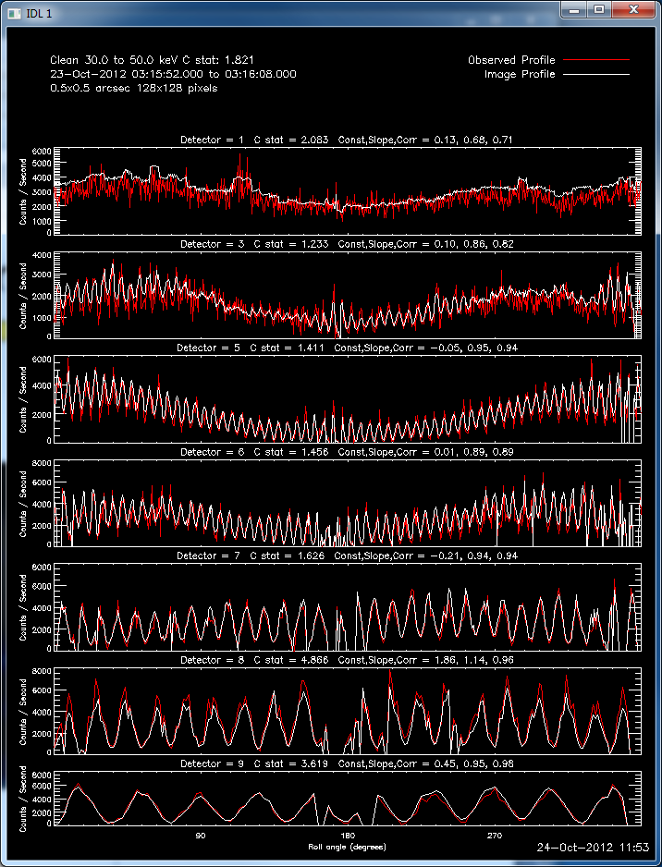
23 October 2012

Slide 13
