Slide 1
14 – 15 October 2014
Brian Dennis
Mathew West

Slide 2
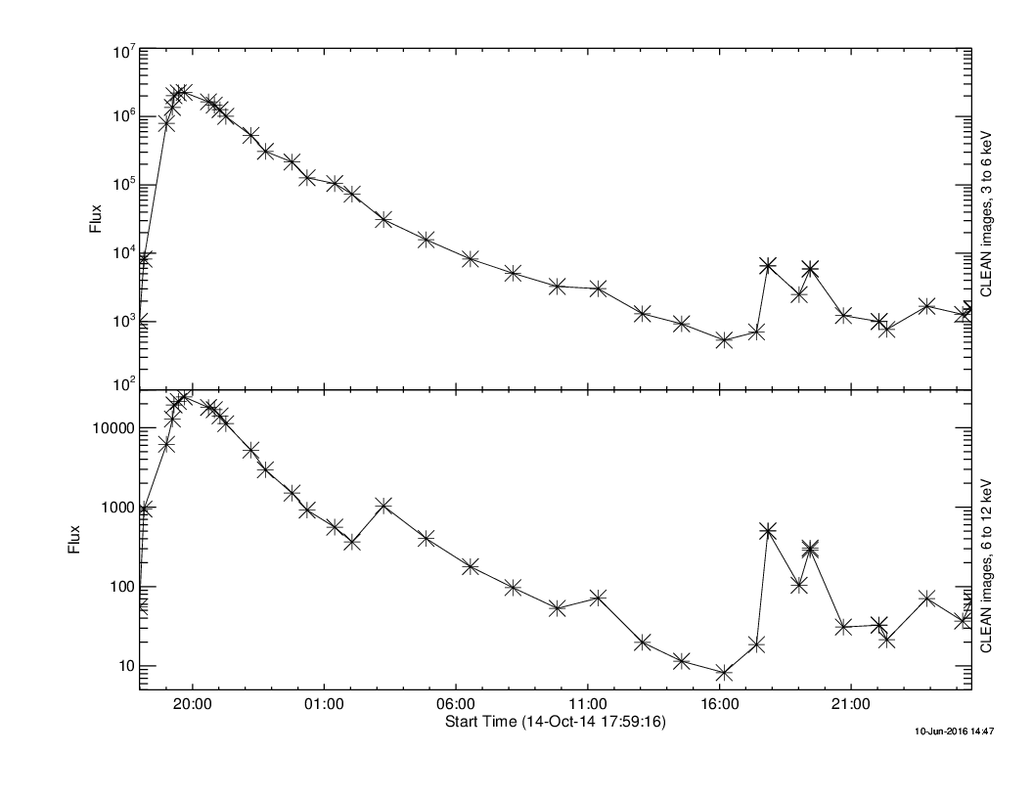
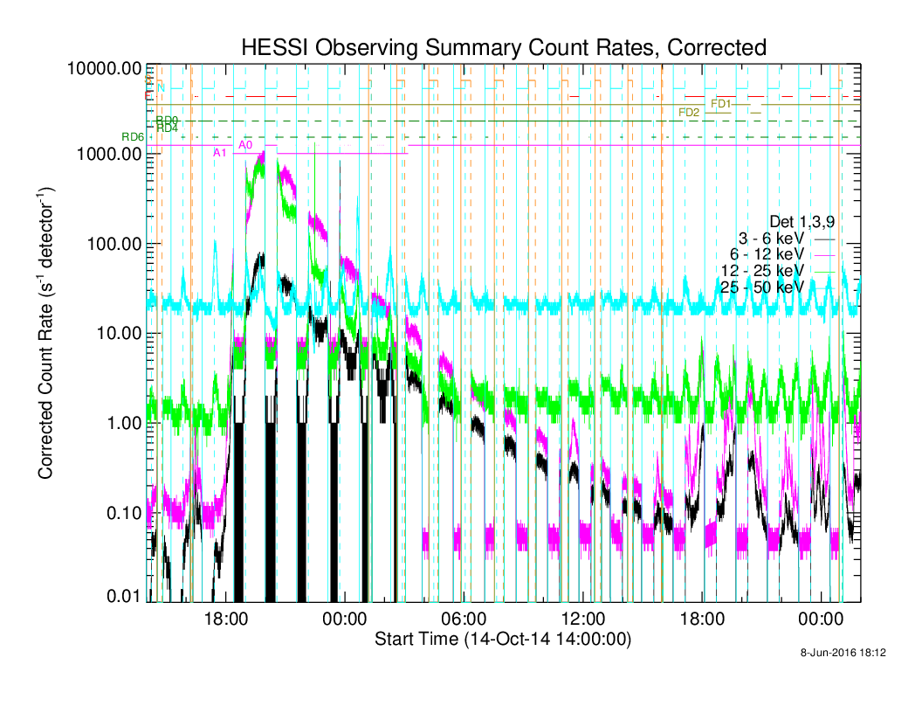
RHESSI Lightcurves

Slide 3
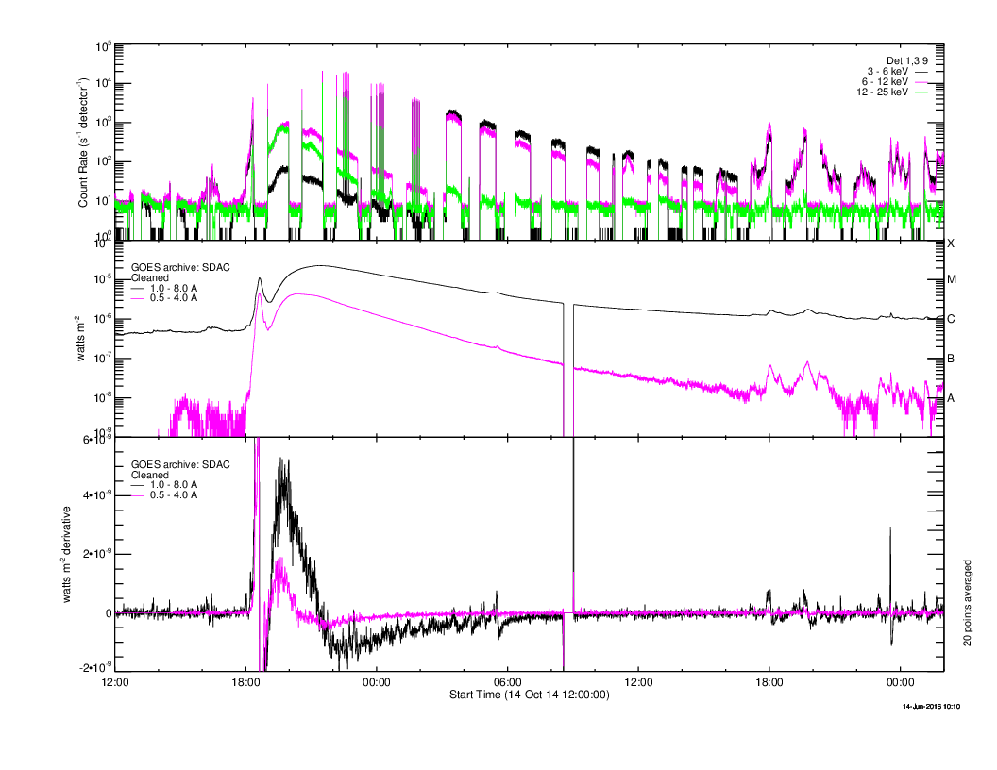
GOES Lightcurves

Slide 4
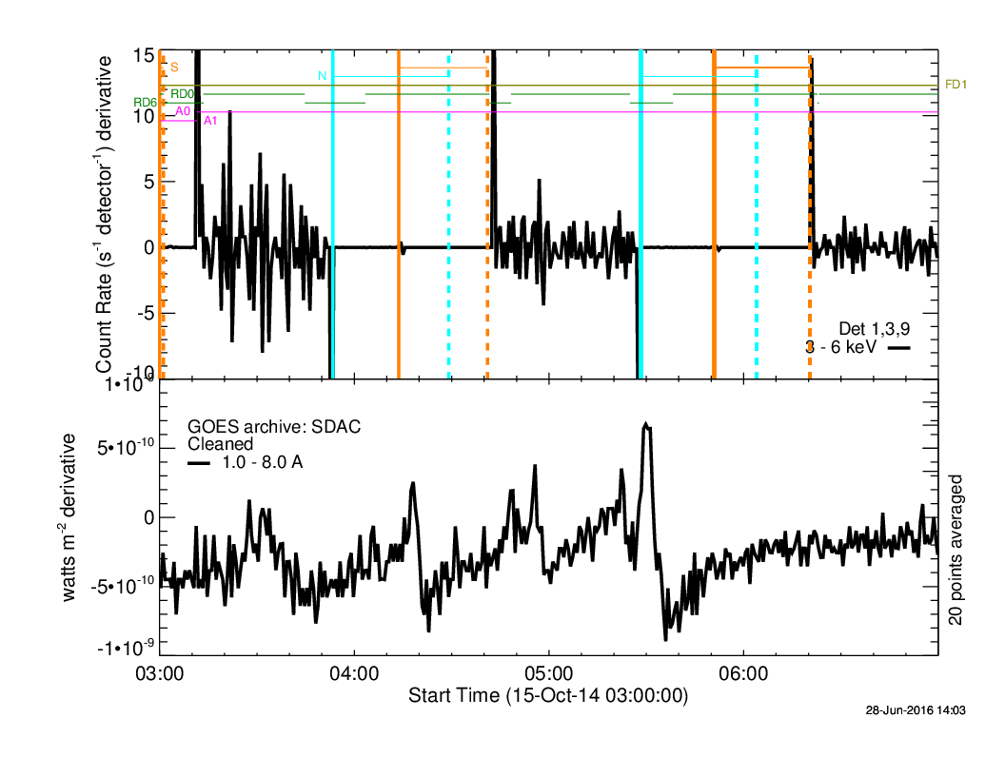
GOES Time Derivative

Slide 5
RHESSI Source Location 3 – 6 & 6 – 12 keV

Slide 6
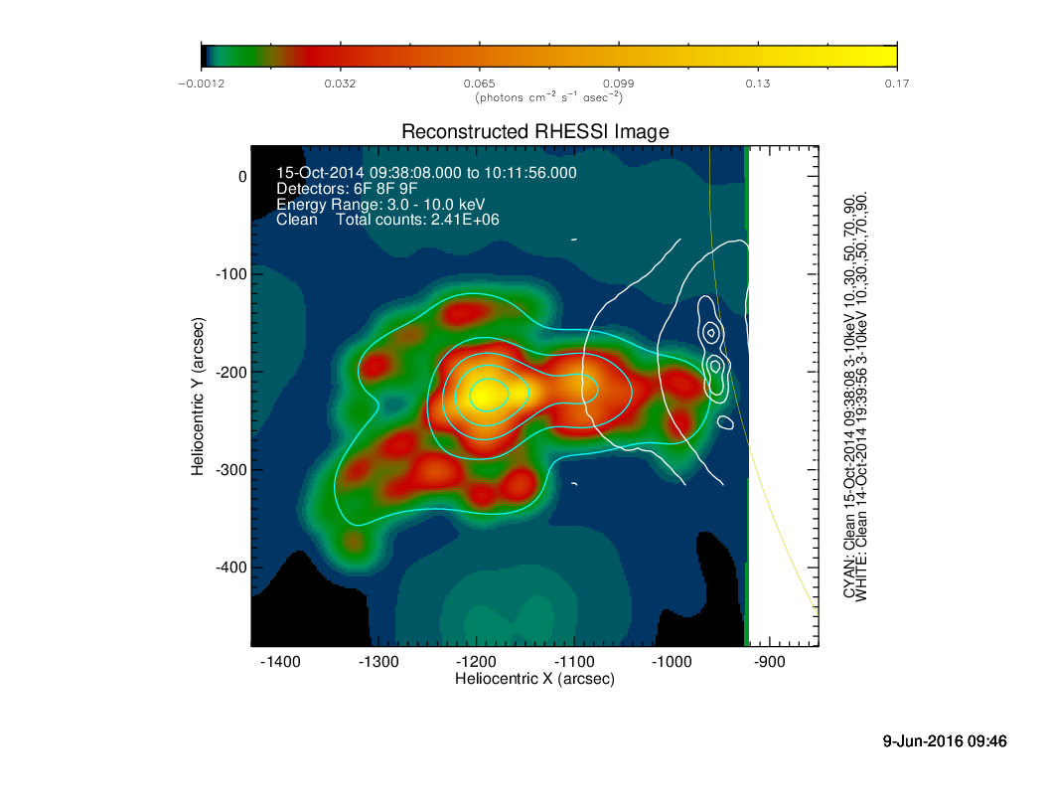
RHESSI Images

Slide 7
RHESSI Images

Slide 8
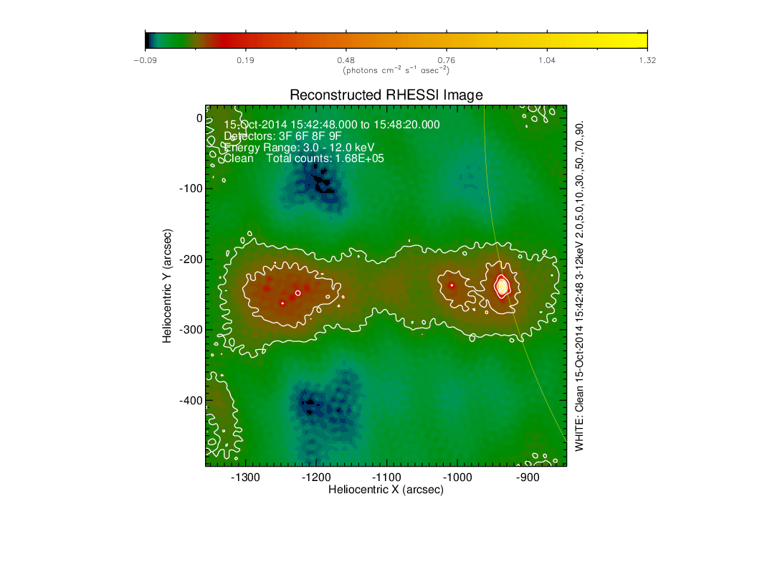
RHESSI Images

Slide 9
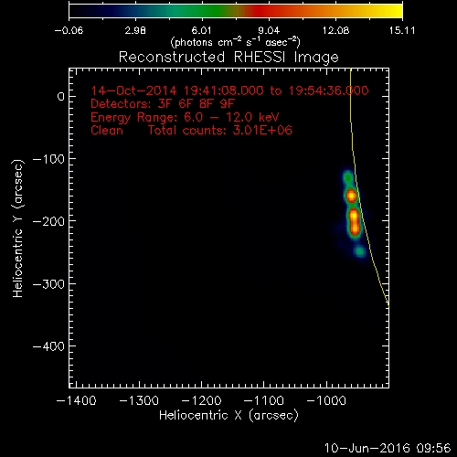
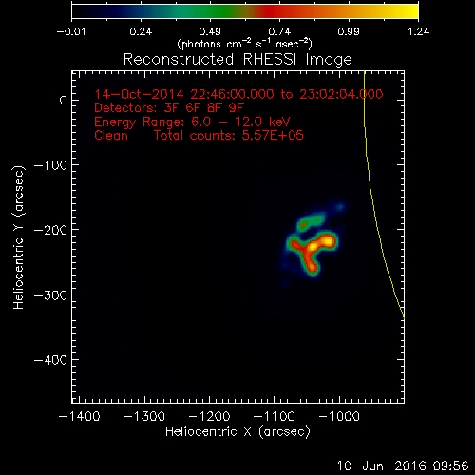
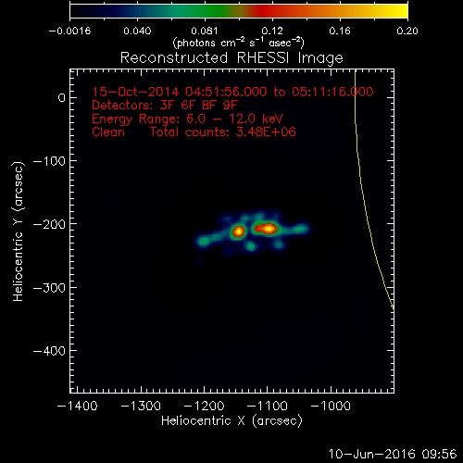
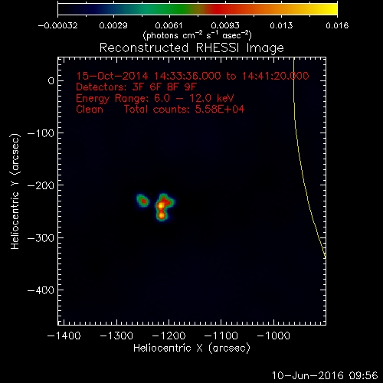
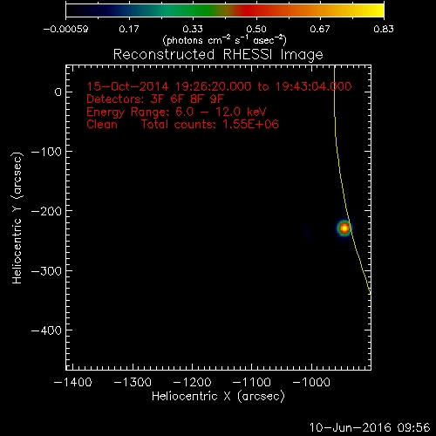
14 – 16 October 2014 RHESSI 6 to 12 keV Images

Slide 10
RHESSI Pixon 3 – 6 keV Images Source Centroids
Time
X Centroid (arcsec)

Slide 11
RHESSI Pixon 3 – 12 keV Images Source Centroids

Slide 12
RHESSI Clean Images Centroid Locations
X Centroid (arcsec)

Slide 13
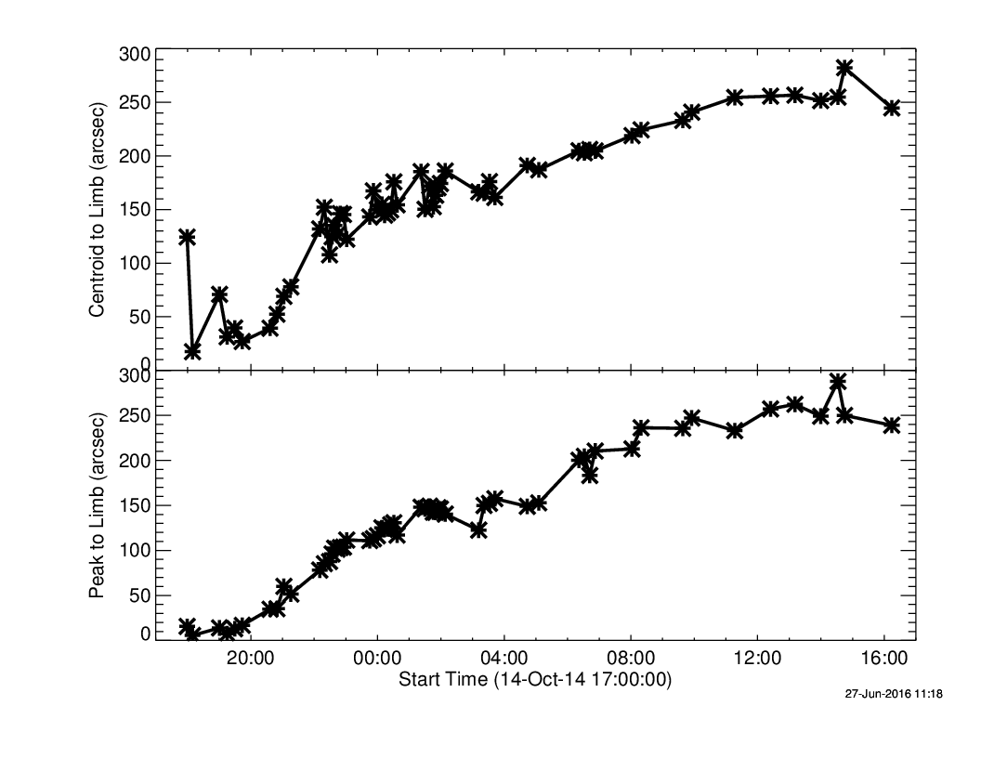
RHESSI Pixon 3 – 12 keV Images Peak and Centroid-to-limb Distance

Slide 14
RHESSI Clean 6 – 12 keV Images Flux and Centroid-to-Limb Distance

Slide 15
AIA 131 Å RHESSI 3 – 25 keV

Slide 16
GOES SXI (Rotated???) RHESSI 3 – 20 keV

Slide 18
Nancay 150 MHz

