Slide 1
Electron Acceleration and Propagation and the Thermal Response in Solar Flares
Gordon D. Holman NASA/Goddard Space Flight Center

Slide 2
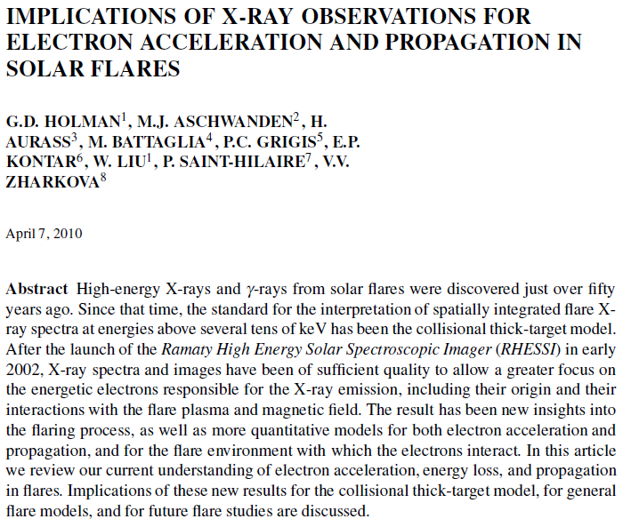

Slide 3
Chapter 3

Slide 4
The Collisional Thick-Target Model
Electrons are accelerated in the corona and stream downward along magnetic field lines to the denser transition region and chromosphere, where they are thermalized and a high flux of X-ray bremsstrahlung is emitted.
The collisional thick-target model allows the energy flux (power, ergs/s) in accelerated electrons above some reference energy E to be determined.

Slide 5
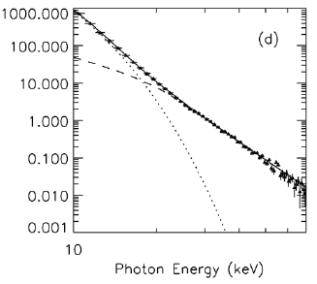
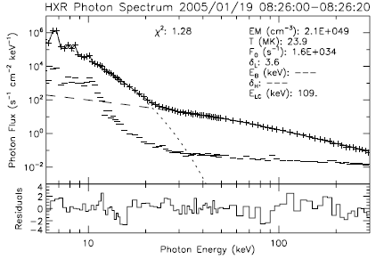
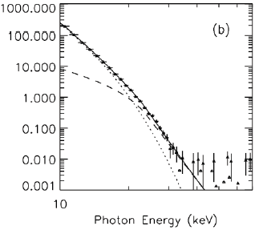
What is the Total Power in Accelerated Electrons? What is the low-energy cutoff?
Upper limit on the low-energy cutoff Lower limit on the total beam power
Well determined value for the low-energy cutoff
Upper and lower limits on the low-energy cutoff
Sui et al. 2005 Warmuth et al. 2009

Slide 6
Chapter 3

Slide 7
What happens to the electrons between the acceleration region and the thick-target region?
Are the spectral shape and low-energy cutoff a characteristic of the acceleration process, or something that happened during propagation?
Electron energy losses during propagation affect the thermal response of the flare plasma.

Slide 8
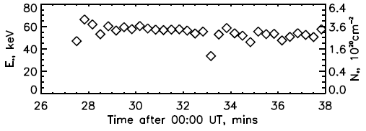
Nonuniform Ionization
Higher energy electrons lose energy in neutral plasma while lower energy electrons lose their energy in fully ionized plasma.
Kink in spectrum at characteristic energy E_{NUI} which determines the column density N(x) = ∫n(x)dx at which the ionization change occurs.
2002 July 23 Flare (Kontar et al. 2003)

Slide 9
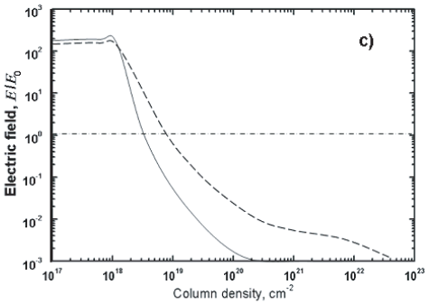
Return-Current Losses
Flatten the X-ray spectrum below an energy determined by the potential drop associated with the return-current electric field
Can result in the deposition of much of the electron energy in the upper part of the flare loop
Depend on the electron flux density (cm⁻² s⁻¹)
Zharkova & Gordovskyy 2006

Slide 10
Chapter 3

Slide 11
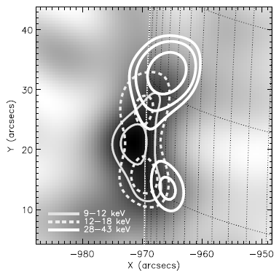
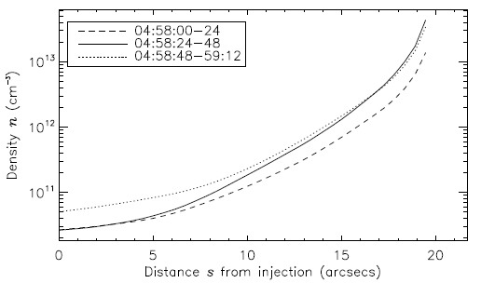
Loop Density Structure from Dependence of X-ray Source Position on Photon Energy
Chromospheric Evaporation
Liu et al. 2006

Slide 12
Chromospheric Evaporation Studies with SOHO CDS or Hinode and RHESSI
Milligan et al. (2006), Brosius & Holman (2007), Milligan (2008), Milligan & Dennis (2009), Brosius & Holman (2010)
Problem: It is difficult to obtain co-spatial slit spectrograph and hard X-ray observations
Problem: Chromospheric evaporation depends on the electron energy flux density (erg cm⁻² s⁻¹) while the thick-target model gives the energy flux (erg s⁻¹).

Slide 13
Time Evolution of Spectral Line Intensities (Allred et al. 2005)
Constant heating by a double-power-law electron beam with δ_{low} = 3, E_{break} = 105 keV, δ_{high} = 4, E_{cutoff} = 37 keV.
F₀ = 1 × 10¹⁰ erg cm⁻² sec⁻¹
F₀ = 1 × 10¹¹ erg cm⁻² sec⁻¹
Ly α 1216 Å
H α 6563 Å
He II 304 Å
Ca II K 3934 Å
Explosive phase begins after 73 s
Explosive phase begins after 1 s
Abbett & Hawley 1999: Single-power-law electron distribution with δ = 5 and E_{cutoff} = 20 keV. Explosive phase begins after 27 s for F₀ = 1 × 10¹⁰ erg cm⁻² sec⁻¹

Slide 14
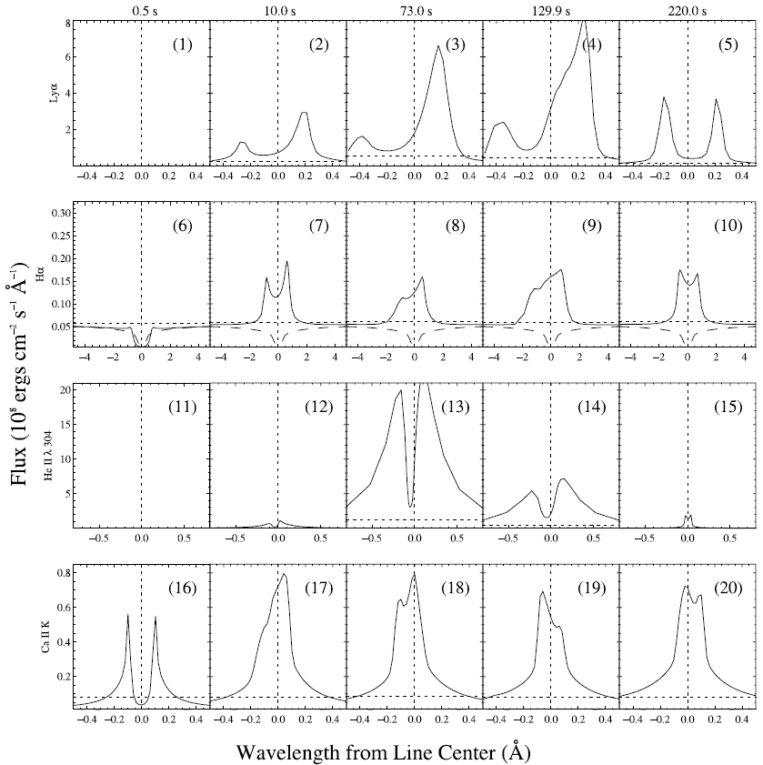
Line Shape vs. Time for F₀ = 1 × 10¹⁰ erg cm⁻² sec⁻¹ (Allred et al. 2005)

Slide 15
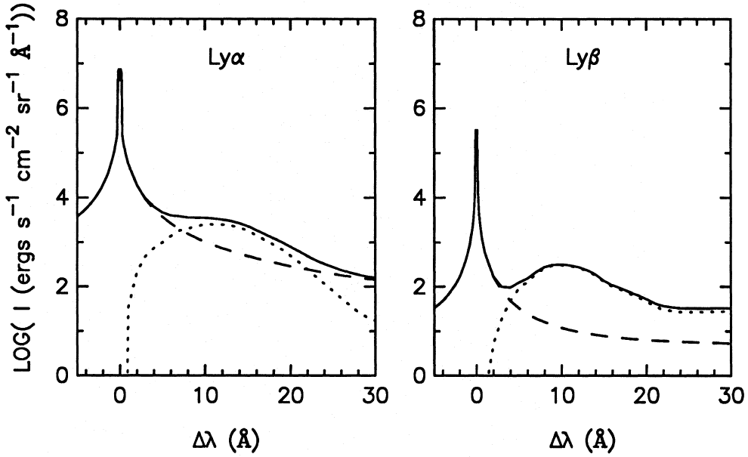
Nonthermal Proton Beam Charge-Exchange Emission (Fang et al. 1995)
1216 Å
1026 Å
Power-law proton beam with F₀ = 5 × 10¹⁰ erg cm⁻² sec⁻¹ and δ = 4 above 150 keV

Slide 16
Desired X-ray/Gamma-ray Instrument Properties
Same imaging spectroscopy capabilities as RHESSI or better
Greater dynamic range than RHESSI
Better gamma-ray sensitivity and resolution

Slide 17
Desired EUV Spectrometer Properties
Field of view ∼ size of a typical active region or greater
Spectra throughout this field with a spatial resolution ∼ 10 arcsec or better
Spectral bands covering H Ly α, Ly β, He II 304 Å, Ca II K, He I 584.3 Å, O V 629.7 Å, Si XII 520.7 Å, Mg X 624.9 Å, Fe XIX 592.2 Å, + ???
λ/Δλ at Ly α ∼ 24,000 or better, covering at least ±30 Å.
High dynamic range for Ly α and weaker lines and coronal heating (nonflaring) diagnostics
Possible problem at Ly α: geocoronal scattering

