Slide 1
Understanding the Origin of Solar Flares
Joseph M. Davila (GSFC)

Slide 2
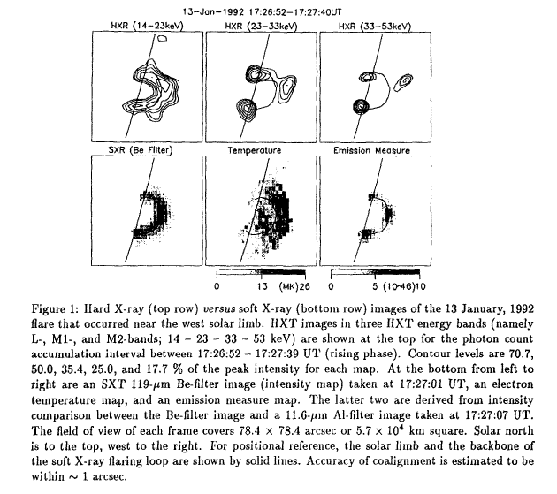
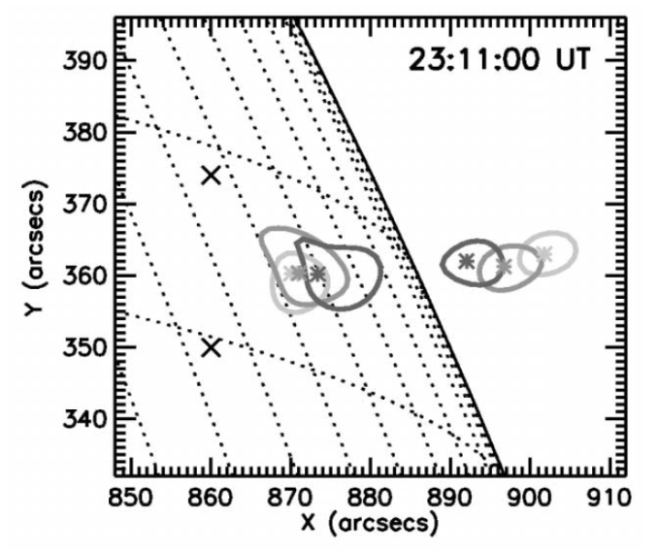
Can We Confirm Observationally Some Basic Flare Assumptions?
Flares originate from energy stored in the corona
Reconnection in the corona releases this stored energy
Accelerated electron beams which travel to denser regions where energetic emission is observed.

Slide 3
Two New Enabling Discoveries
High Resolution white light corona imaging
  Contrary to previous conventional wisdom, recent eclipse images show that fine-scale (1 arcsec) structures are present and visible
  These structures are tracers of magnetic field lines
New diagnostic capability developed
  Davila and Reginald have developed and demonstrated at a series of recent eclipses a new temperature and velocity diagnostic capability applicable to ONSET-type white light coronagraphs

Slide 4
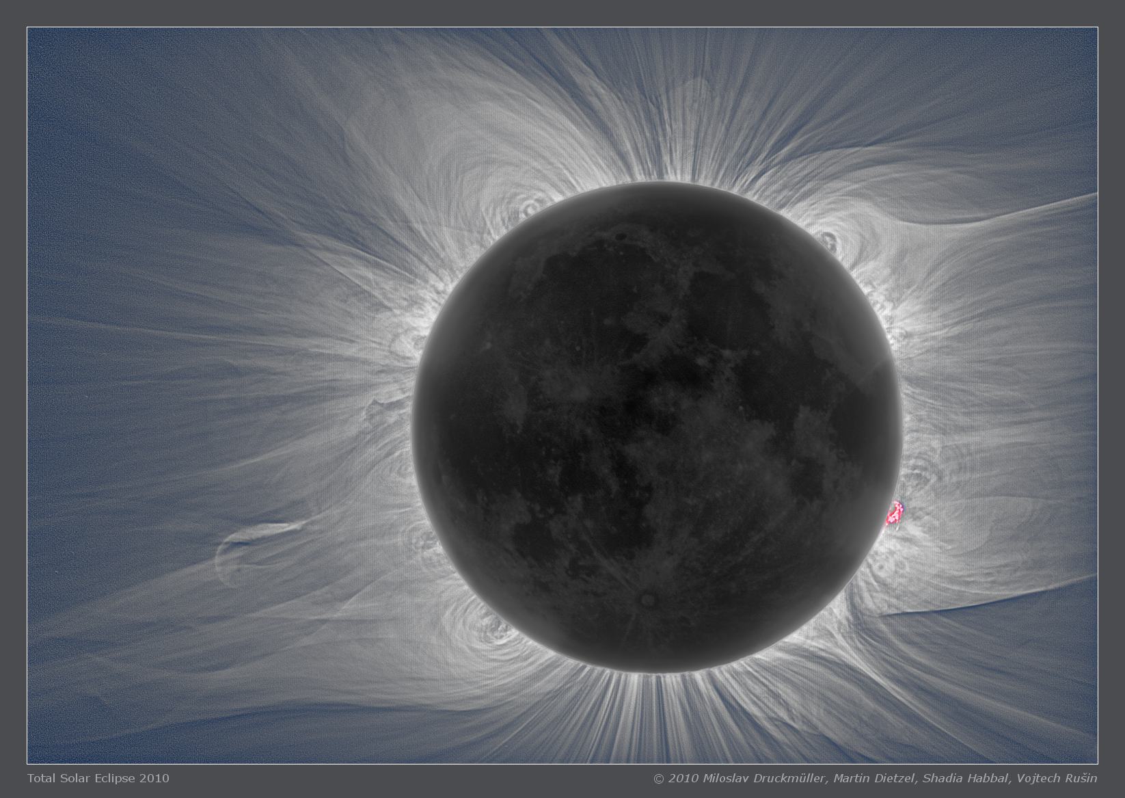
2010

Slide 5
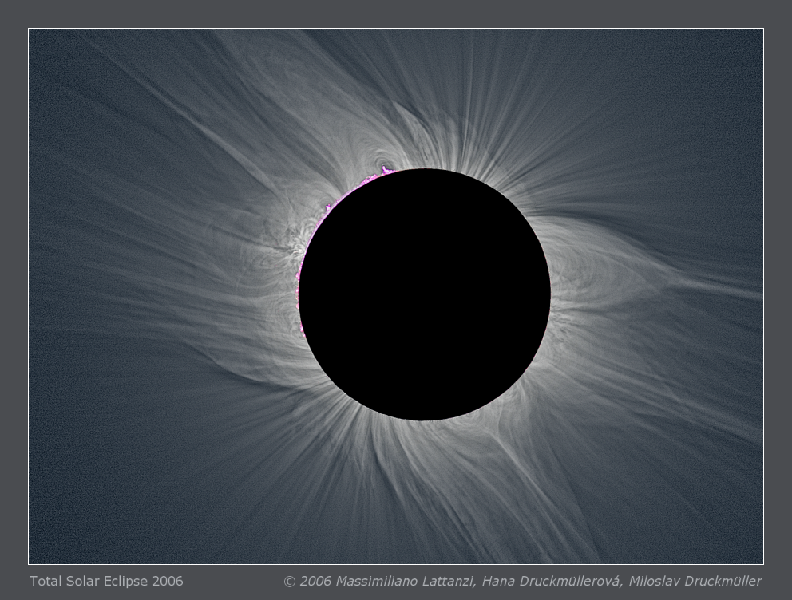
2006

Slide 6
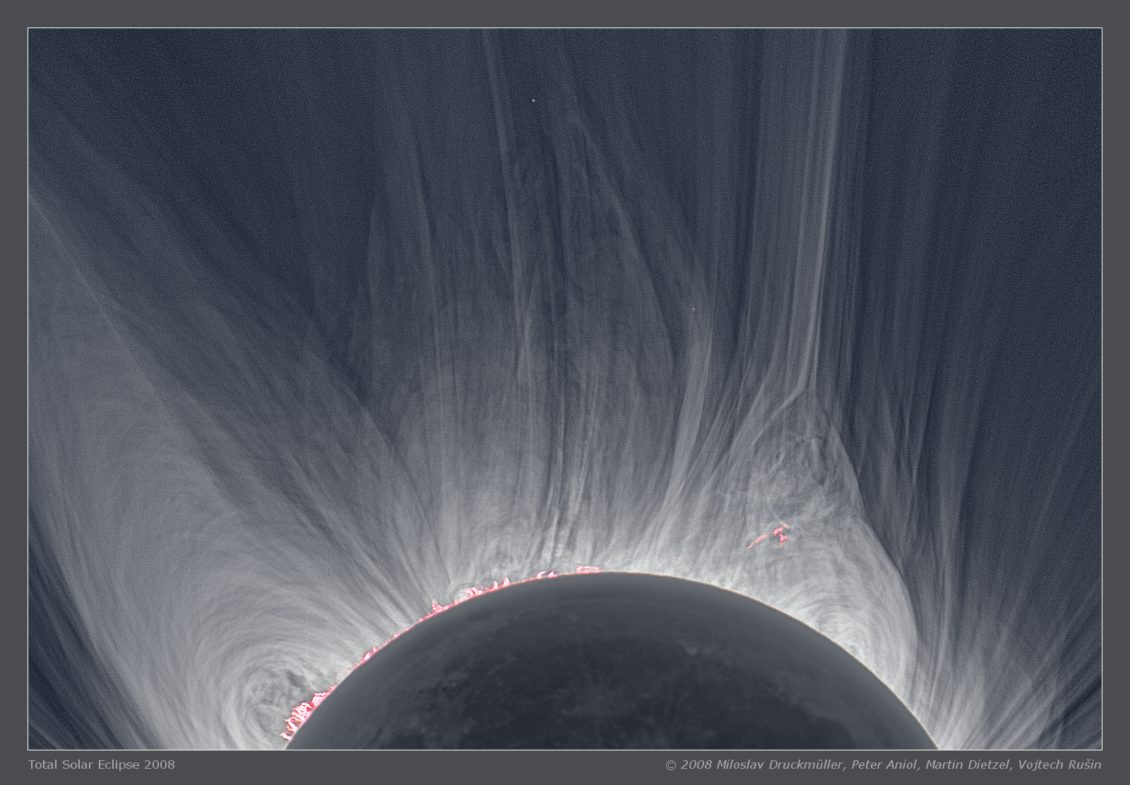
2008

Slide 7
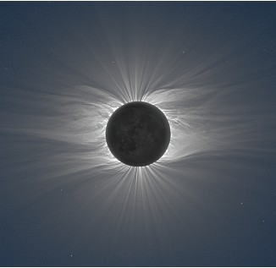
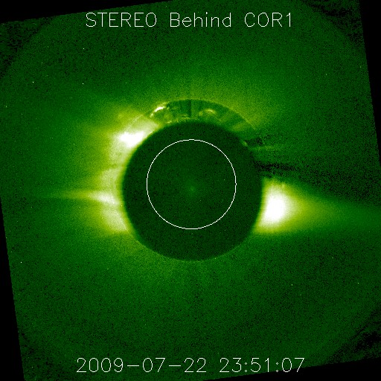
Coronagraph-Eclipse Comparison
Eclipse 7-22-2009
COR1 7-22-2009

Slide 8
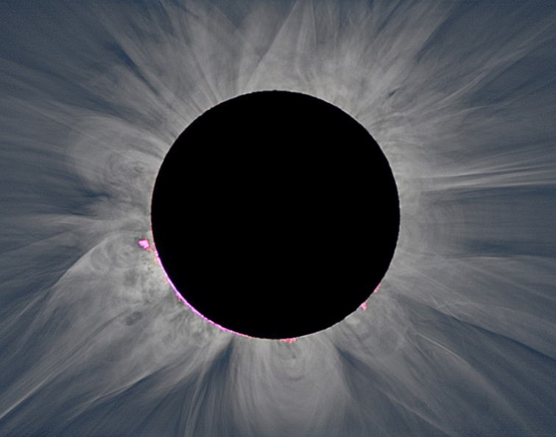
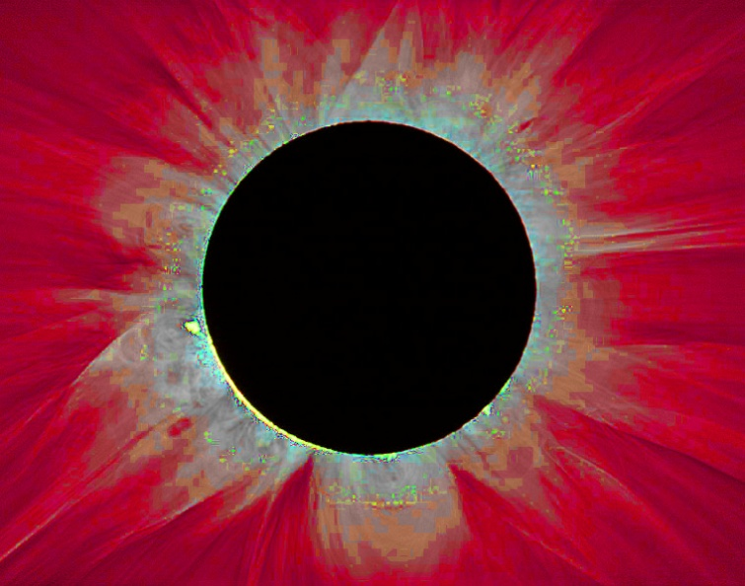
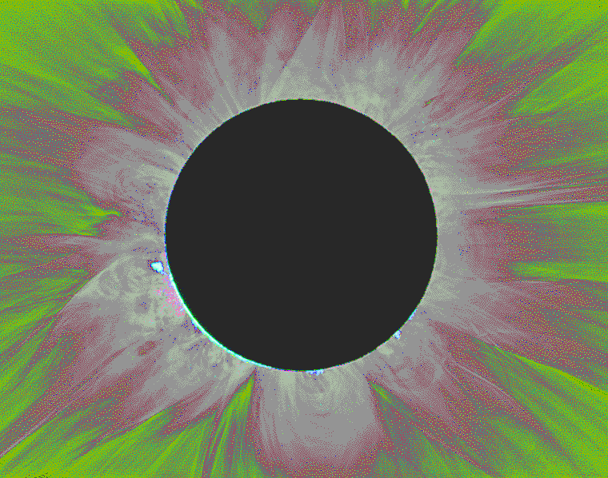
Diagnostic Capability
Currently white light coronagraph images provide electron density
The next generation of coronagraphs will use spectral information, to also determine
Density
Temperature
Velocity

Slide 9
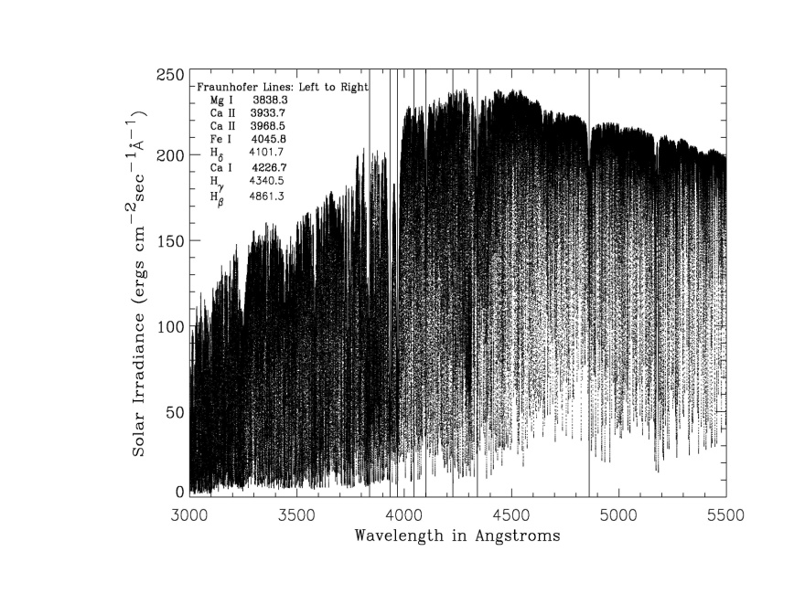
How Does it Work?
Coronal Model Spectrum
Photospheric Spectrum
High temperature coronal electron distribution “smooths” photospheric spectrum
The degree of smoothing is proportional to the electron temperature
Doppler shift of the entire spectrum is proportional to the flow speed

Slide 10
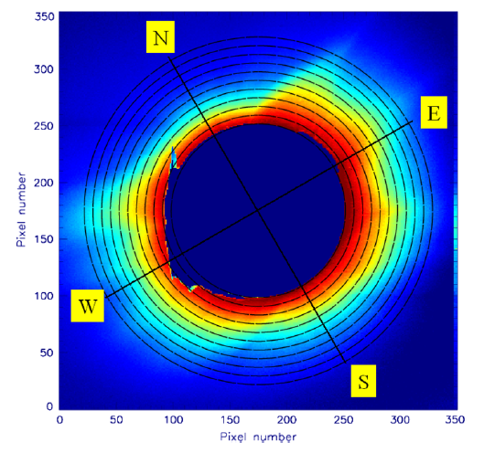
Temperature Measurement
Coronal Model Spectrum
The ratio of intensity two 50 A wide bands is temperature sensitive
Velocity sensitive ratio is available also

Slide 11
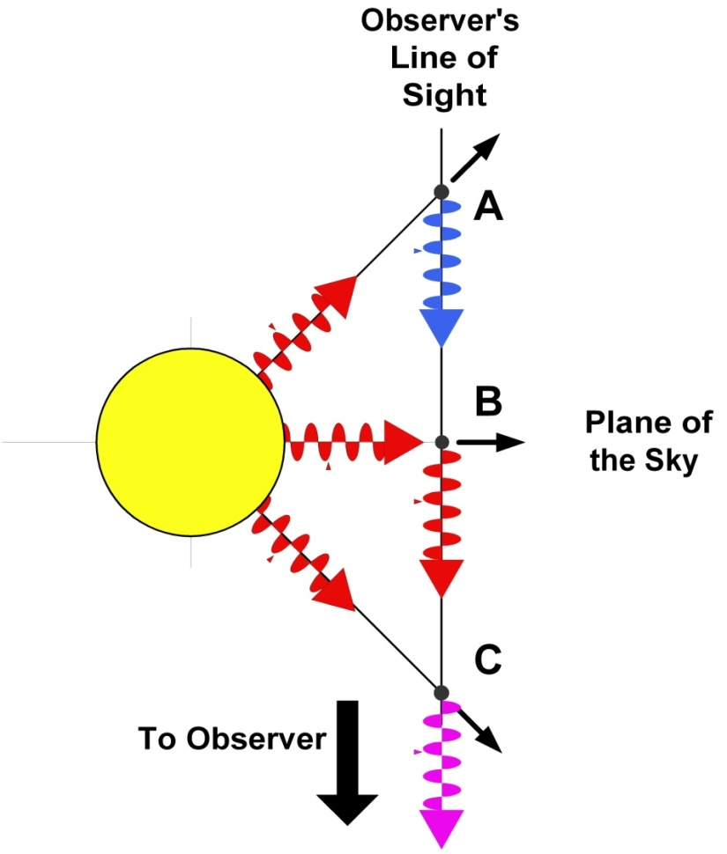
Thomson Scattering Physics
Wavelength conserved in the frame of the moving electron
Doppler shift of source is observed in scattered radiation
Even if motion is transverse
Integration over Maxwellian velocity distribution, and line of sight sums all red and blue shift contributions
Spectral shift of approximately 4 A per 100 km/s
Technique demonstrated by observations during total solar eclipse

Slide 12
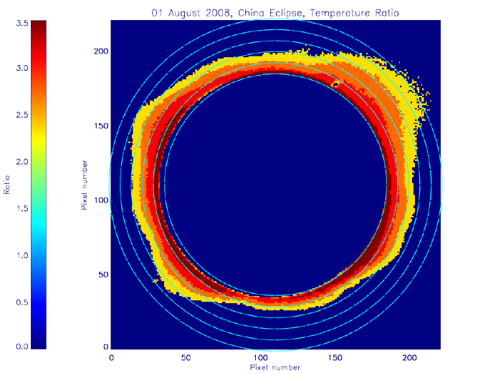
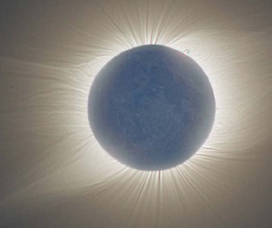
Temperature Results from China Eclipse (2008)

Slide 13
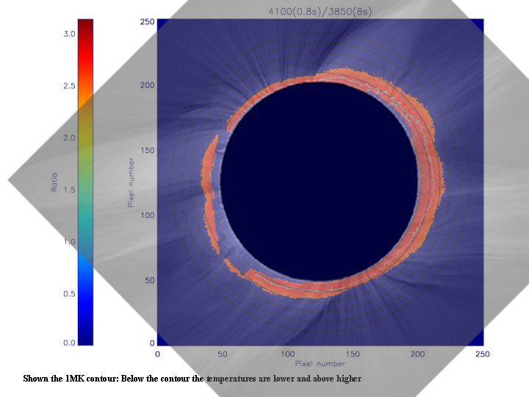
Radial Cut

Slide 14
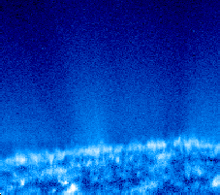
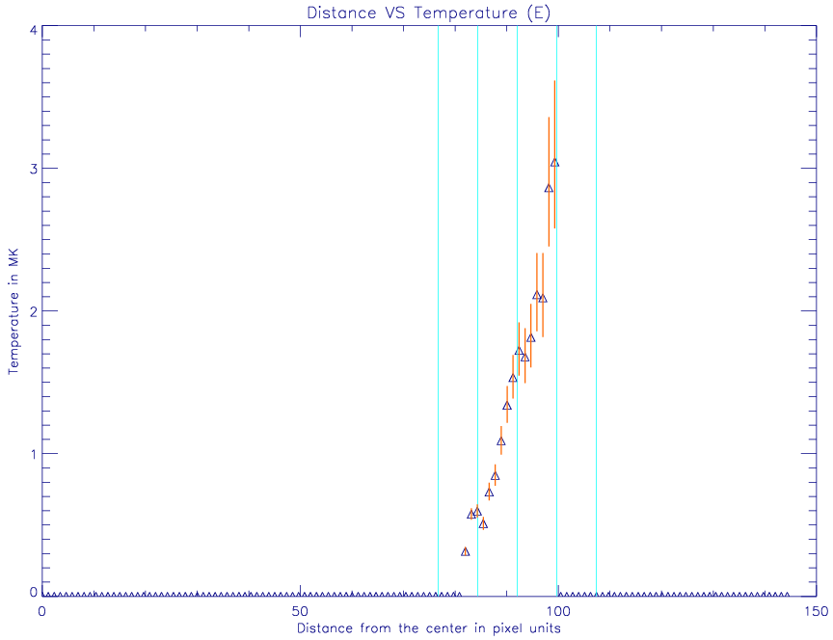




Results
SUMER Limb Scans
Filter Ratio Temperature
3
Mg X 1.1 MK
2
Temp (MK)
N V 180 000 K
1
S II 25 000 K
1.0
1.2
1.4
H I Ly a 20 000 K)
r/Rsun
C I < 10 000 K)

Slide 15
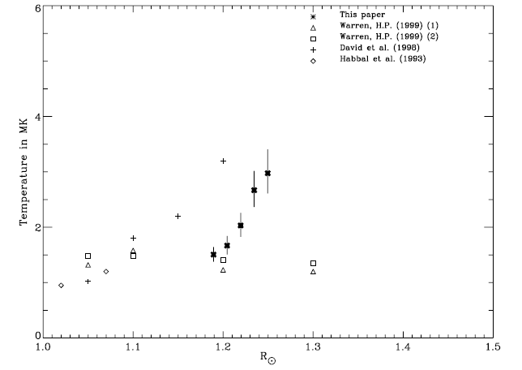
West Limb Temperature
(2006 Eclipse)

Slide 16
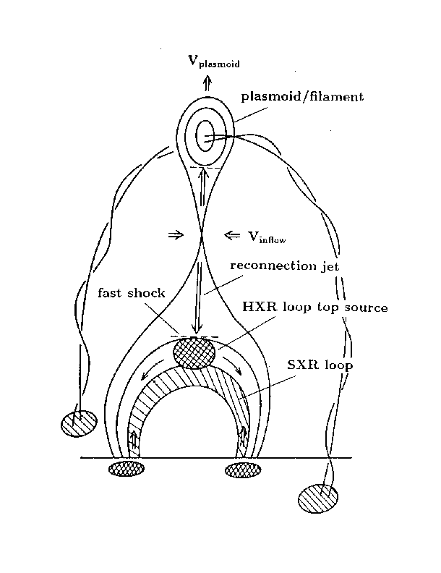
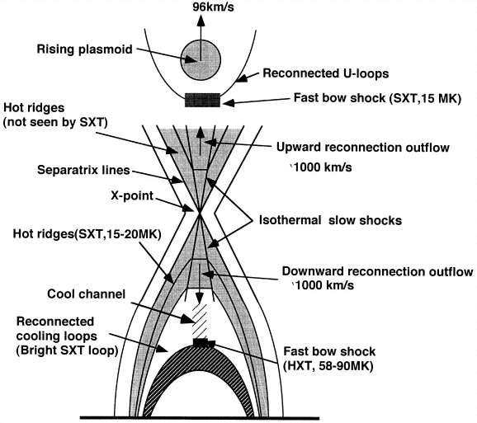
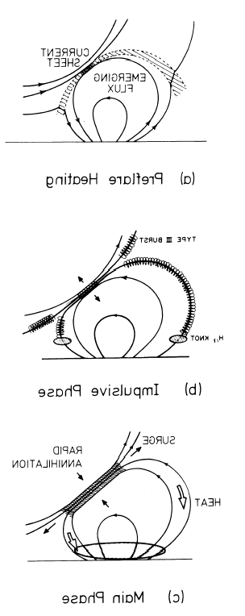
Reconnection Jets

Slide 17
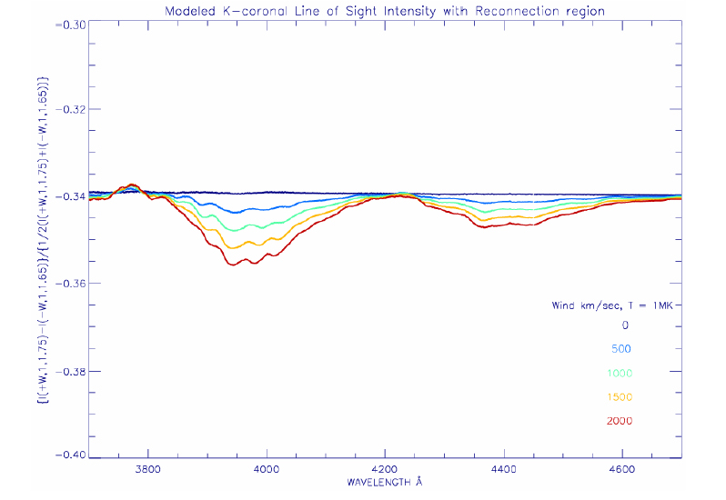
Observing Reconnection
Sun
Line of Sight 1
Line of Sight 2
Few percent difference
Flux Ratio
Wavelength

Slide 18
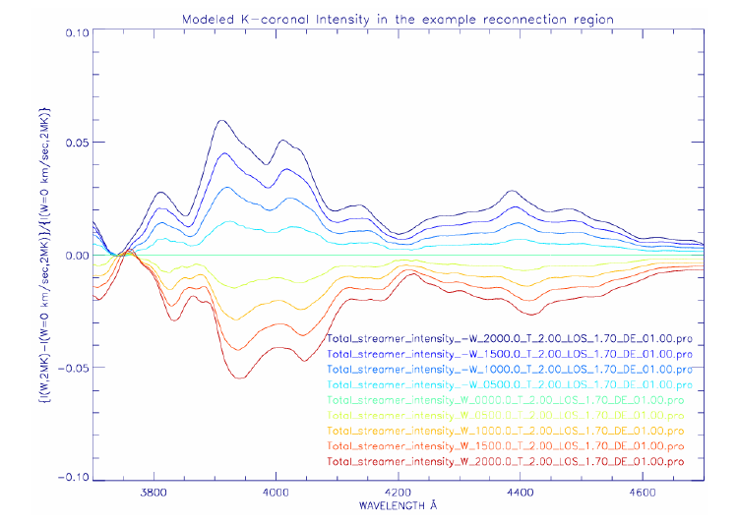
Reconnection Jets

