Slide 1
Gamma-ray imager/polarimeter concept based on GRIPS
Albert Y. Shih (NASA/GSFC)
on behalf of the GRIPS team

Slide 2
Measurements and science objectives
Angular resolution of ~5 arcsec up to 2.2 MeV
Spatial separation between ion-associated and electron-associated emission
Clean point-response function
Source sizes and shapes
Multiple sources needing high dynamic range
Minimum detectable polarization of ~1% in a large flare, also imaging polarimetry
Pitch-angle distribution of relativistic electrons
Albedo
Spectral resolution of <~0.5% FWHM
Accelerated abundances and ion angular distributions
Atmospheric conditions from 511 keV line

Slide 3
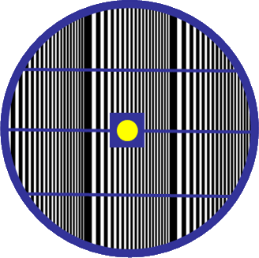
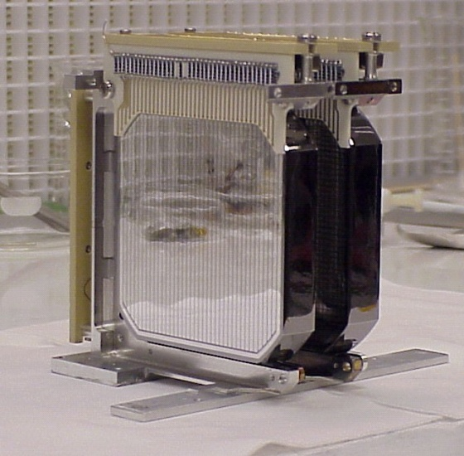
Instrument technologies
3D position-sensitive germanium detectors (3D-GeDs) developed by LBNL
Locate to within <0.1 mm³
Compton-scatter track reconstruction
Multi-pitch rotating modulator (MPRM)
2-cm thick tungsten
Functions like RMC or coded-mask imaging
Photo of two NCT detectors
(7.5 cm × 7.5 cm × 1.5 cm)
Illustration of the MPRM

Slide 4
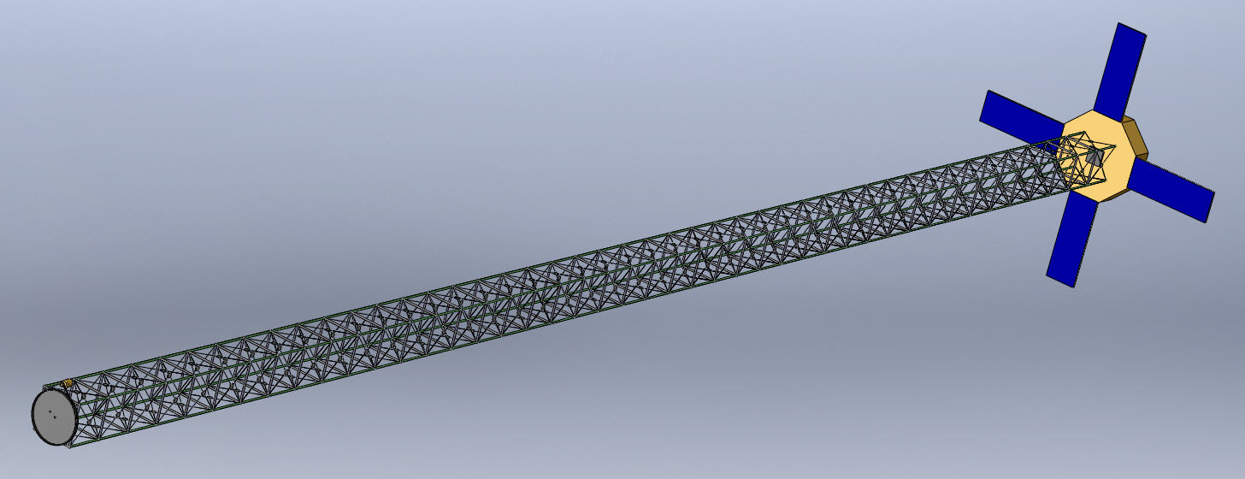
Instrument concept
Compact arrangement of 3D-GeDs in one or more cryostats
16 in a 2×2×4 configuration (same as GRIPS balloon instrument)
64 in a 4×4×4 configuration
Regular annealing to preserve resolution and line shape?
Individual photon tagging, >5 GB/day
Scintillator-based anti-coincidence shield
In addition to background rejection via Compton imaging
20-meter boom with loose requirements on pointing/stability
Or formation flying?
Illustration of a 20-meter boom

Slide 5
Instrument capabilities
5” minimum angular resolution (compared to 35” with RHESSI)
Point-response function virtually free of sidelobes
~1% minimum detectable polarization at 150–650 keV
3 keV to >~10 MeV, resolution of 1.8 keV at 662 keV
Simultaneous imaging, polarimetry, and spectroscopy
Energy (MeV) | Effective area, spectroscopy (cm²) |  | Effective area, imaging (cm²)
 | GRIPS | RHESSI | GRIPS | RHESSI
0.511 | ~150 | 39 | ~96 | 6.0
2.223 | ~52 | 22 | ~25 | 3.3
4.4 | ~27 | 11 | ~5 | 1.7
4×4×4 configuration

